Slide 1
Art and Design
European Art
Year One
Art | LKS2 | European Art | Painting on the Ceiling | Lesson 2

Slide 3
Aim
I can paint like a famous artist.
I can tell you about the artist Michelangelo.
Success Criteria
I can paint upside down like Michelangelo did.
I can comment on the experience of painting upside down.
I can tell you the names of at least two of Michelangelo’s artworks.
I can tell you two interesting facts about Michelangelo’s life.
I can share something interesting about his work.

Slide 4
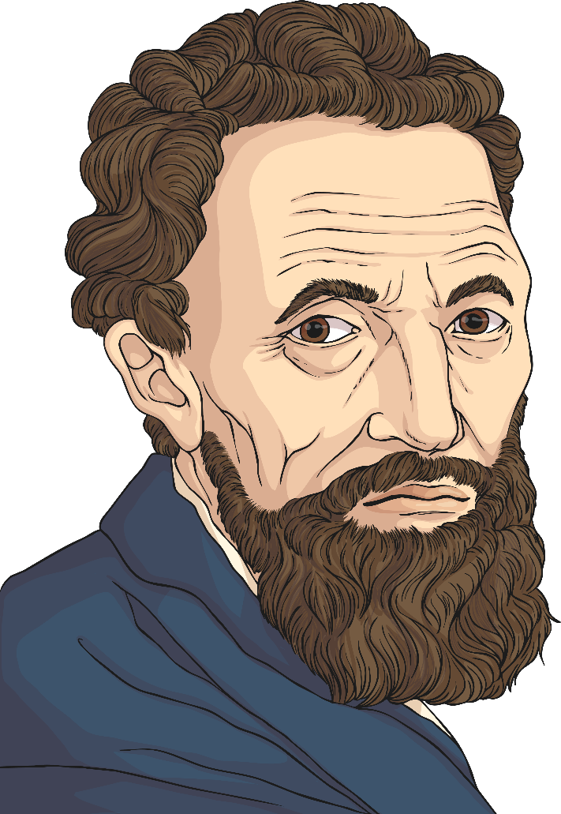
Michelangelo

Slide 5
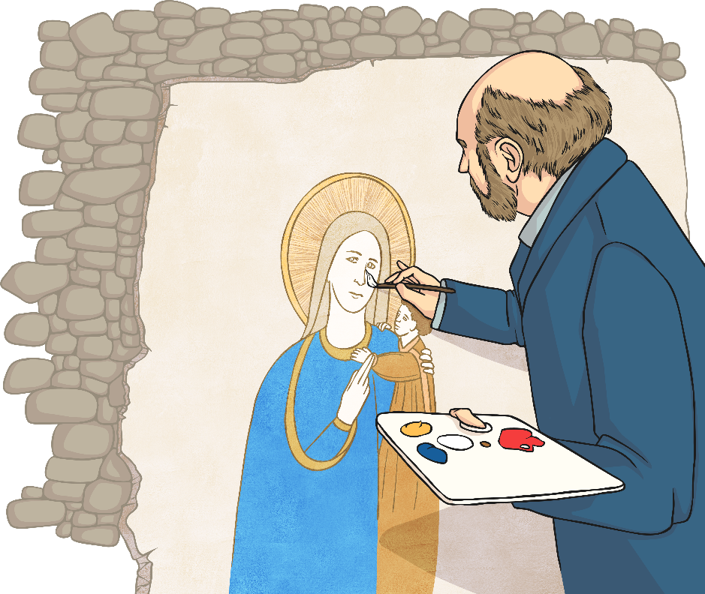
Michelangelo (1475-1564) Italian
Michelangelo is considered to be the greatest artist of all time. He was a sculptor, painter, architect, poet and engineer. He is most famous for his sculptures ‘David’ and ‘Pieta’, but also his paintings on the Sistine Chapel in Italy. His Sistine Chapel paintings took him four years to complete, painting them upside down whilst on scaffolding.
Michelangelo never married or had a family. He spent a lot of his time alone and seemed to prefer being alone more and more as he got older. For his paintings, Michelangelo had assistants who would grind up different colours and heat them. He then mixed the dusty colours with water and used a paintbrush to apply the mixtures to fresh plaster. The painting needed to be done quickly because plaster would dry very easily (these were called ‘fresco’, meaning ‘fresh’ paintings).
Michelangelo is so famous because of the detail he showed in sculptures and paintings of the human body. He understood the body so well because he had been allowed to study dead bodies at the hospital in Florence, where he lived.

Slide 6
Looking at Art
Look at your image.
How many different colours can you see?
Which is the best way to describe the colours you can see – warm, cool, dull, bright, light or dark?
What is happening in the artwork?
What can you tell about the people in the artwork?
What evidence can you see in your image that proves Michelangelo was a great artist?
Which of the artworks from today would you like in your home? Why?

Slide 7
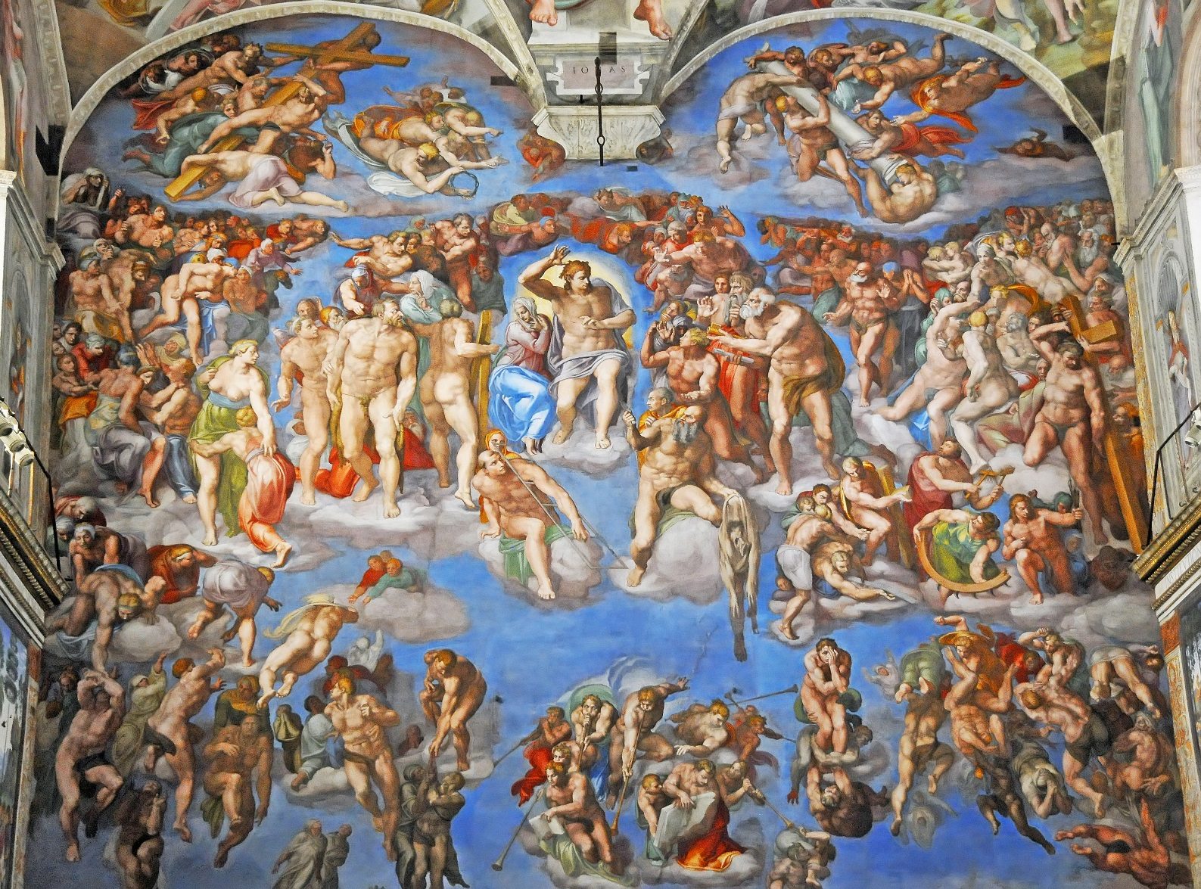
The Last Judgement, Sistine Chapel by Michelangelo
Photo courtesy of archer 10 (@flickr.com) - granted under creative commons licence - attribution

Slide 8
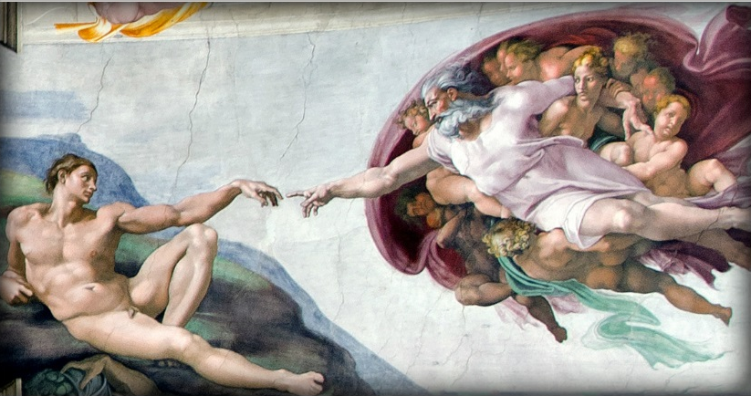
Creation of Adam, Sistine Chapel by Michelangelo
Photo courtesy of stevecorey (@flickr.com) - granted under creative commons licence - attribution

Slide 9
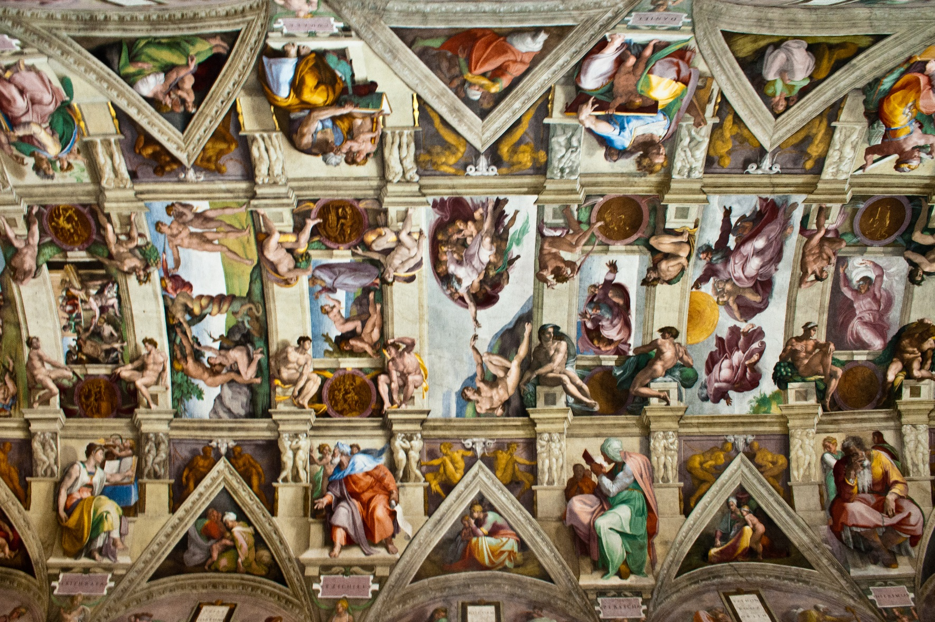
Sistine Chapel Ceiling by Michelangelo
Photo courtesy of daverugby83 (@flickr.com) - granted under creative commons licence - attribution

Slide 10
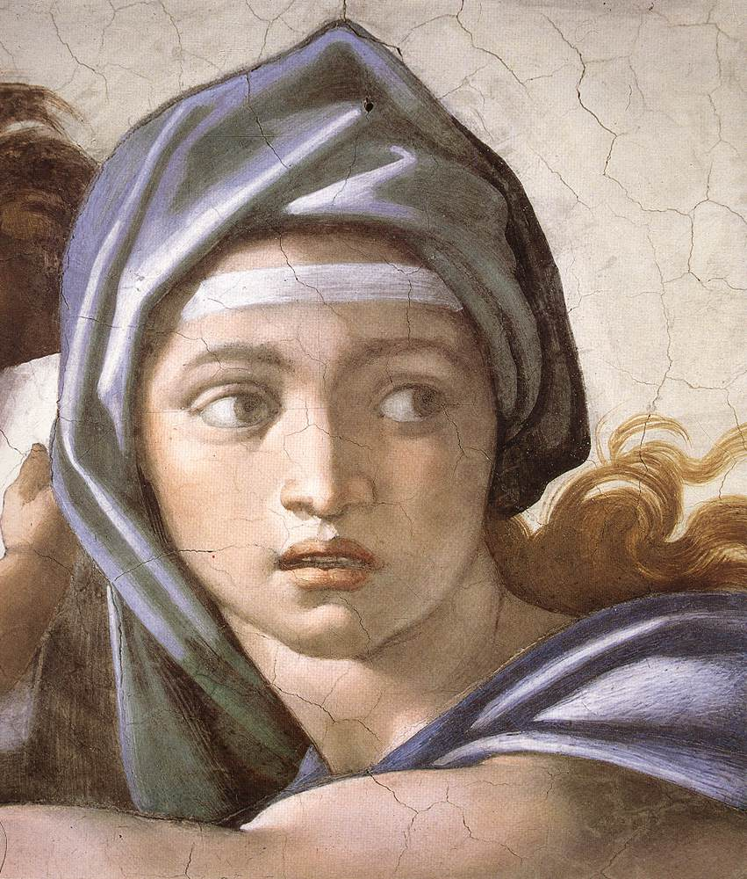
Sistine Chapel Detail by Michelangelo
Photo courtesy of freeparking-imago (@flickr.com) - granted under creative commons licence - attribution

Slide 11
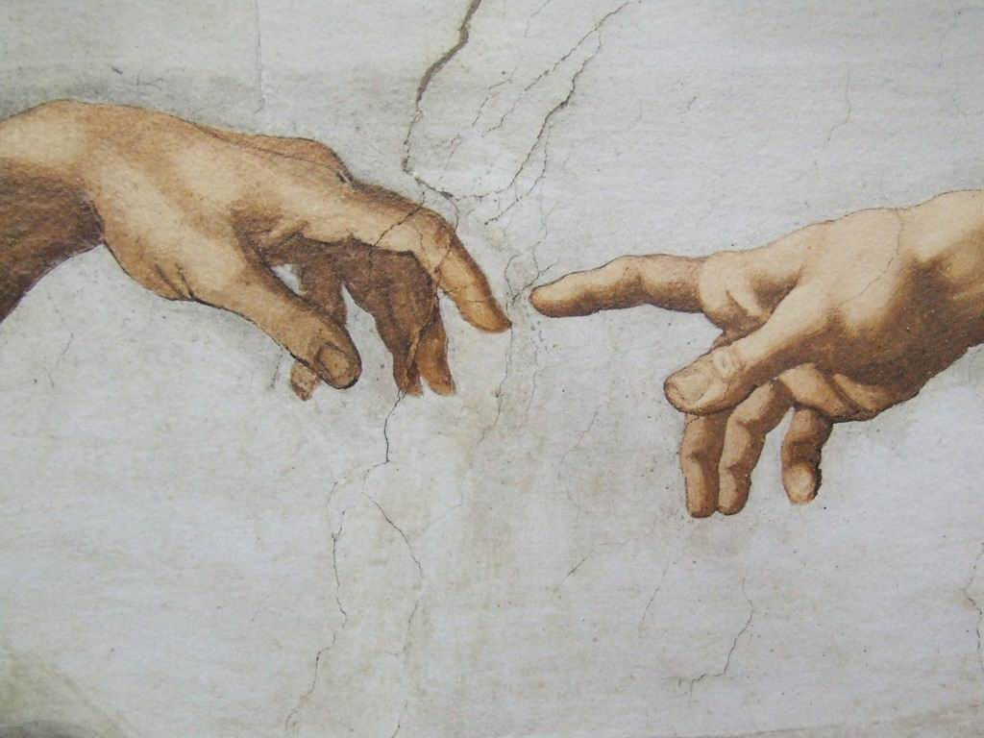
Creation of Adam Detail, Sistine Chapel by Michelangelo
Photo courtesy of gnuckx (@flickr.com) - granted under creative commons licence - attribution

Slide 12
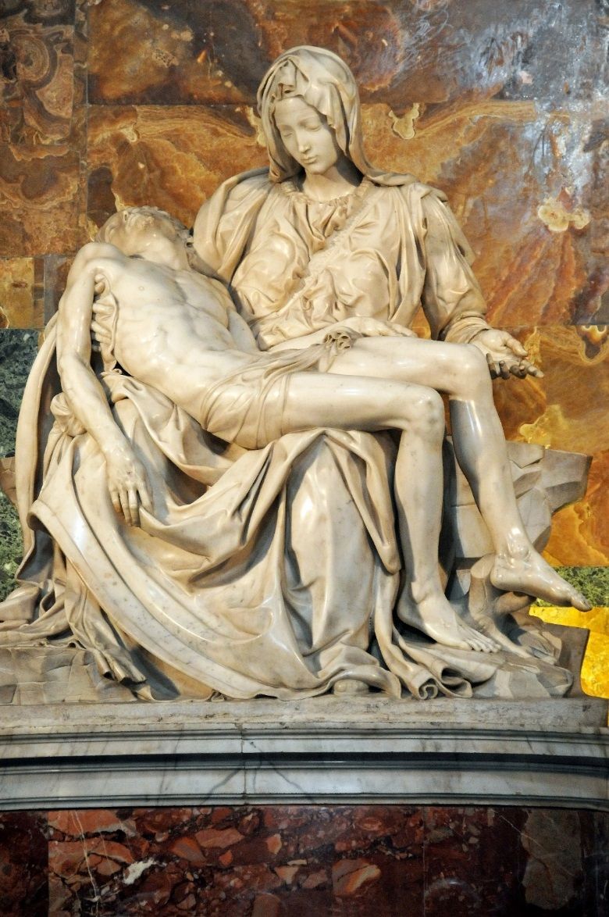
The Pieta by Michelangelo
Photo courtesy of archer10 (@flickr.com) - granted under creative commons licence - attribution

Slide 13
Pieta
More about the sculpture…
These figures are Jesus Christ and his mother, Mary. You can see this today in St. Peter’s Basilica in Vatican City in Rome, Italy. Michelangelo sculpted this when he was only 24 years old. Wow!
Photo courtesy of archer10 (@flickr.com) - granted under creative commons licence - attribution

Slide 14
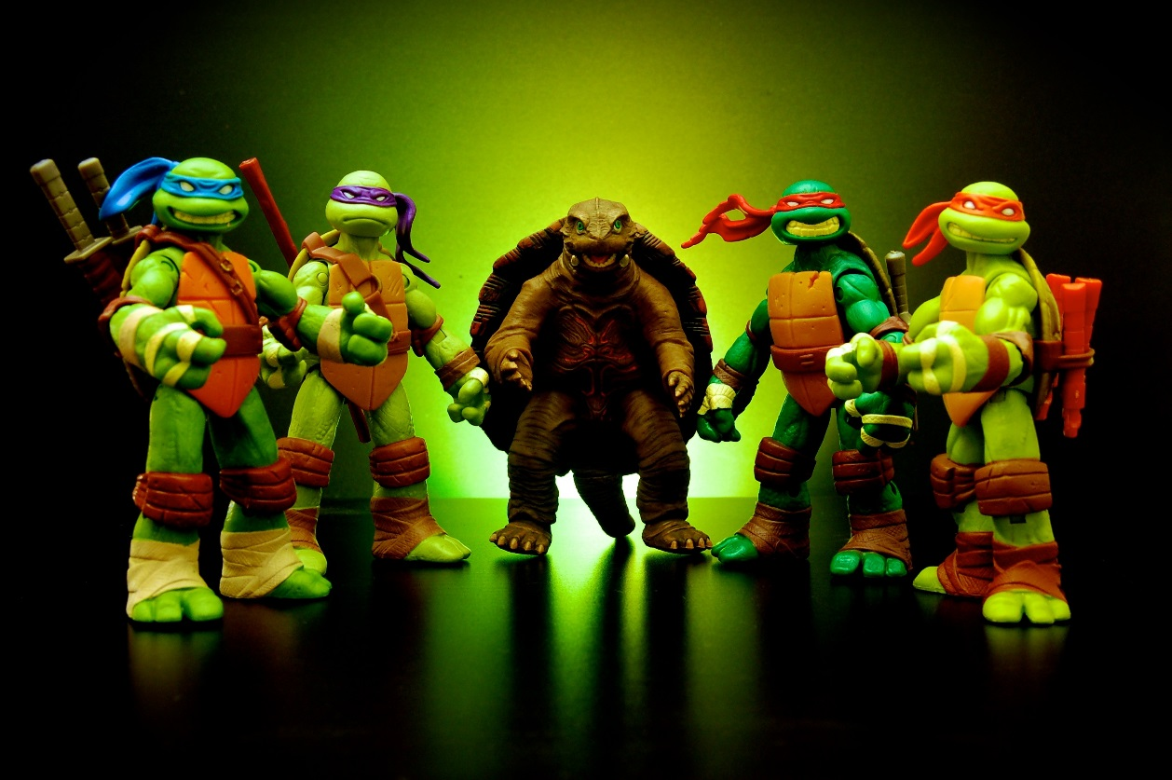
What Another Michelangelo Looks Like
These turtles are all named after famous artists. Can you name them?
Photo courtesy of jdhancock (@flickr.com) - granted under creative commons licence - attribution

Slide 15
Michelangelo’s Sistine Chapel
More about the painting…
This is one of the many scenes on the Sistine Chapel. The ceiling of the Sistine Chapel took about 4 years to complete. The paintings stretch over 500 square metres of ceiling, and contain over 300 people. This part of the ceiling shows Adam and God just about to touch hands. This is the most important part of the painting.
God’s hand is shown as strong and stretched whilst Adam’s hand is weak. This is the moment when God gives spirit to Adam. Some people think that God has his other arm around Eve, the first woman, and the children that she will have with Adam. Also, some think that the red cloth draped around God is shaped to look like a human brain.
Photo courtesy of stevecorey (@flickr.com) - granted under creative commons licence - attribution

Slide 16
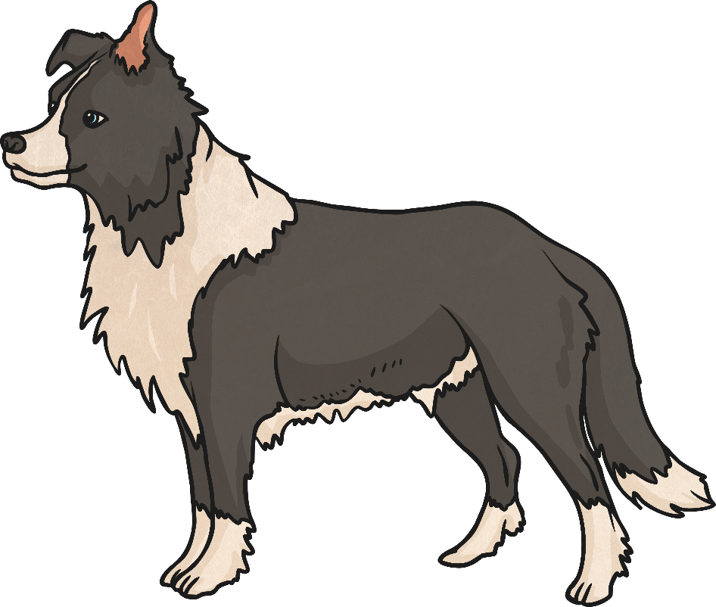
Who Let the Dogs Out?
Michelangelo painted many humans on the Sistine Chapel ceiling, however the one living thing that he did not paint was…
… an animal!
Today you are going to choose any animal to paint.
These can be added to Michelangelo’s famous fresco!
Which animal will you choose?

Slide 17
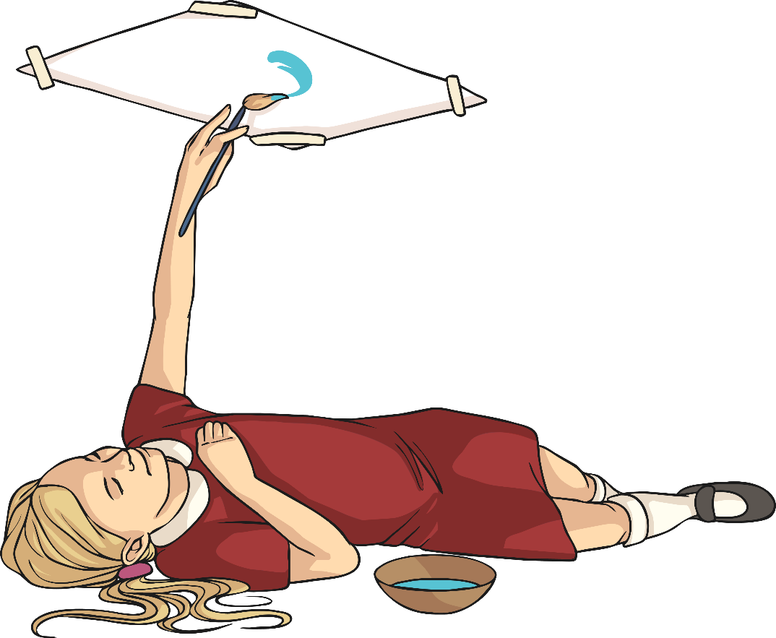
Painting Sistine Style
There’s one last thing to remember just before you get started…
How did Michelangelo paint the Sistine Chapel ceiling?
Upside
Down!
You are going to have to paint your animal whilst underneath the painting surface.
Good luck!

Slide 18
The Life of a Ceiling Fresco Painter
What if…?
…you had never painted upside down?
How would you have thought differently about Michelangelo?
How would you have felt about Michelangelo’s artwork?
…you had never known about Michelangelo being very famous?
What if…?

Slide 19
Aim
I can paint like a famous artist.
I can tell you about the artist Michelangelo.
Success Criteria
I can paint upside down like Michelangelo did.
I can comment on the experience of painting upside down.
I can tell you the names of at least two of Michelangelo’s artworks.
I can tell you two interesting facts about Michelangelo’s life.
I can share something interesting about his work.

