Slide 1
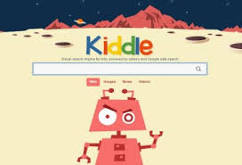
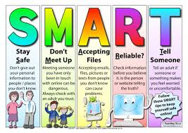
Class Cremyll
Computing
Online Safety

Slide 2
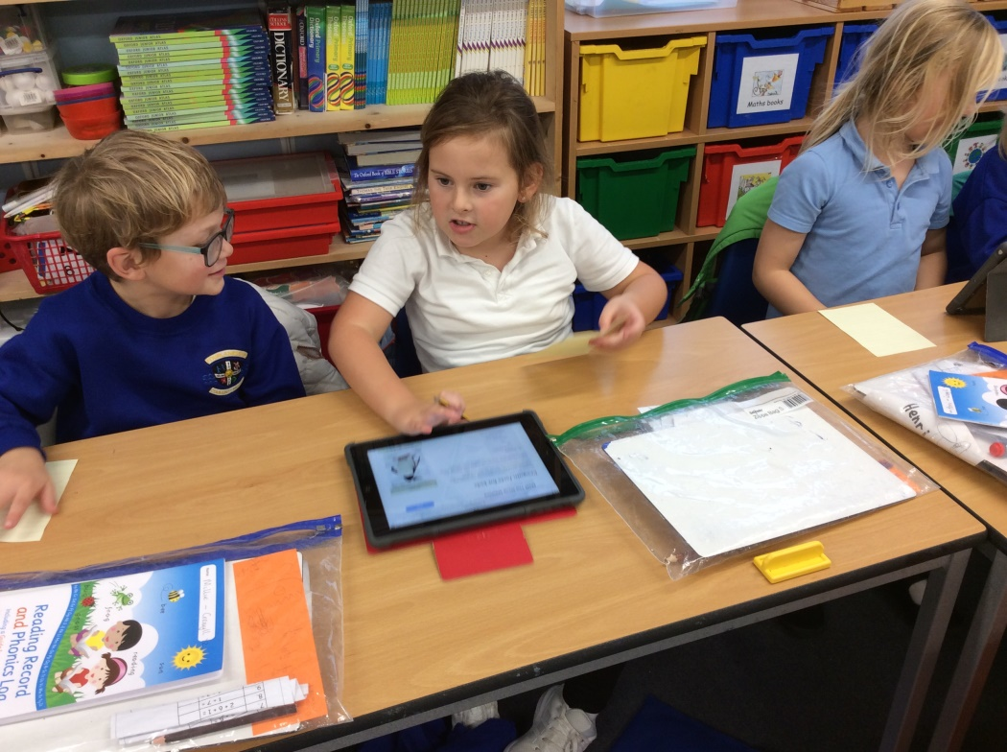
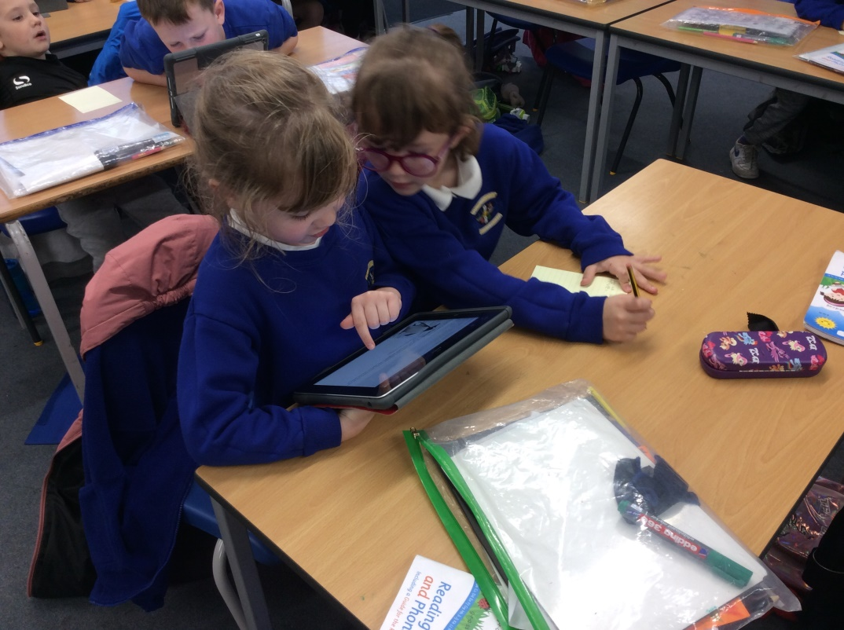
We talked about how to select and use Safe Search filters when we use the internet.
“I enjoyed searching for facts about penguins.”
“I remembered to use the Safe Search.”

Slide 3
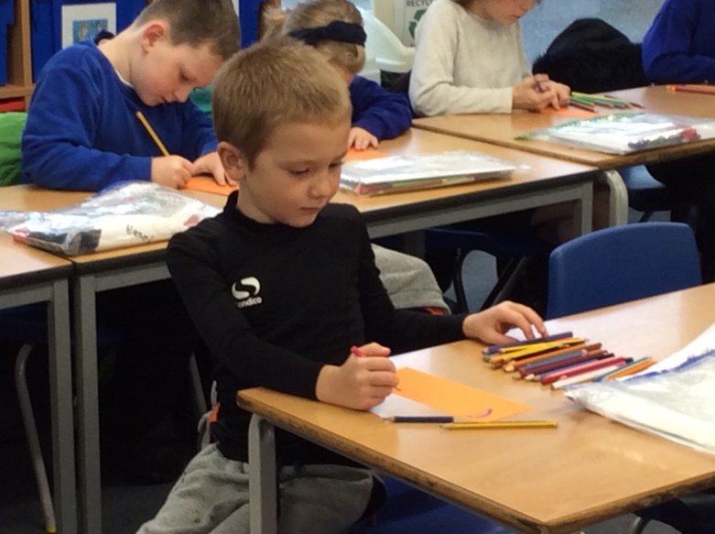
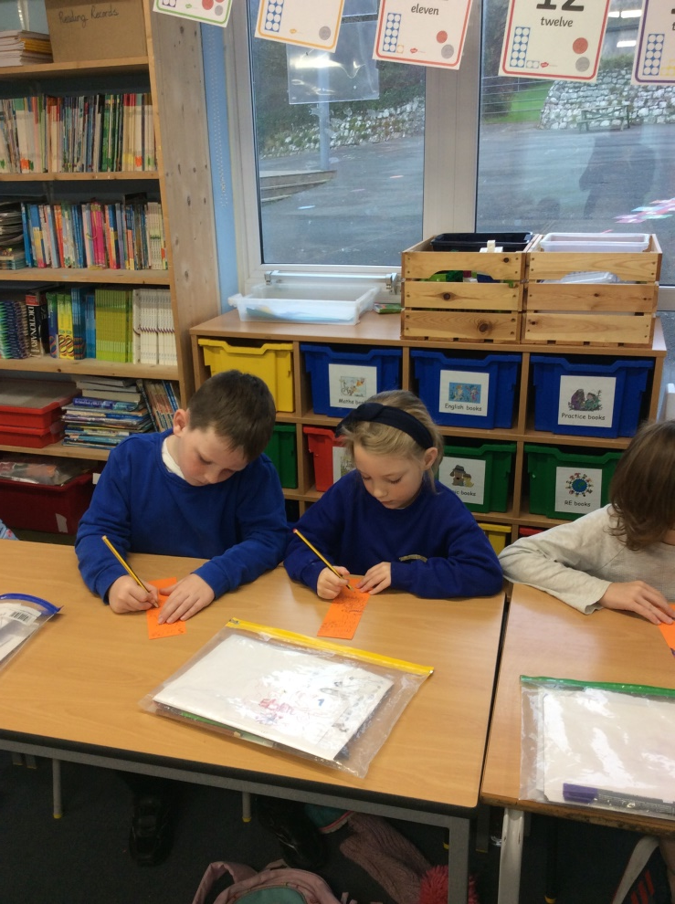
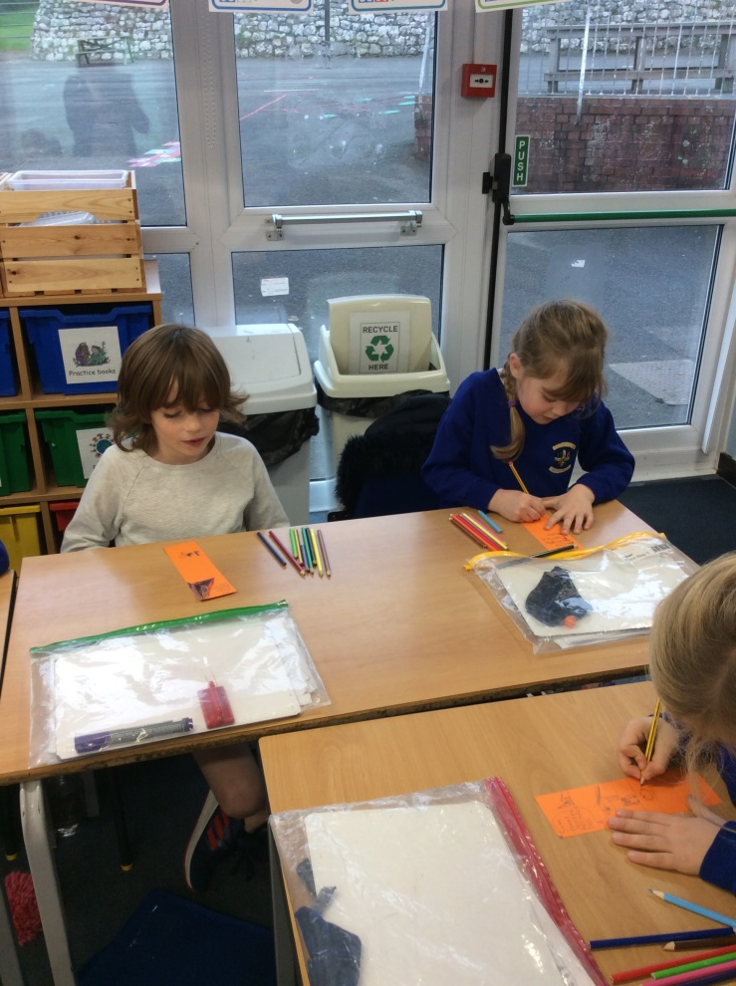
We learnt about staying SMART online and made bookmarks to help us remember.
Safe
Meet
Accept
Reliable
Tell
“SMART means Safe Meet Accept Reliable Tell.”
“You definitely would not meet up with Creepy Croc because he might not be telling the truth.”

Slide 4
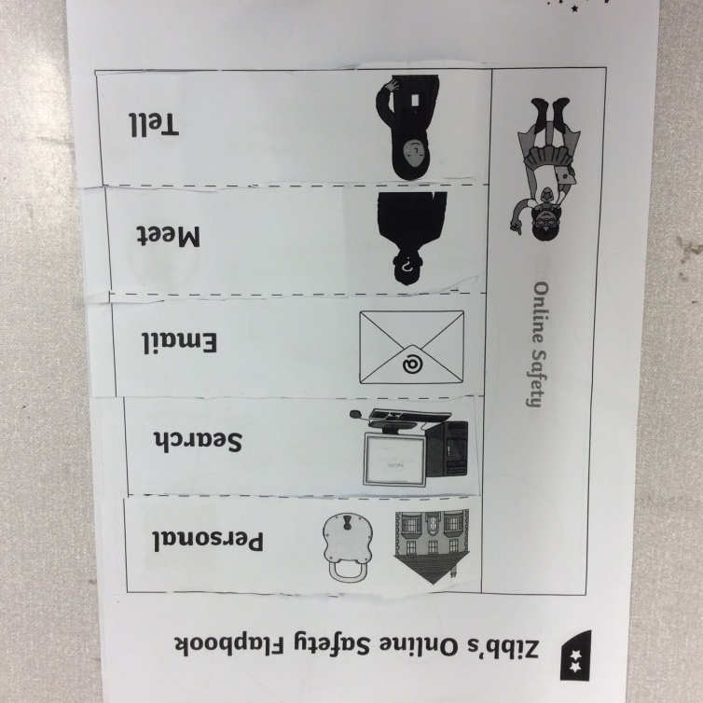
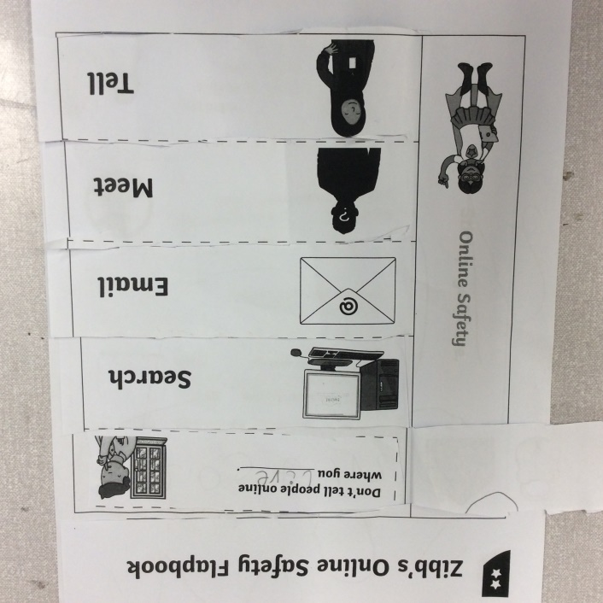
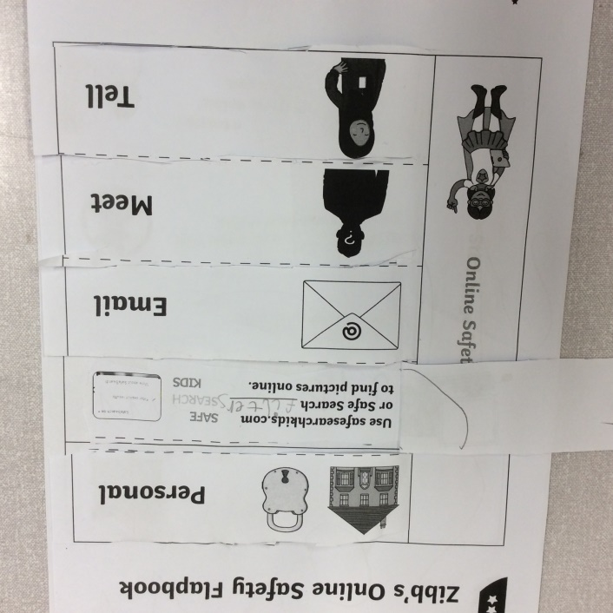
Next, we talked about how to make safe choices online.
“I liked helping Zibb to make safe choices.”
“You don’t tell people where you live.”

Slide 5
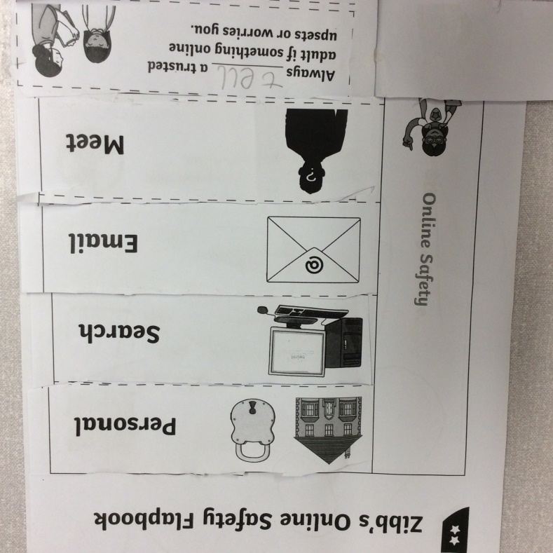
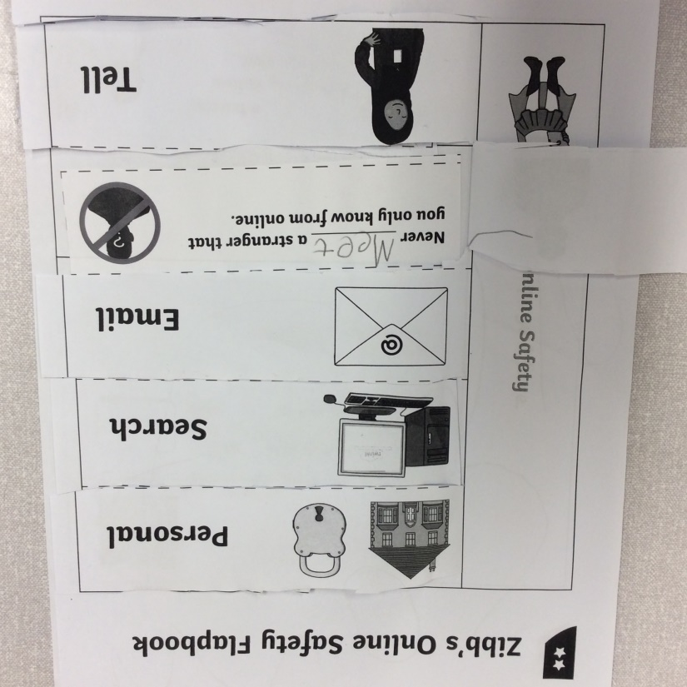
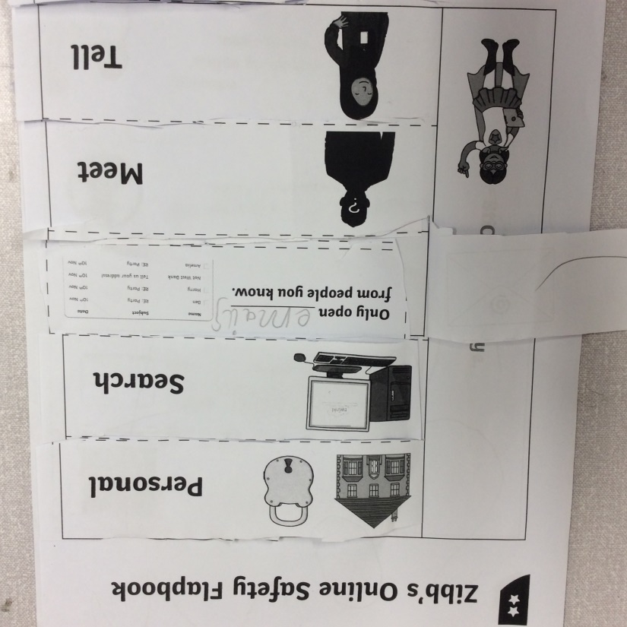
We enjoyed making a flap book to help Zibb the alien know how to make safe choices online.
“You always tell an adult if you are worried about something on the computer.”

