Slide 1
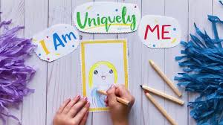
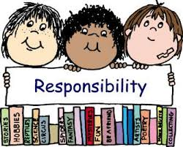
Class Cremyll
Jigsaw
Being me in my world

Slide 2
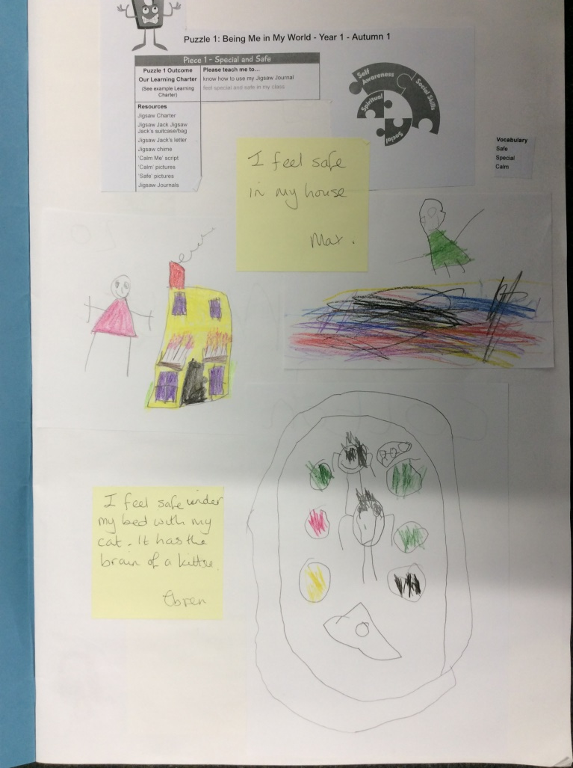
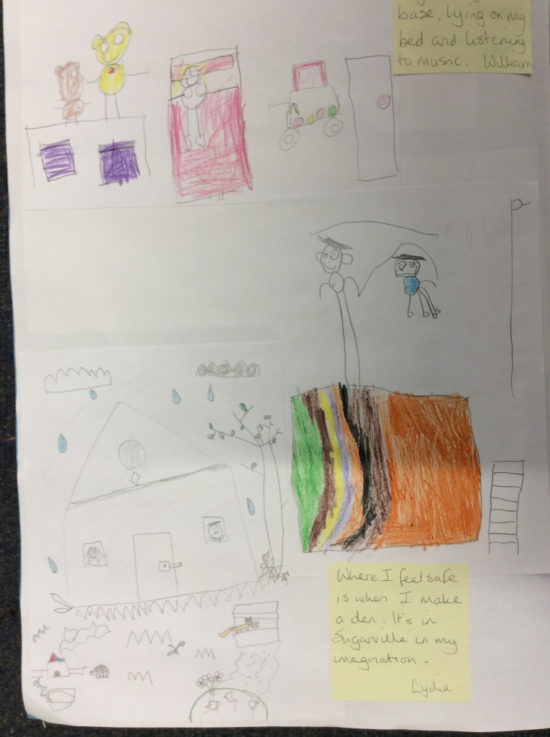
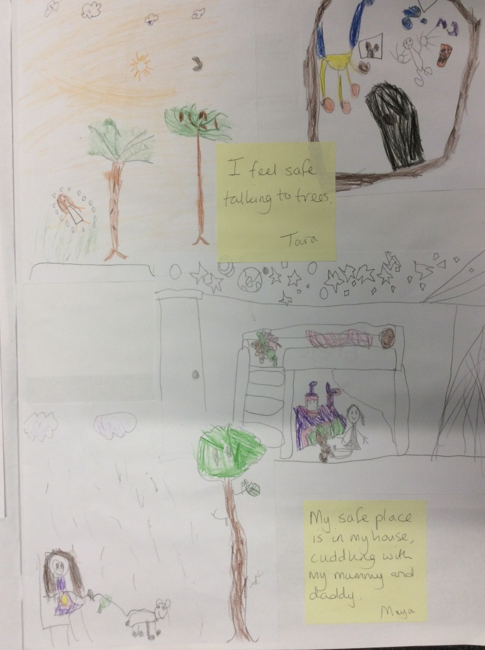
We thought about times and places where we feel special and safe.
“I feel safe when I am in my bedroom.”
“I feel happy when I am in nature.”

Slide 3
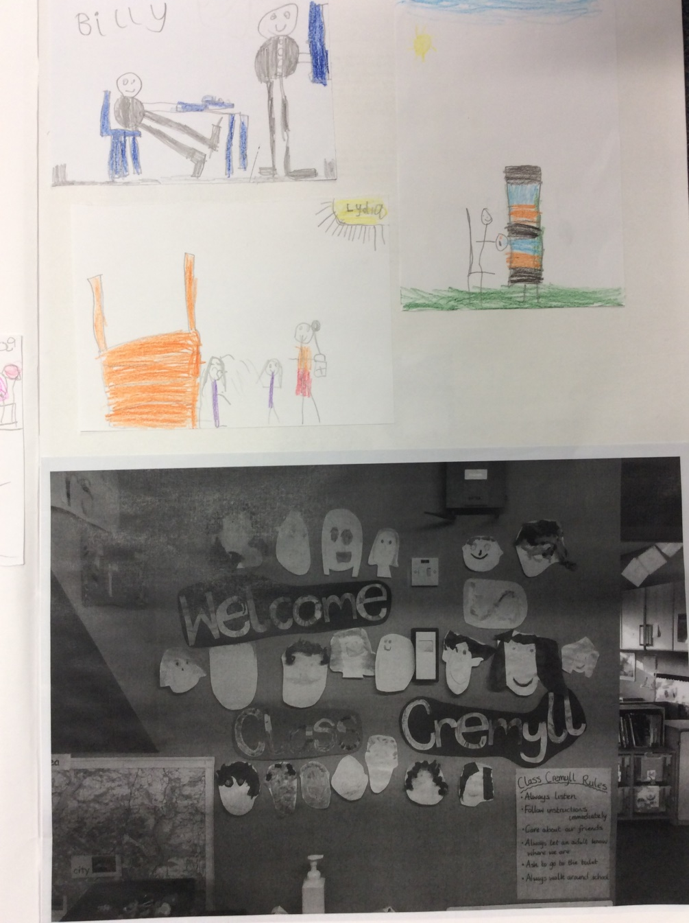
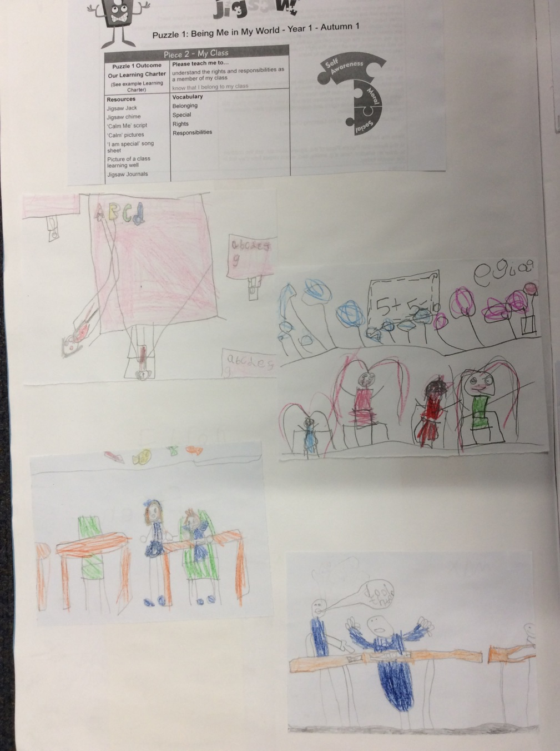
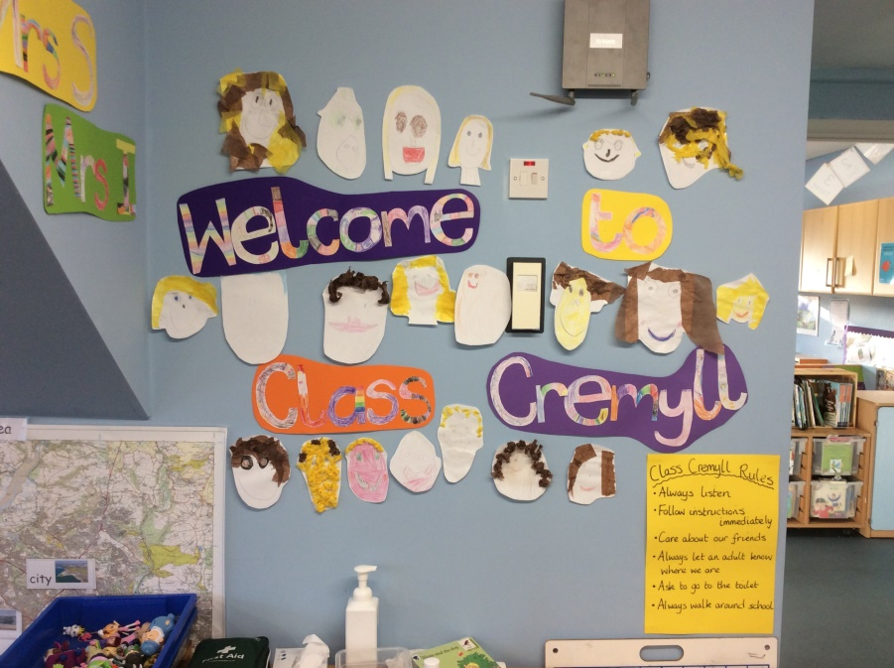
We discussed what it means to be part of Class Cremyll and how we should treat each other.
“We need to use our values.”
“We should look after all our things in the classroom.”

Slide 4
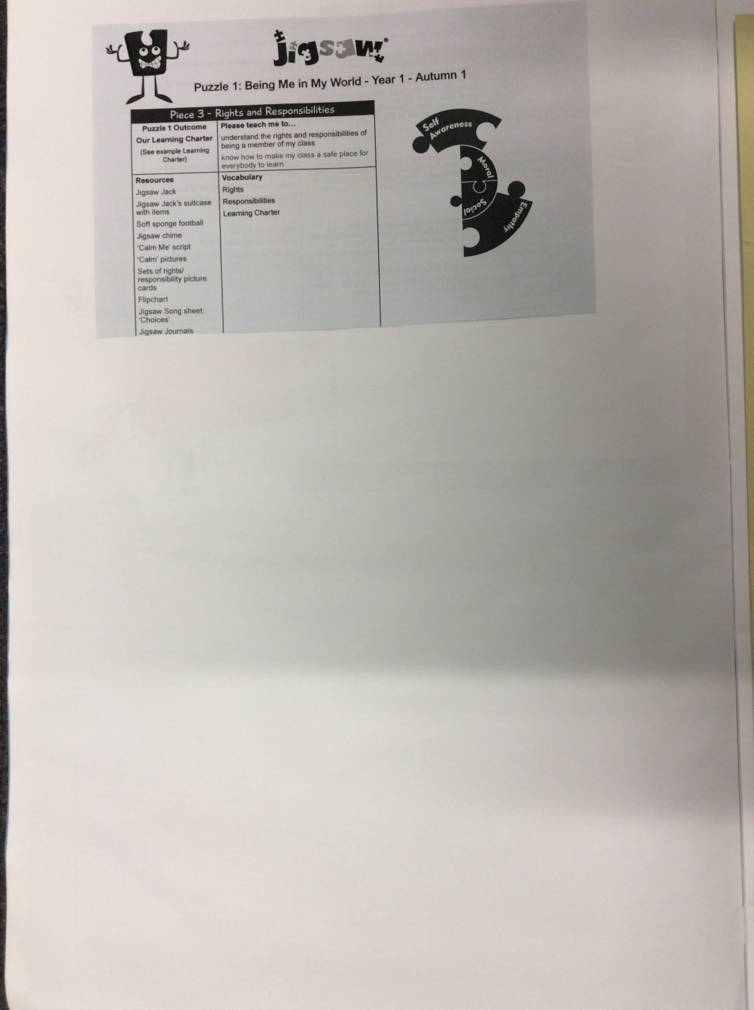
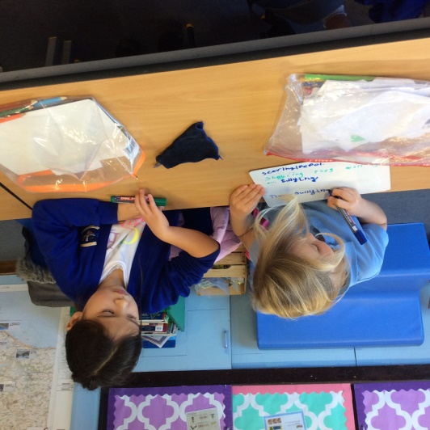
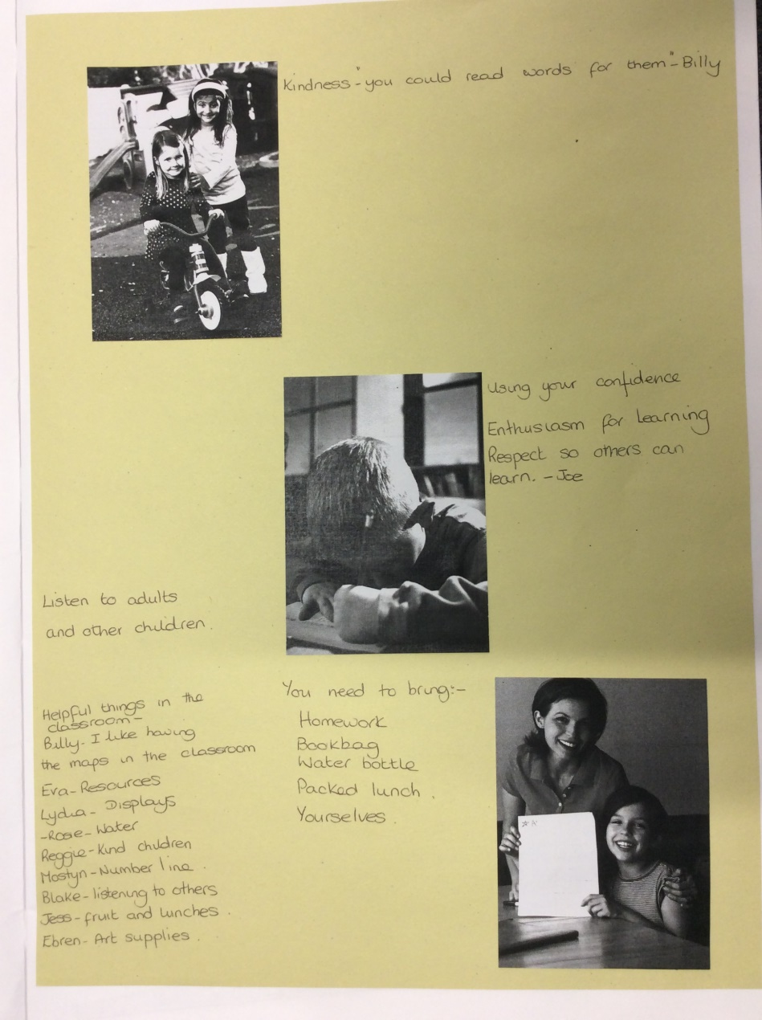
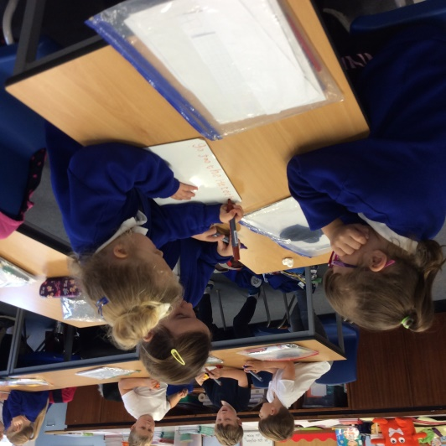
We thought carefully about how to make our classroom a safe place to learn.
“We can help each other if we get stuck.”
“We can use the phonics board to help us when we’re writing.”

Slide 5
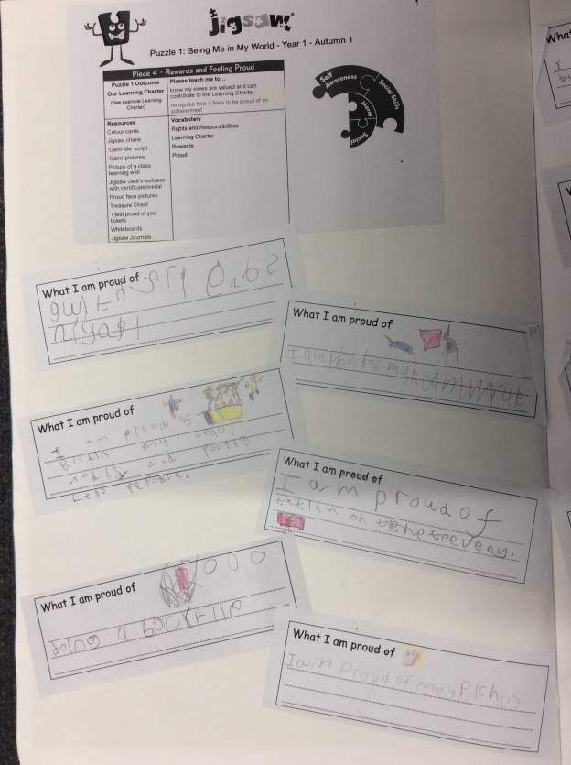
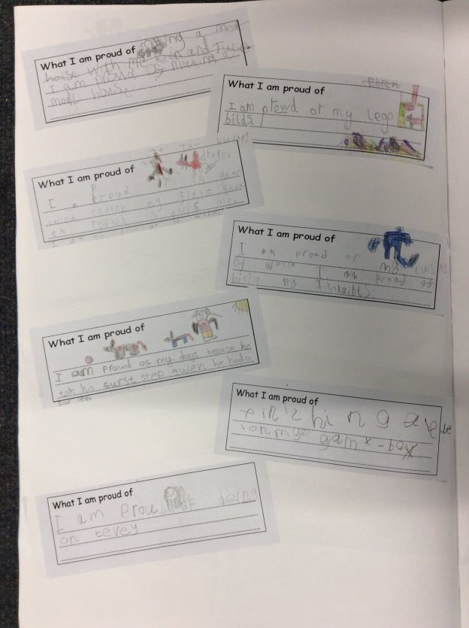
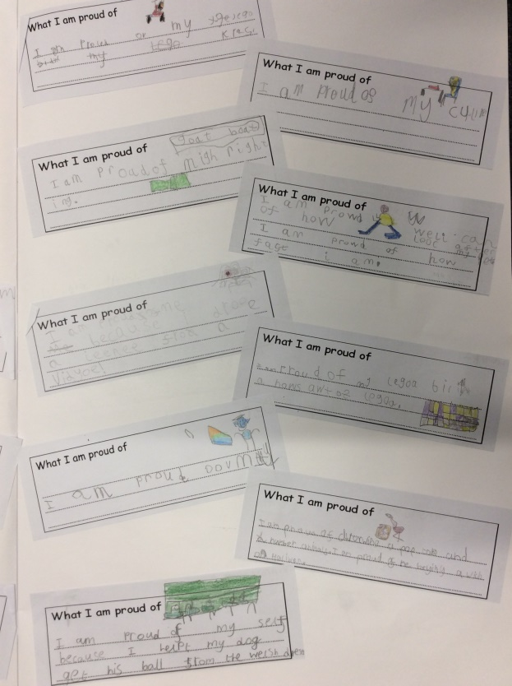
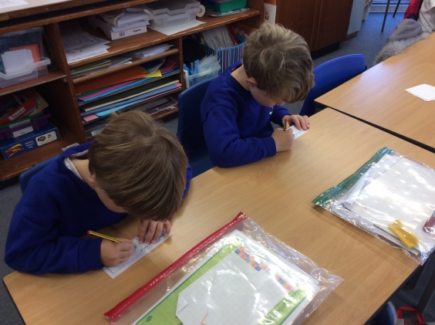
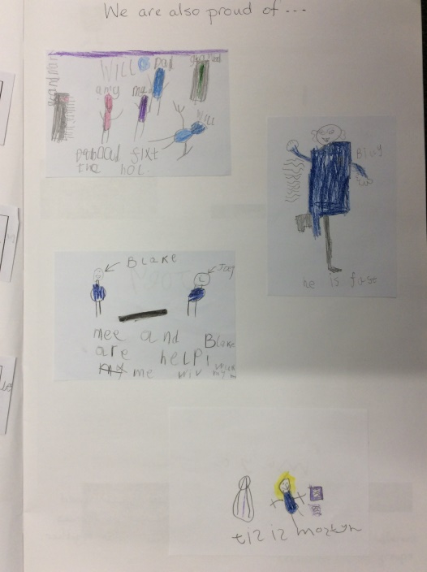
We thought about our achievements and talked about how it felt to be proud of something.
“I am proud of my Lego builds.”
“I am proud of my colouring.”

Slide 6
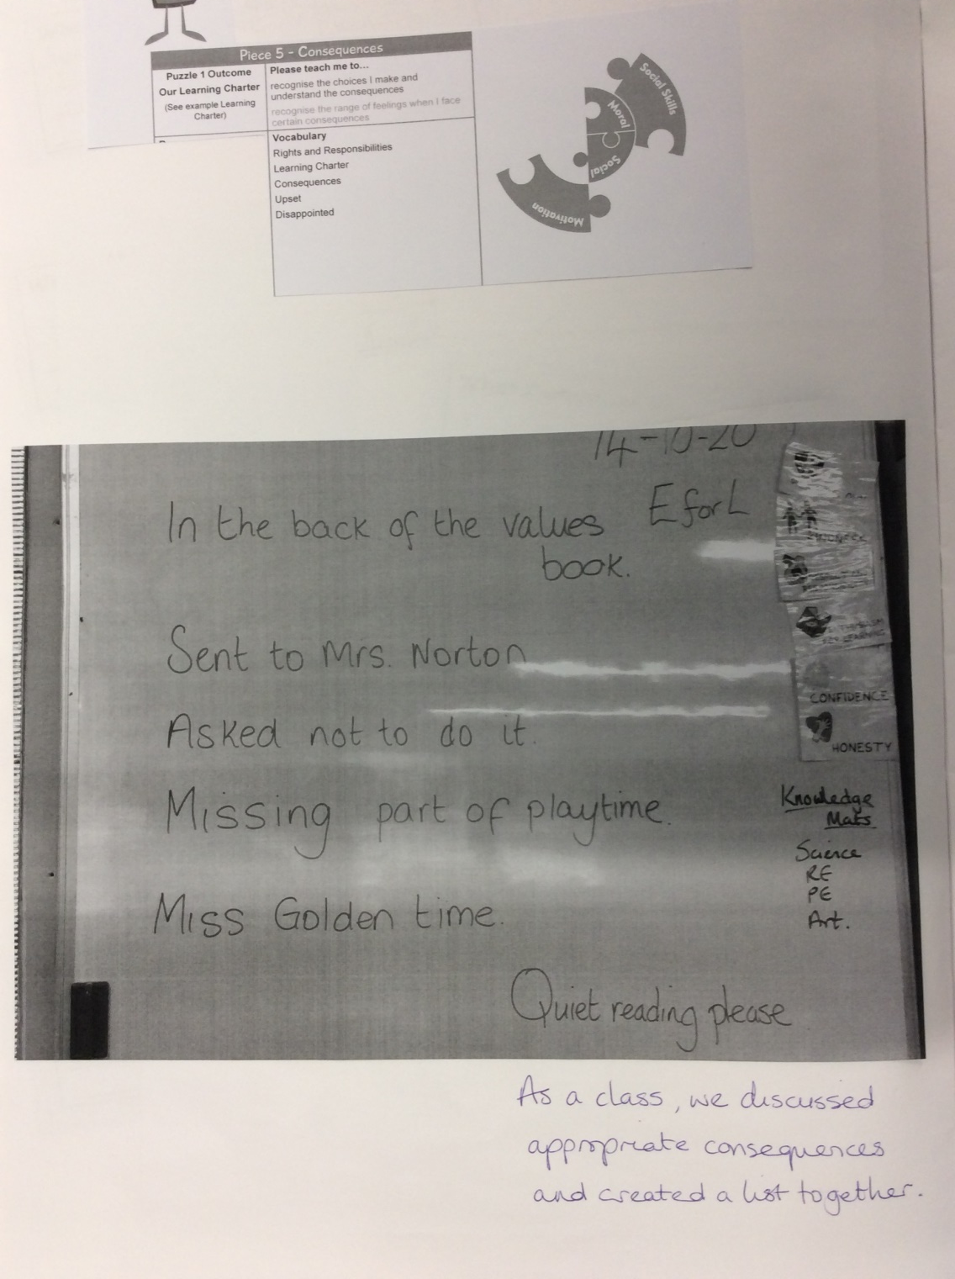
We discussed the choices we make in our learning and in our behaviour. Then we thought about the consequences this might have and the sanctions we might face.
“I
“It’s not nice to lie. We need to use our honesty.”
“We can use our Jigsaw rules so no-one gets upset.”

Slide 7
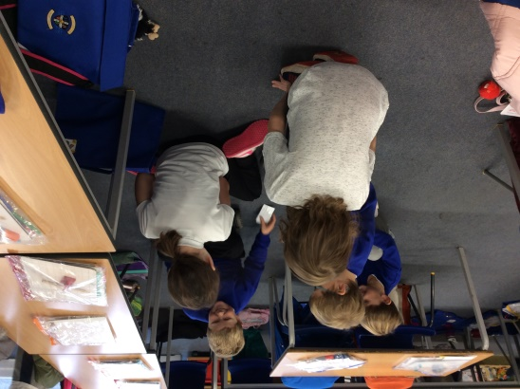
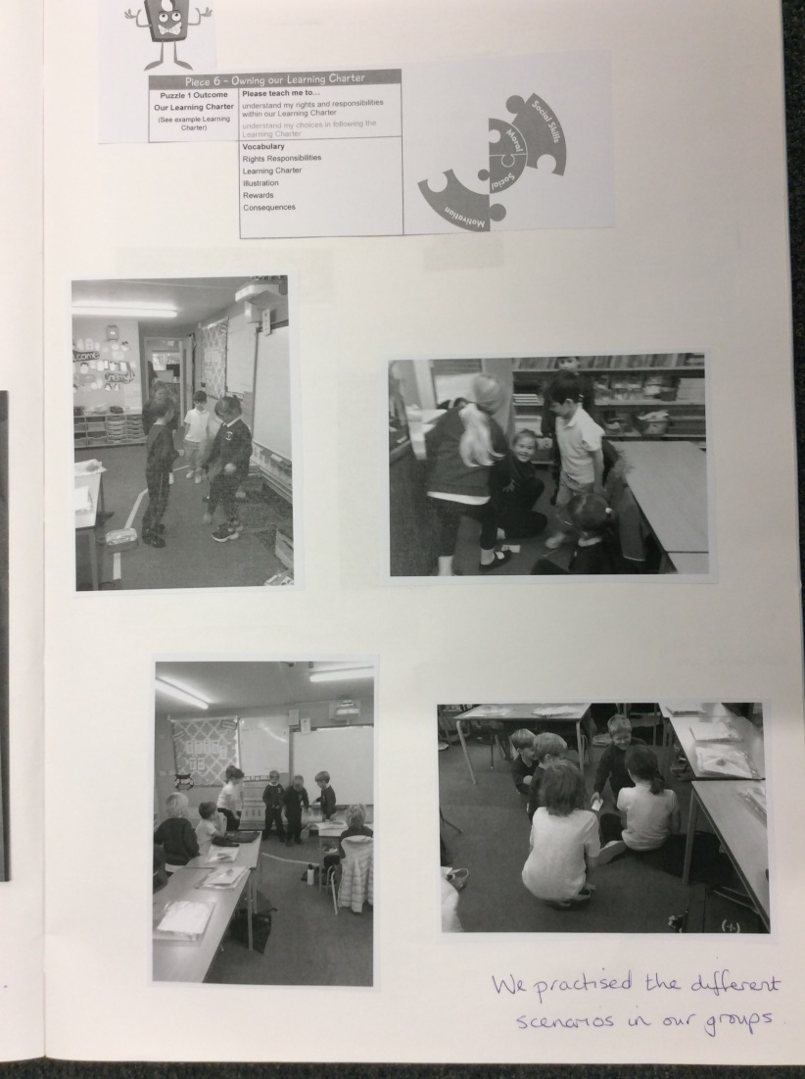
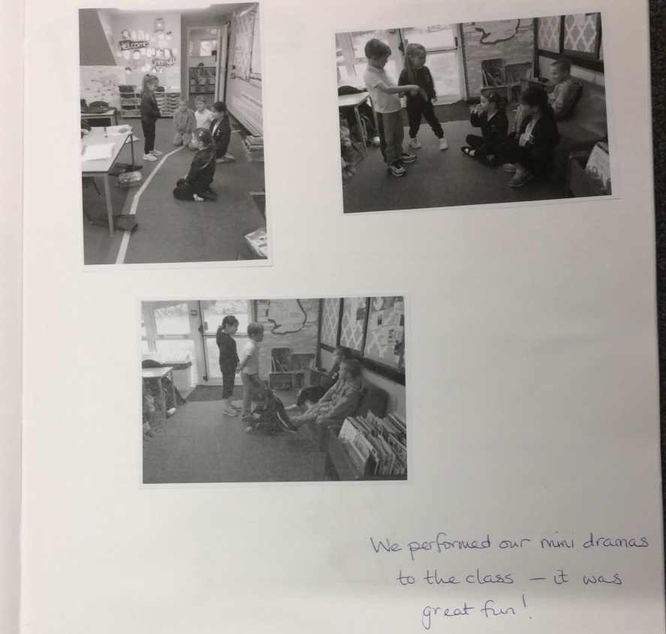
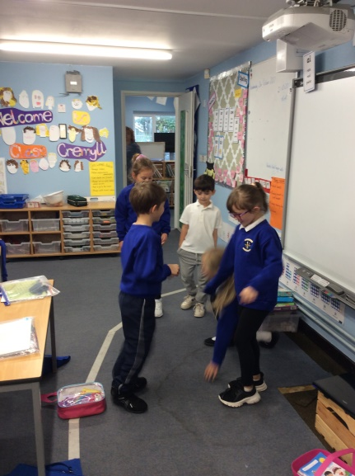
We thought about everything we had learnt - being proud of our achievements, using our values in our learning and that there are consequences to our behaviour. We acted out some mini dramas to help us remember to make good choices.
“I love working with each other because it helps me feel more confident.”

