Slide 1
Science
Class Tamar
Living things and their Habitats

Slide 2
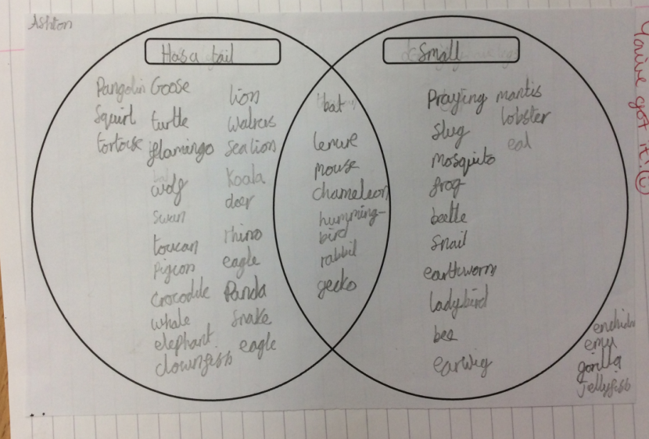
We were introduced to the different life processes and that we can remember these using MRS GREN.
We grouped different living things by using a Venn Diagram.

Slide 3
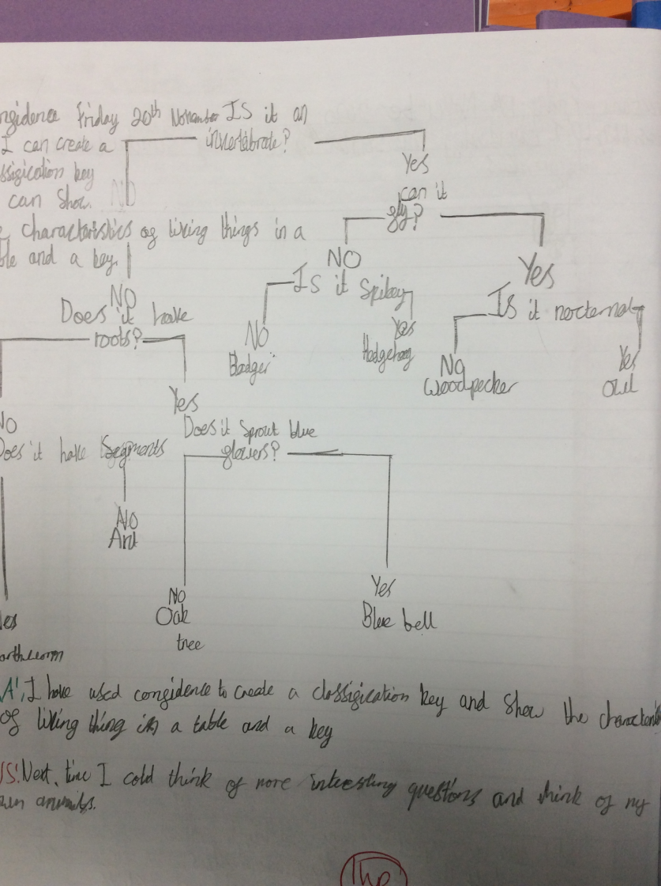
We were introduced to classification keys and sorted living things using our own classification key.

Slide 4
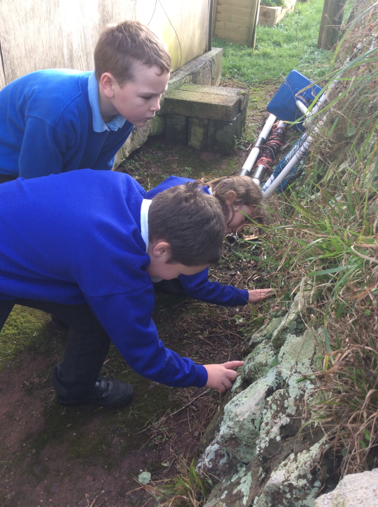
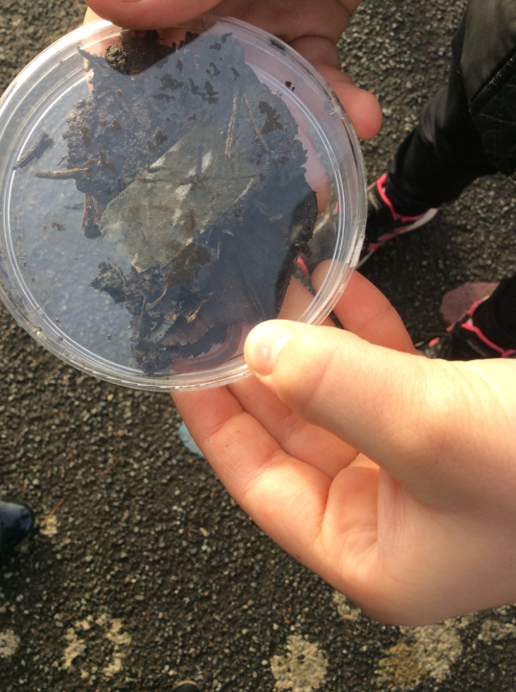
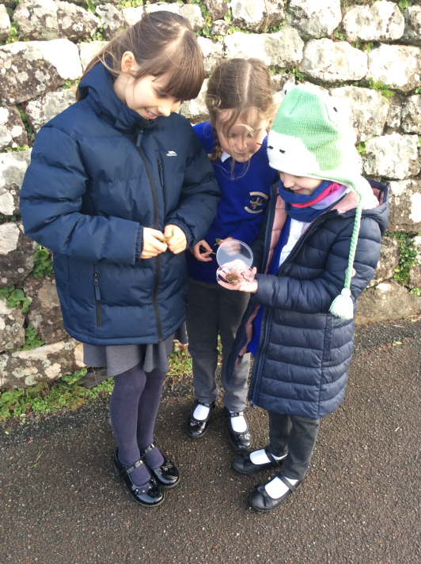
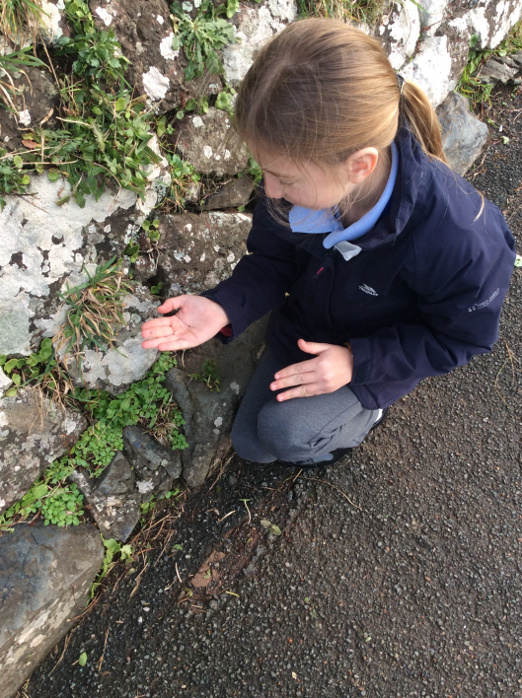
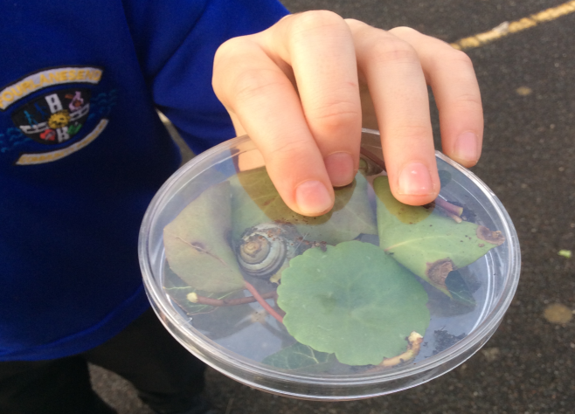
We went on an invertebrate hunt! We carefully took our invertebrates back to the classroom and carefully analysed each one, identifying what type of invertebrate they were.

Slide 5
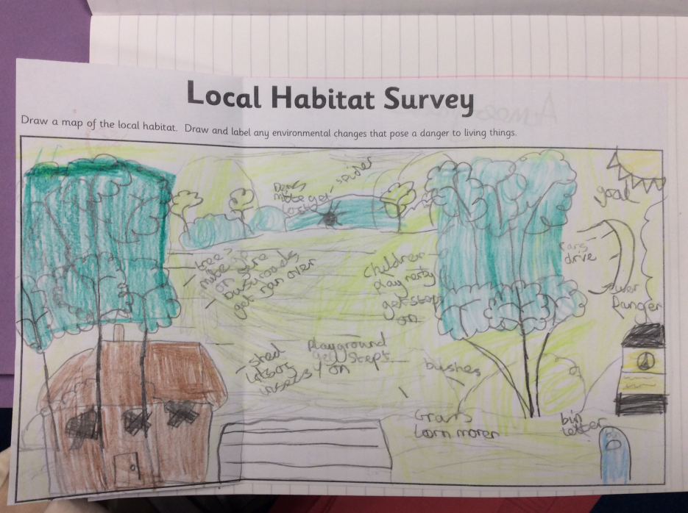
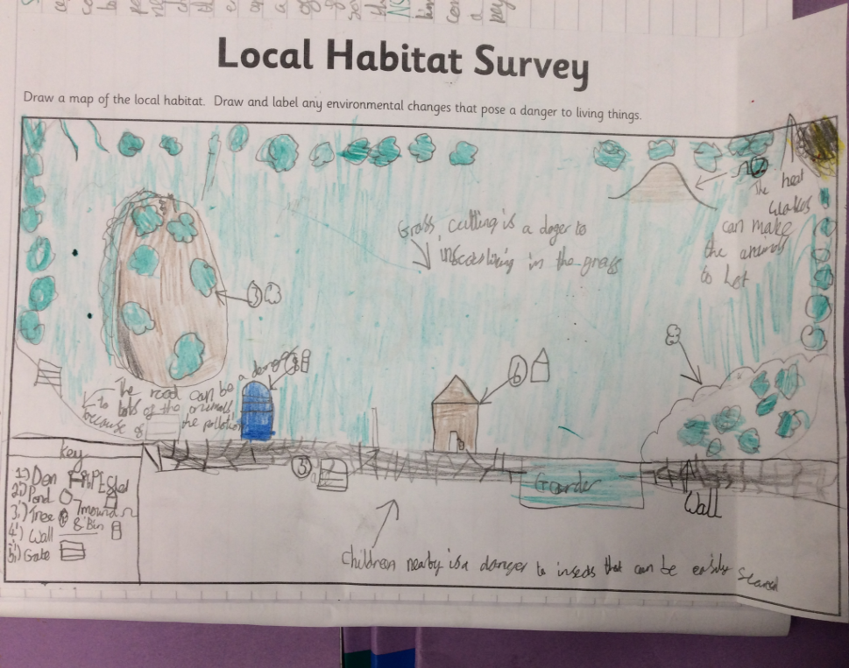
We mapped out the school field and identified various dangers for local habitats.
Cutting the grass could harm the insects that live there.
The busy road is a danger to any animals that might try to cross it.

Slide 6
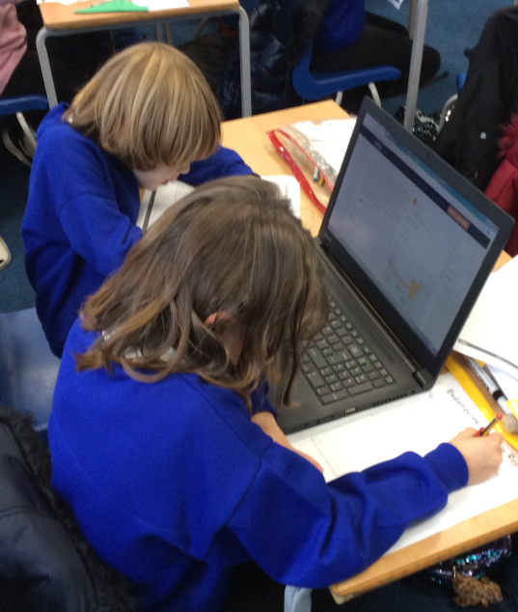
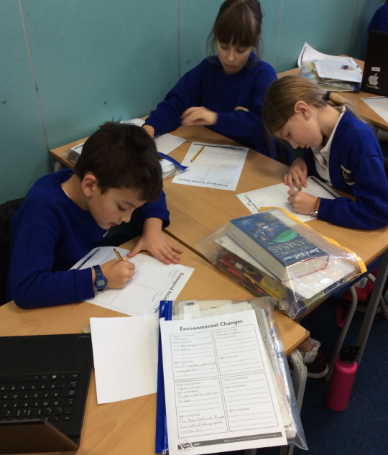
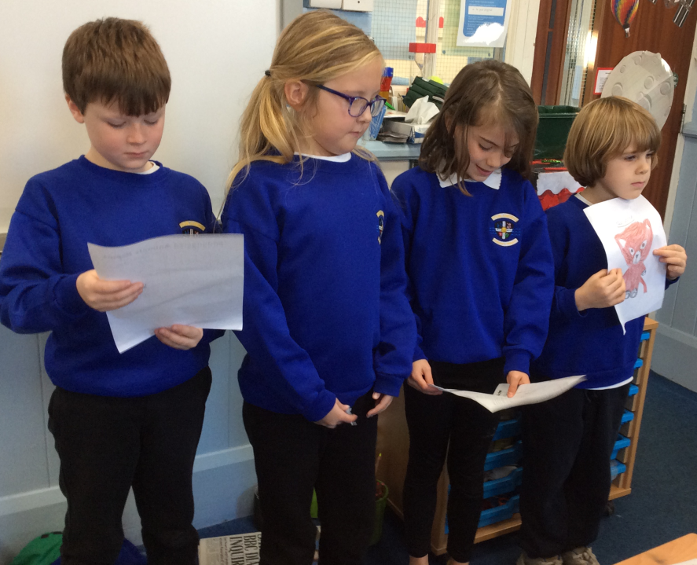
We researched endangered animals and chose one to present information about to the class. We explained why they are endangered and what we can do to help.

