Slide 1
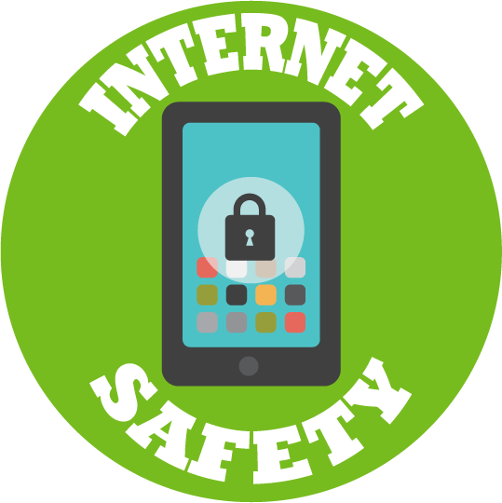
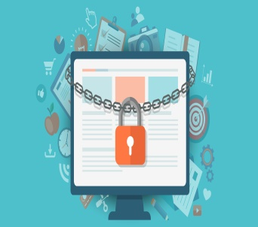
Computing
Class Tamar
Online Safety

Slide 2
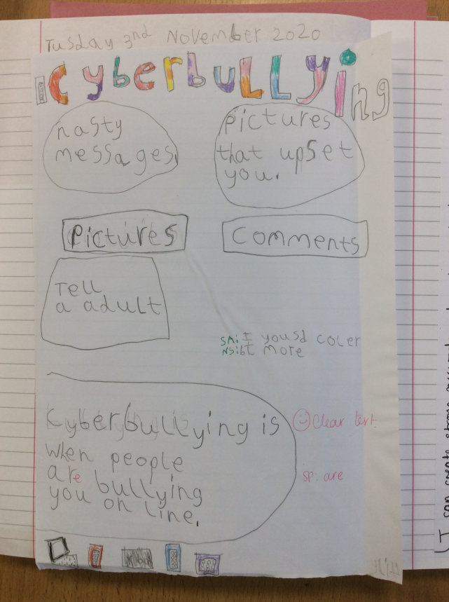
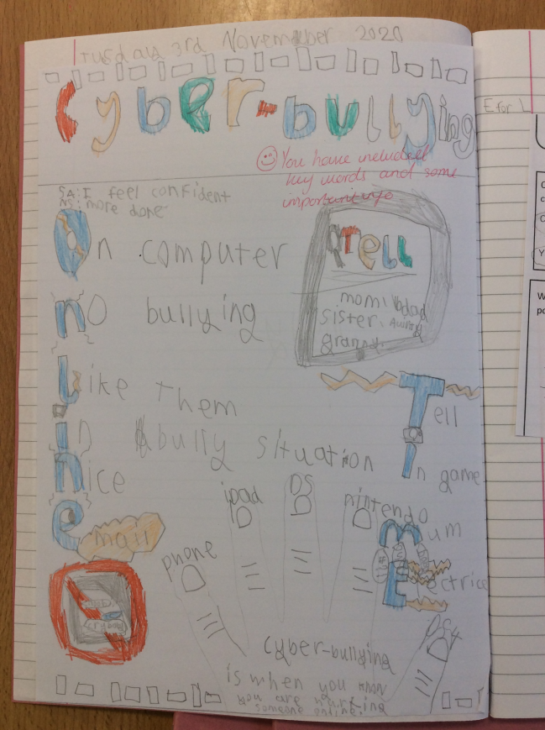
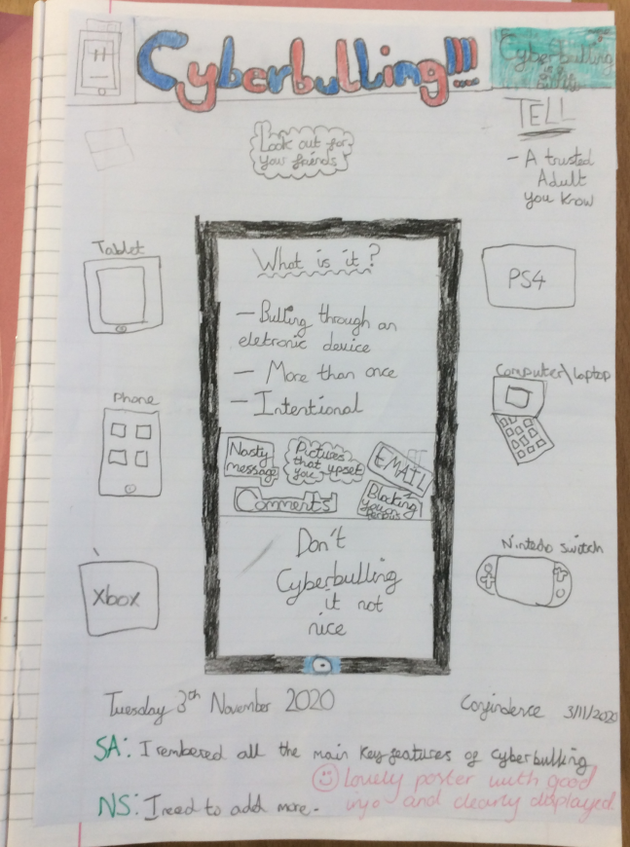
We discussed what cyberbullying means and what we should do if we were worried about cyberbullying.

Slide 3
We talked about the different adverts that we see online and discussed what ‘digital footprint’ means.
The class had a debate about whether we think it is fair for children to have adverts aimed at them.
It helps us know what toys are out there to buy.
What if the parents can’t afford it and then the child gets upset?

Slide 4
We need a strong password that isn't easy for someone to guess!
We learnt about the importance of passwords and how to create a password that is safe and secure.
If someone knows your password they might be able to get hold of your personal information.

Slide 5
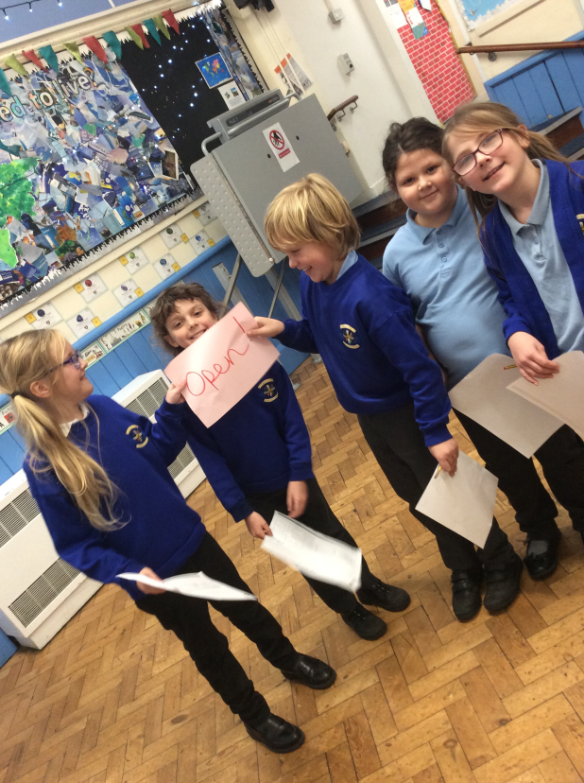
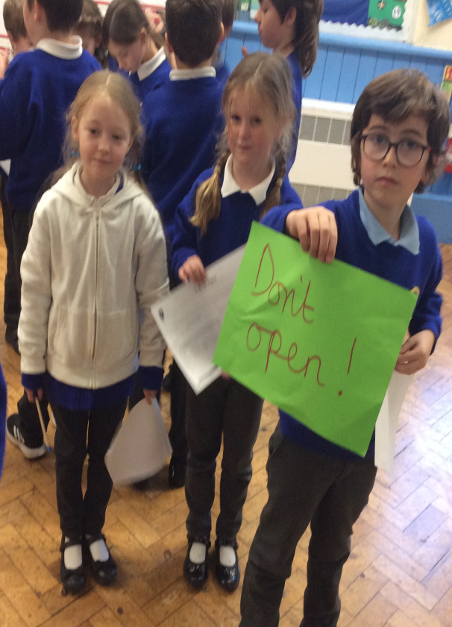
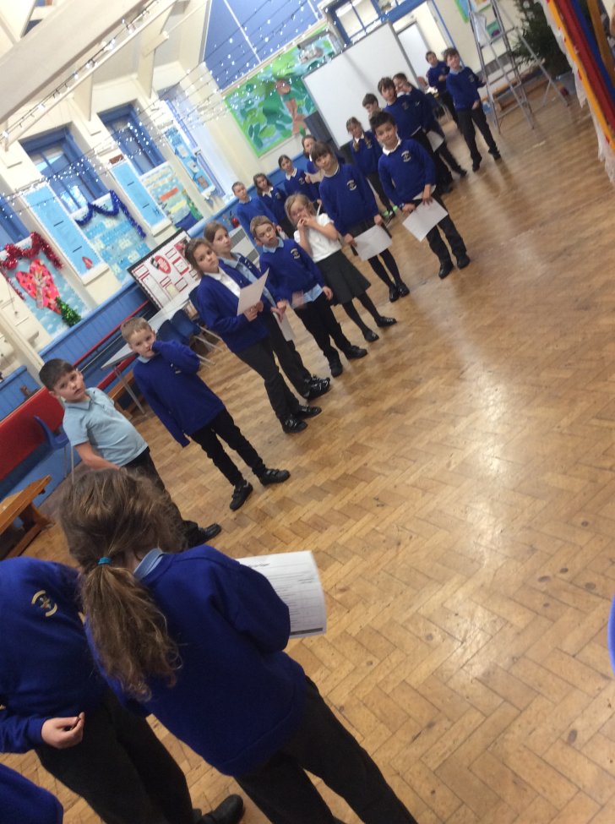
We reflected on the warning signs of when an email isn’t safe to open and why.

