Slide 1
PSHE
Relationships

Slide 2
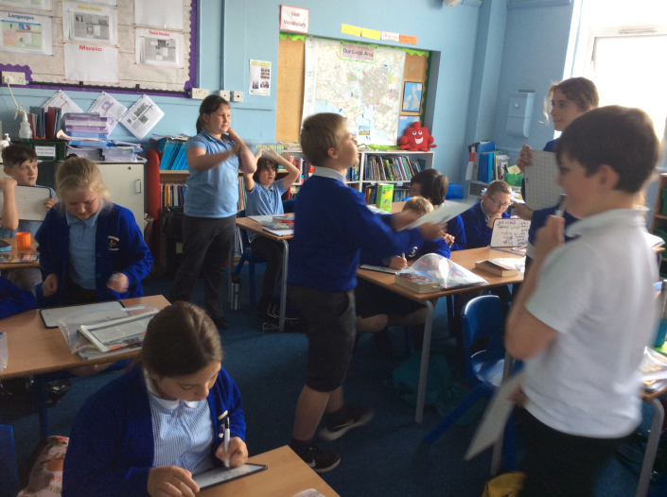
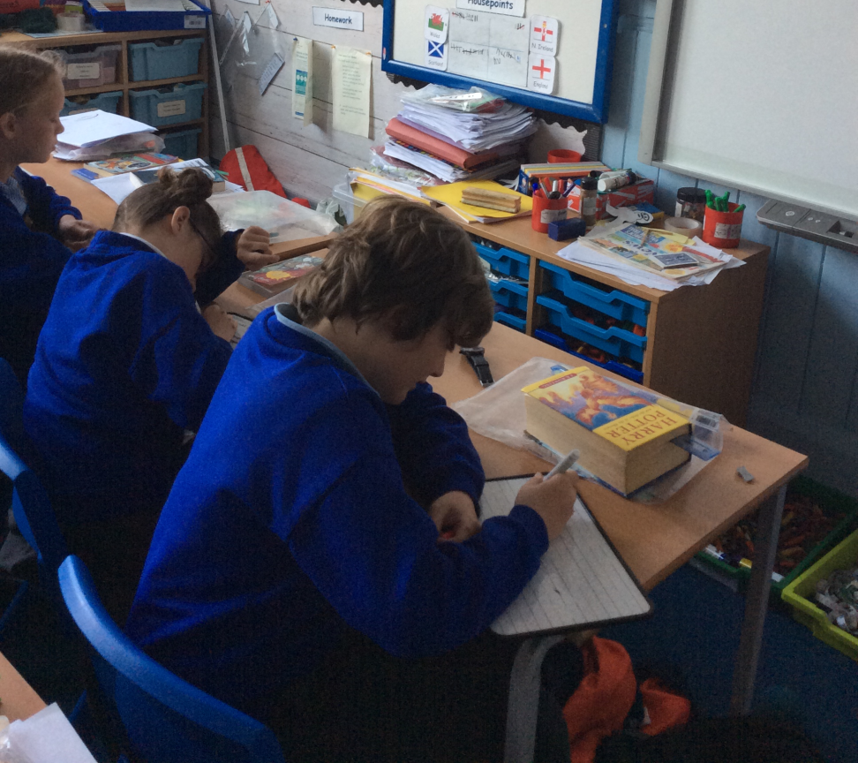
Self image – how do I see myself?
I thought about how I saw myself, then asked others how they saw me. It made me feel good about myself

Slide 3
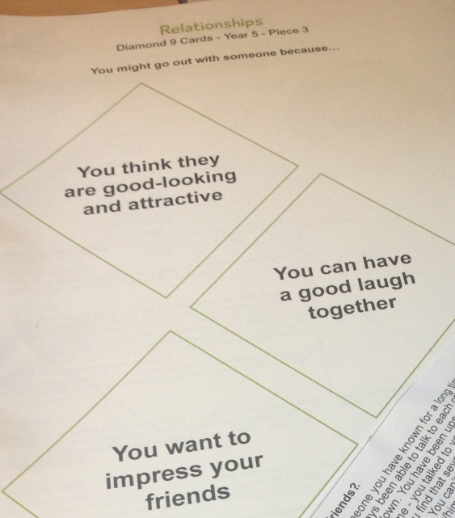
Girlfriends and Boyfriends
We are too young to think about this yet – let’s build friendships
I understand relationships are personal and should not feel pressured into having a boyfriend or a girlfriend.

Slide 4
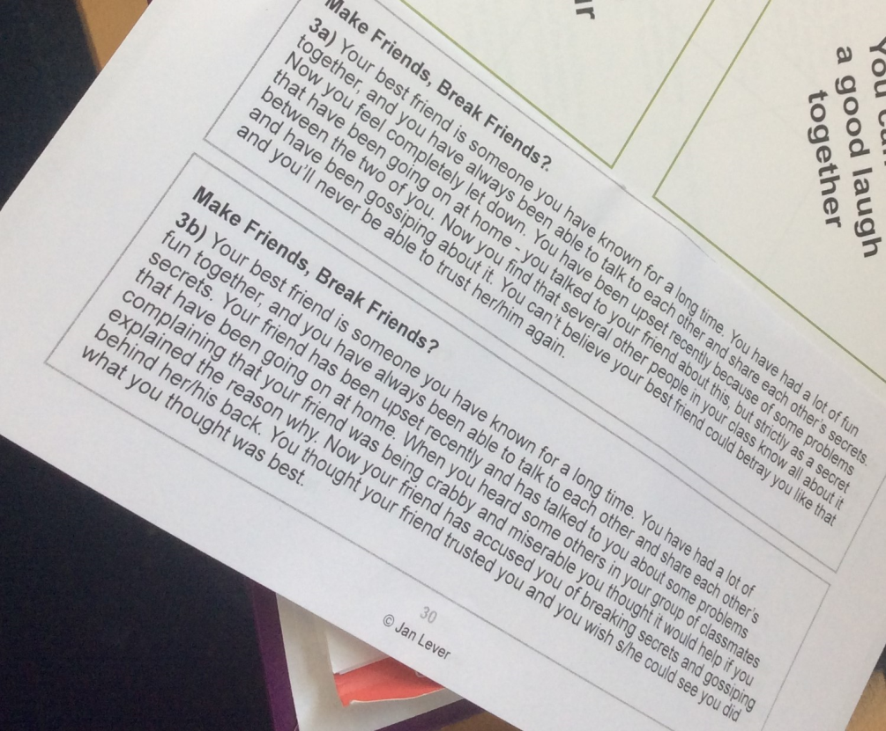
Friendship
Friends need to trust and support each other
Friendships change as you get older, that is part of life

Slide 5
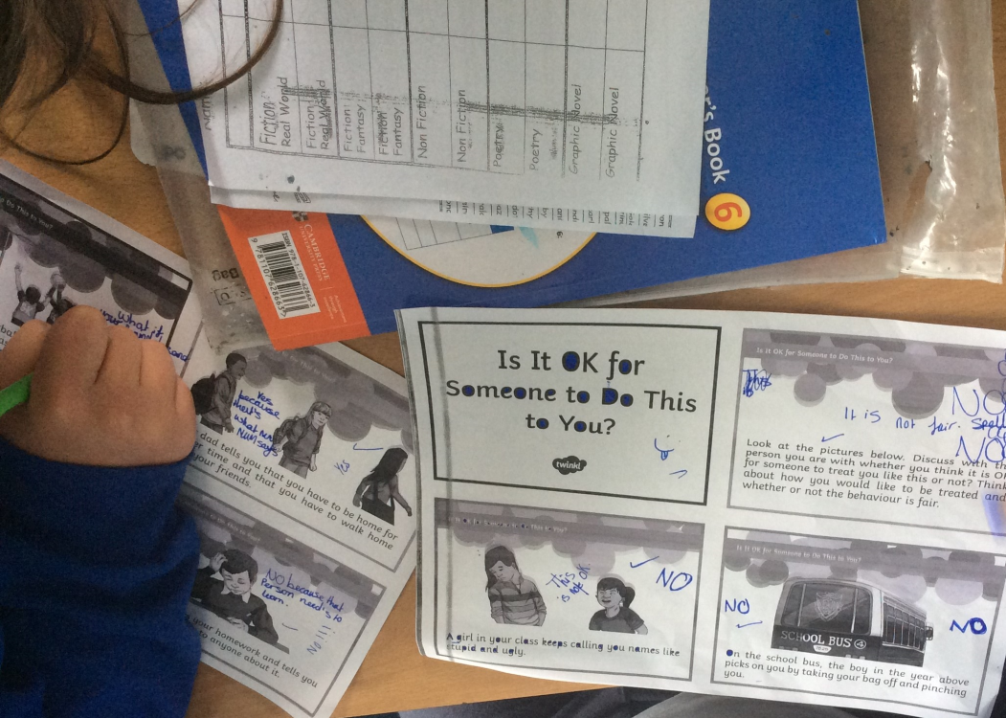
Healthy relationships - resolving conflicts
I understand what behaviours are acceptable and what is a healthy or an unhealthy relationship.
Your right to privacy
Your freedom to express yourself
Your right to be treated with respect
Your right to personal space
Emotional boundaries, like what sort of language is acceptable and not acceptable to use
Behavioural boundaries, like what sort of behaviour is acceptable and not acceptable
Sometimes I find things unfair, I need to evaluate the situation and understand what is happening. Then I can talk it through to resolve it.

Slide 6
Managing feelings
When we have fallen out with someone, it is easy to raise our voice. When resolving a conflict, try to keep your voice at a low level as if you were talking to someone sitting next to you in the classroom.
We may need to listen, empathise or compromise . I need to think about what triggers my feelings.

