Slide 1
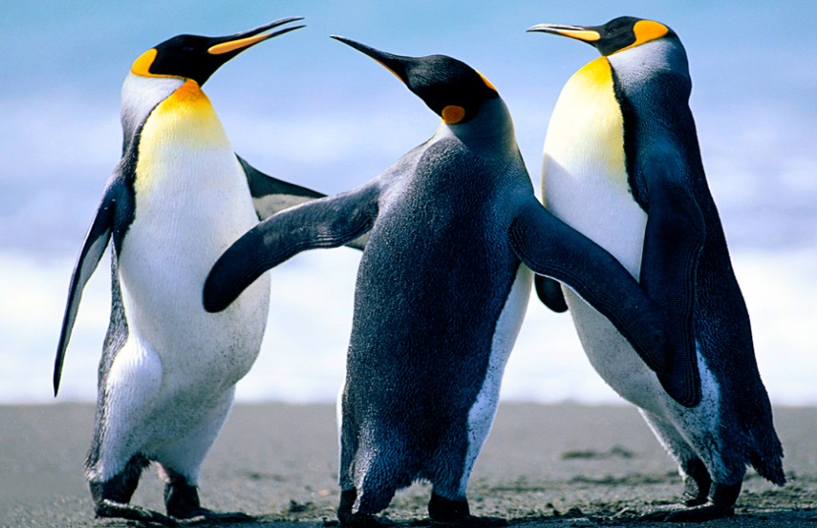
Science – Animals and their Habitats. Autumn 2020
Explore and compare differences between things that are dead, alive or never alive.
- identify that most living things live in habitats that they are suited for and have their basic needs met.
- Identify and name a variety of plants and animals the a selection of habitats.

Slide 2
Living, dead or never alive?
We started by looking at what it means to be alive, dead and having never been alive. We then had a go at sorting things into the three categories.
My bunny rabbit used to be alive but then it died and went up into the sky to be a star – James
Is a basket ball alive because it has air in it? Alma
Dogs are alive because they breathe and need to eat and sleep – Amos

Slide 3
What is a habitat?
We discovered that a habitat needs to offer its inhabitants a number of things:
Shelter
Food
Water
Space to grow and move
Oxygen
Sunlight

Slide 4
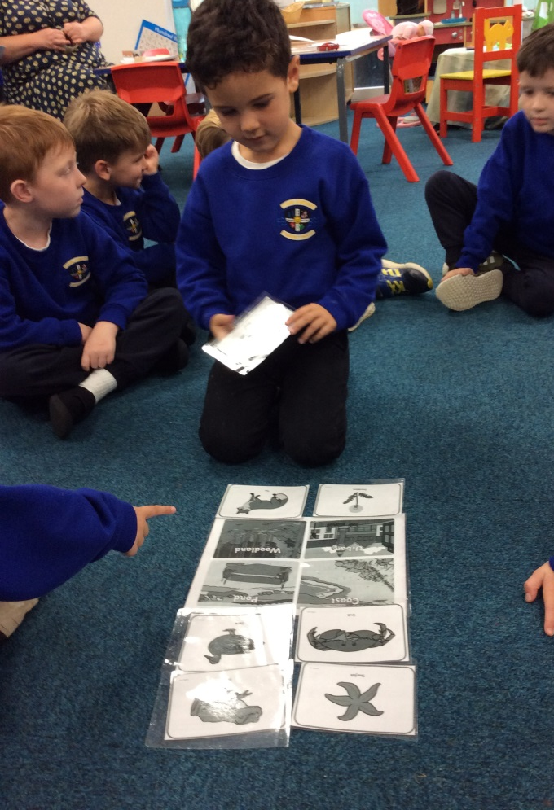
A local habitat and its residents
We looked at Urban, Woodland, Coastal and Pond habitats.
As our school is located near the beach, we chose a coastal habitat to explore the inhabitants of.
We decided that there would be lots of fish in the sea and in the rock pools, sea weed on the shore, crabs hiding in the sand and some muscles on the rocks.

Slide 5
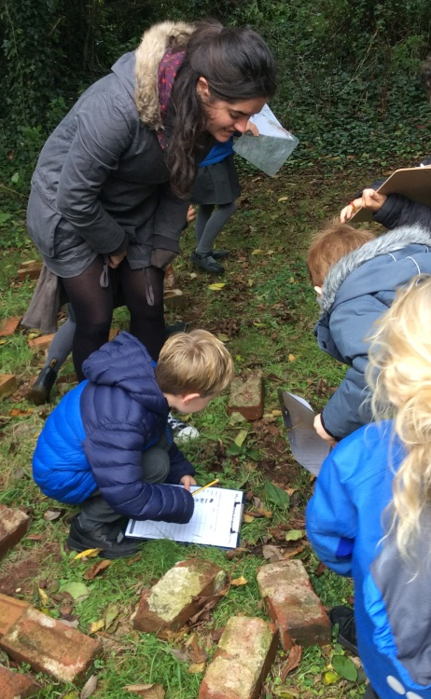
Microhabitat
I have found 6 woodlice, 3 spiders and an earwig! Oliver
There are a lot of ants under this rock! Hugo
We found out that larger habitats are made up of smaller habitats called Microhabitats. We chose to explore the outdoor classroom and look under rocks to see what we could find. We kept our own tally to see what was most common.

Slide 6
We then looked more closely at world habitats and chose our favourite to create our own posters. We chose between a Desert, Ocean, Rainforest and an Arctic habitat.
I think a killer whale would live in an ocean habitat, I’m going to draw one of those. –Alfie H
I think a colourful parrot would live in the rainforest – James
Polar bears and penguins live in Arctic habitats where there is lots of snow – Bobby

Slide 7
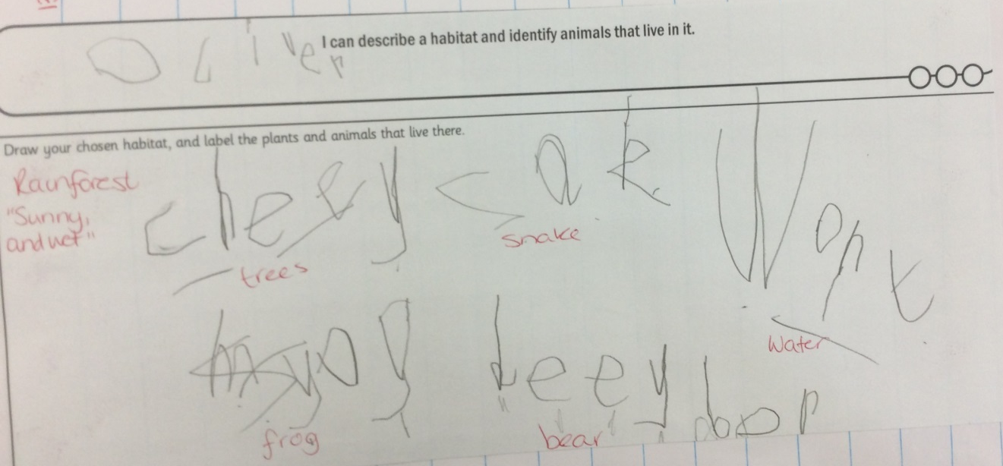
A desert habitat by Archie, a rainforest habitat by Oliver and an ocean habitat by Alfie H.

Slide 8
