Slide 1
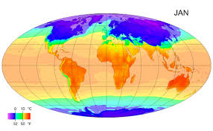
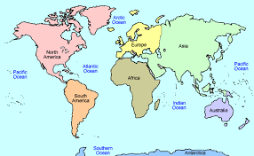
Class Cremyll
Geography
What a wonderful world

Slide 2
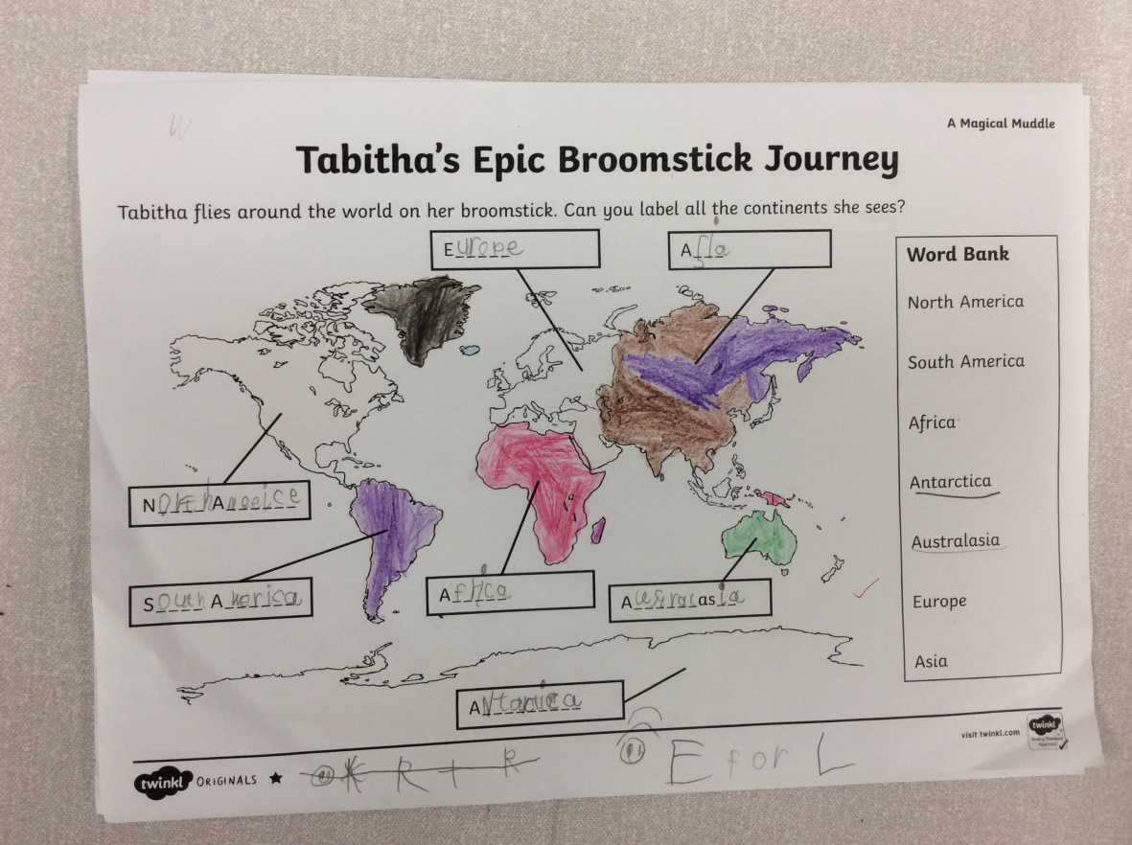
“We live in England and that’s in Europe.”
“The boy and the penguin rowed to Antarctica in our English book - ‘Lost and found’.”
We learnt about the seven continents of the world.
Asia, Africa, North America, South America, Australasia, Europe and Antarctica.

Slide 3
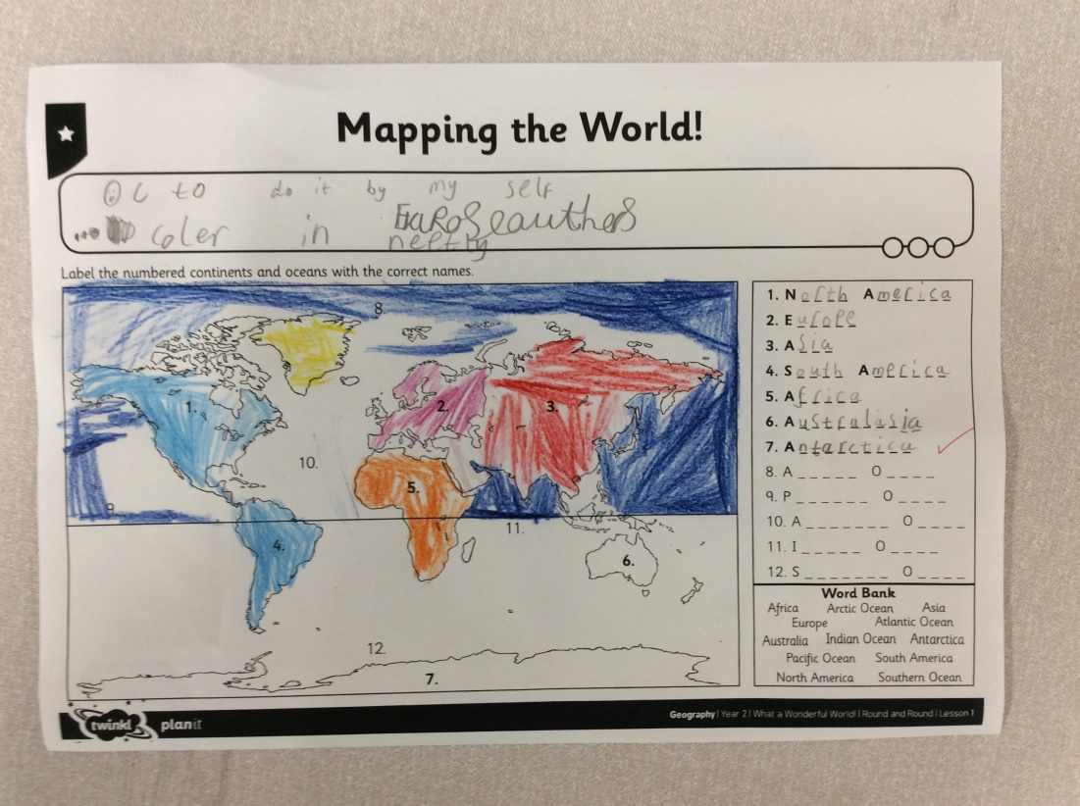
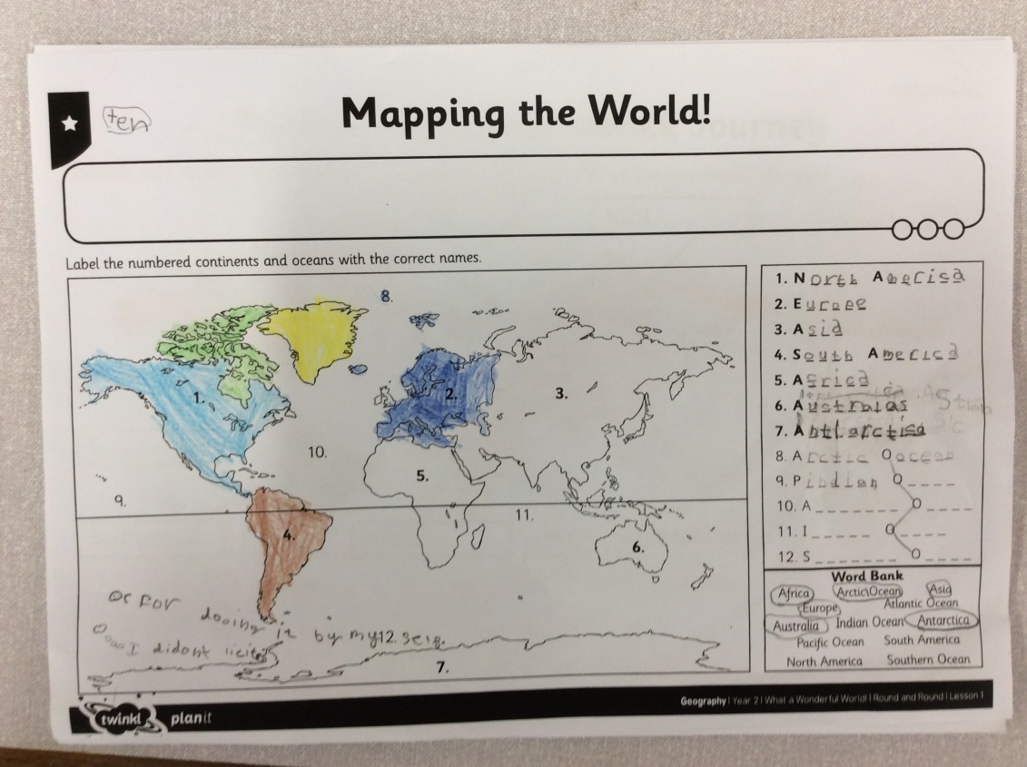
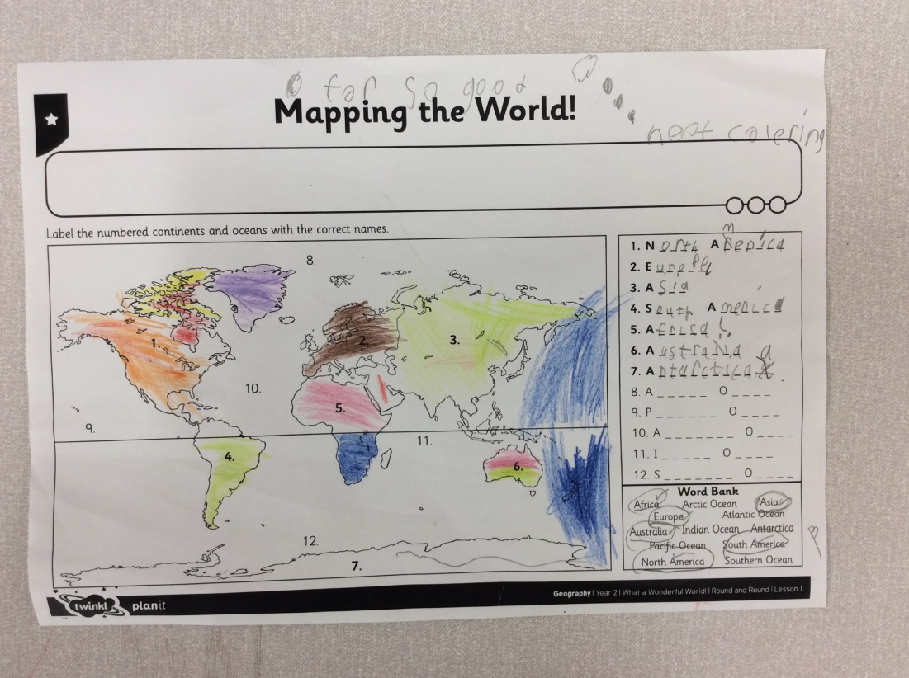
Next, we learnt about the 5 major oceans of the world.
The Atlantic, The Pacific, The Indian Ocean, The Arctic Ocean and The Antarctic Ocean.
“The oceans wrap around all of the world.”
“The oceans are bigger than the land.”

Slide 4
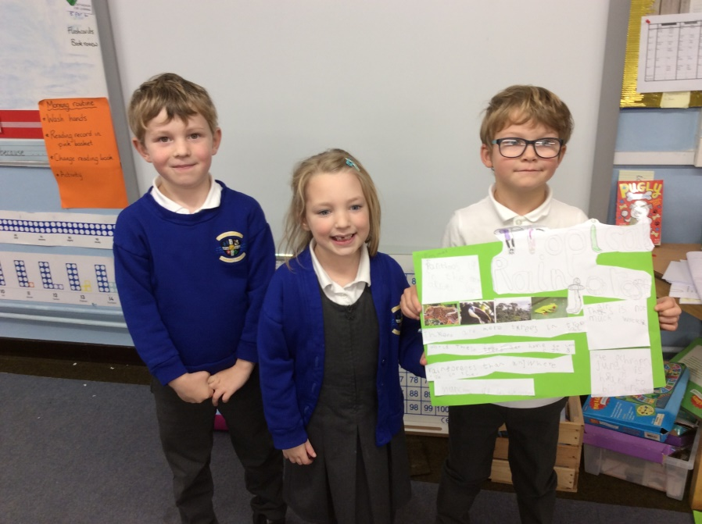
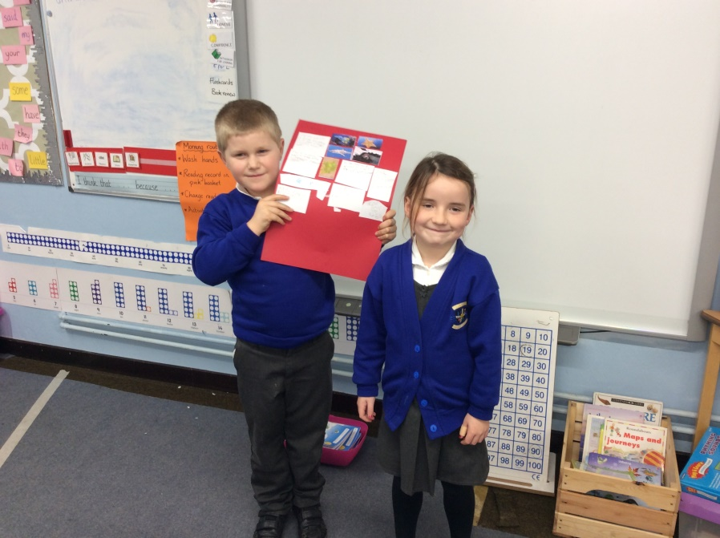
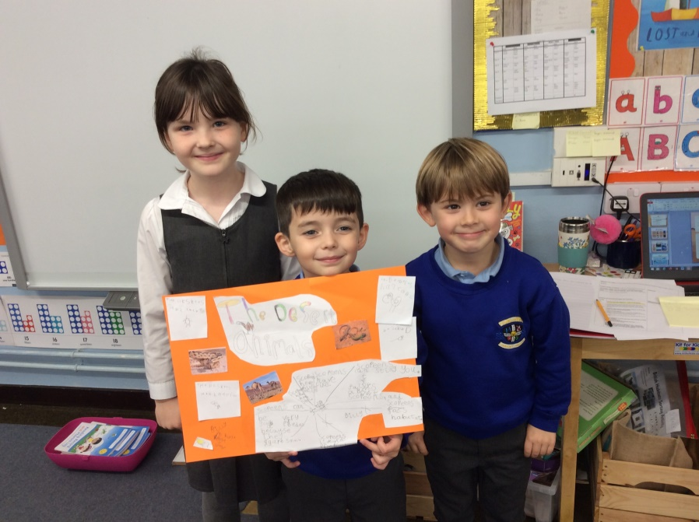
We learnt about hot and cold climates and discussed how the animals and plants might be different between the two. Then we designed and created posters for different climates.
“Animals have thicker fur in cold climates like Antarctica.”
“You find lizards in a hot climate.”

