Slide 1
Music
Music through the 20th Century
Summer 2021
Class Lynher

Slide 2
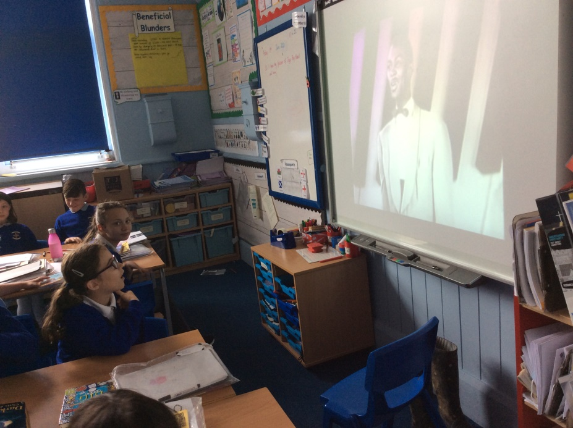
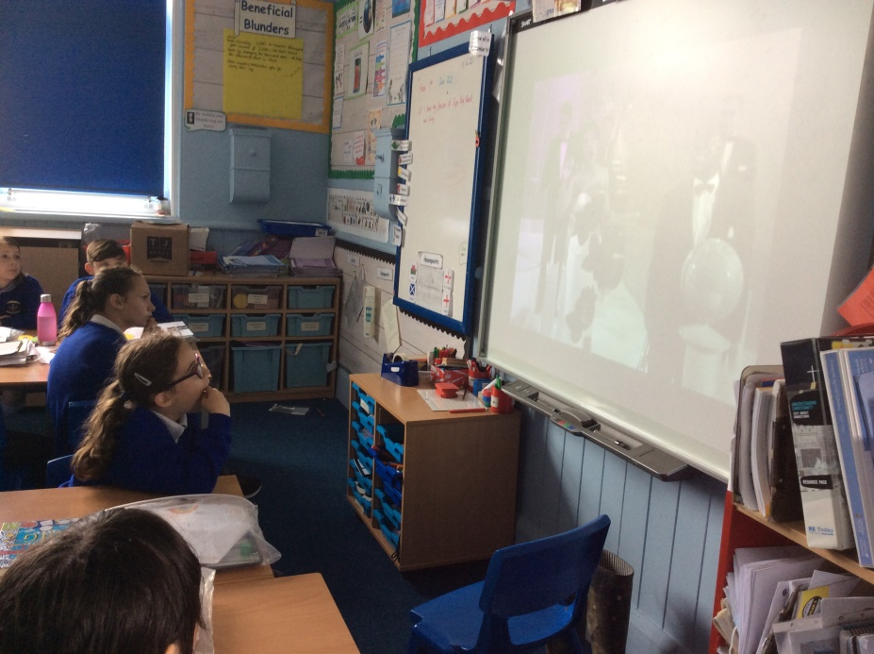
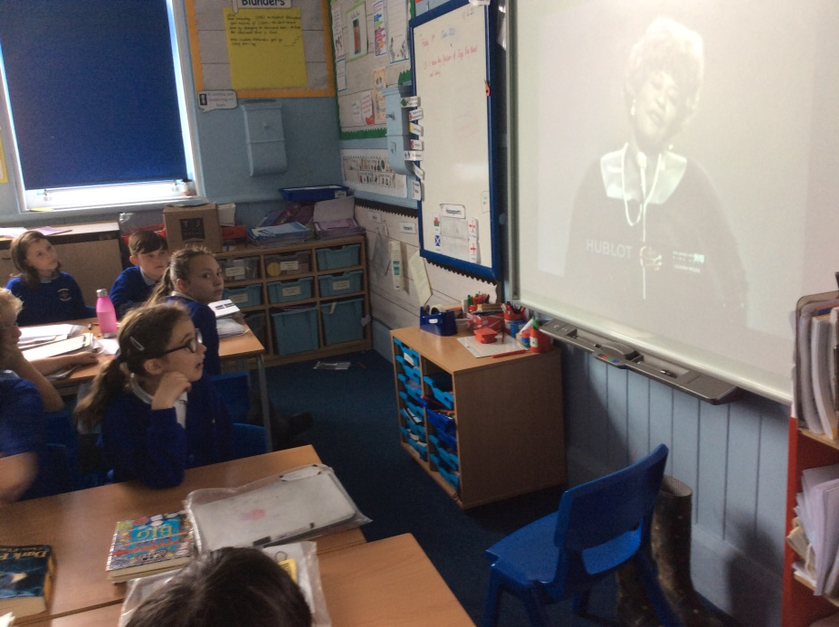
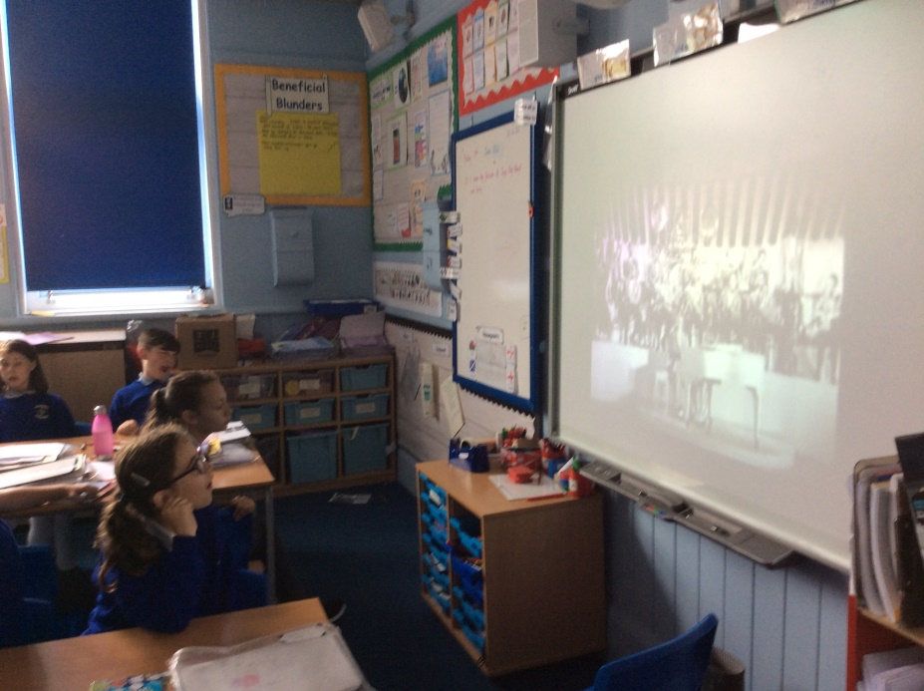
We started at the beginning of the century by listening to some big band, swing and jazz music.

Slide 3
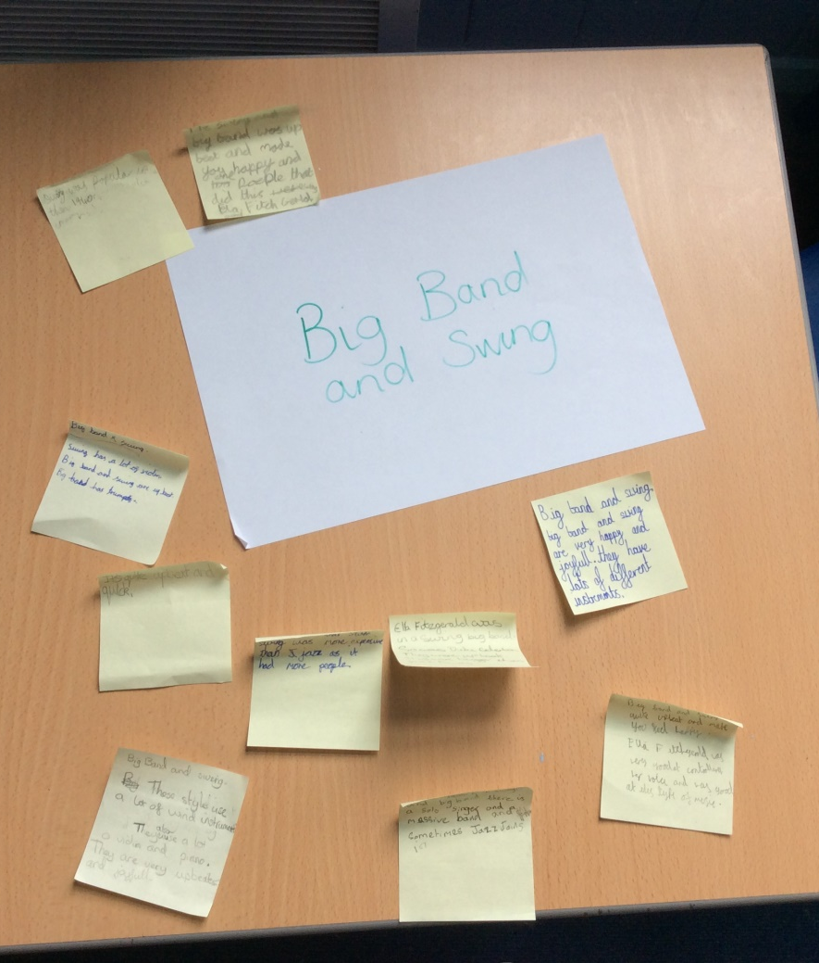
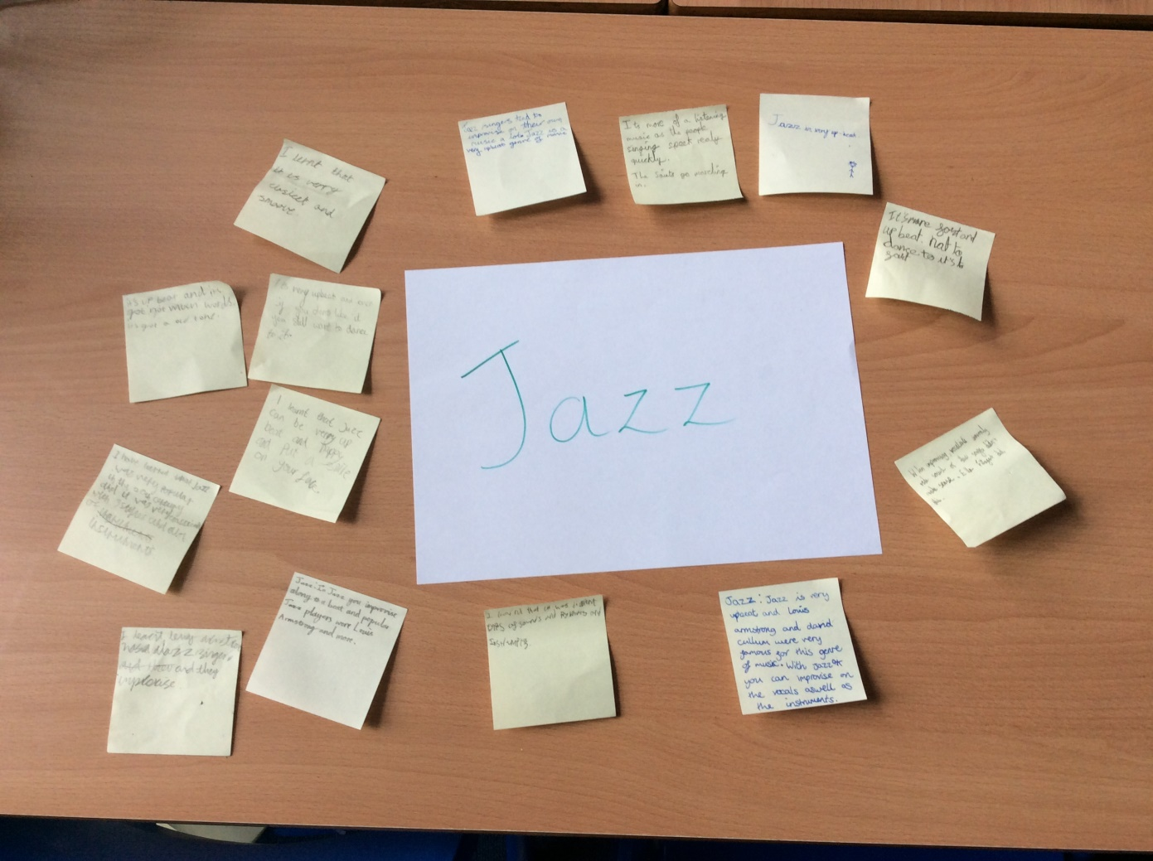
Most of us preferred the older jazz to a modern version.
This music was upbeat and made us want to move.

Slide 4
Next we listened to some Rock ‘n’ Roll, Soul and Pop.
Soul can use elements of gospel music like with their backing singers.
Elvis Presley made people swoon with his dance moves!
I love The Beatles because I love their melodies.

Slide 5
Finally we listened to Funk, Disco,Hip Hop, Indie and R’n’B. Here are some of our thoughts…
I liked it as it was upbeat.
It was very groovy
Amazing
Upbeat
Makes you want to dance
Funk
Disco
It made you want to join in.
Encourages you to dance
I like the mix. It sounds like rock and pop
I thought it was shouty.
I liked how upbeat it was but not the lyrics.
My favourite of the styles
Couldn’t stop moving my feet but not my favourite.
I like the instruments but not the singing
It seemed more modern
Indie

Slide 6
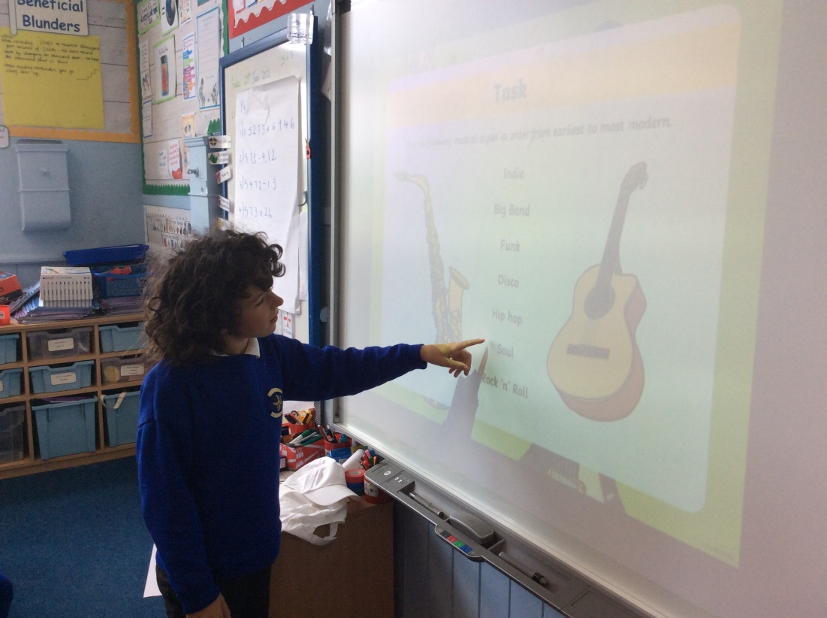
We recapped the different styles we had listened to and tried to remember the order that they first appeared in.
We all had to use our respect and responsibility because different people liked different music and nobody was wrong. It was their opinion.

Slide 7
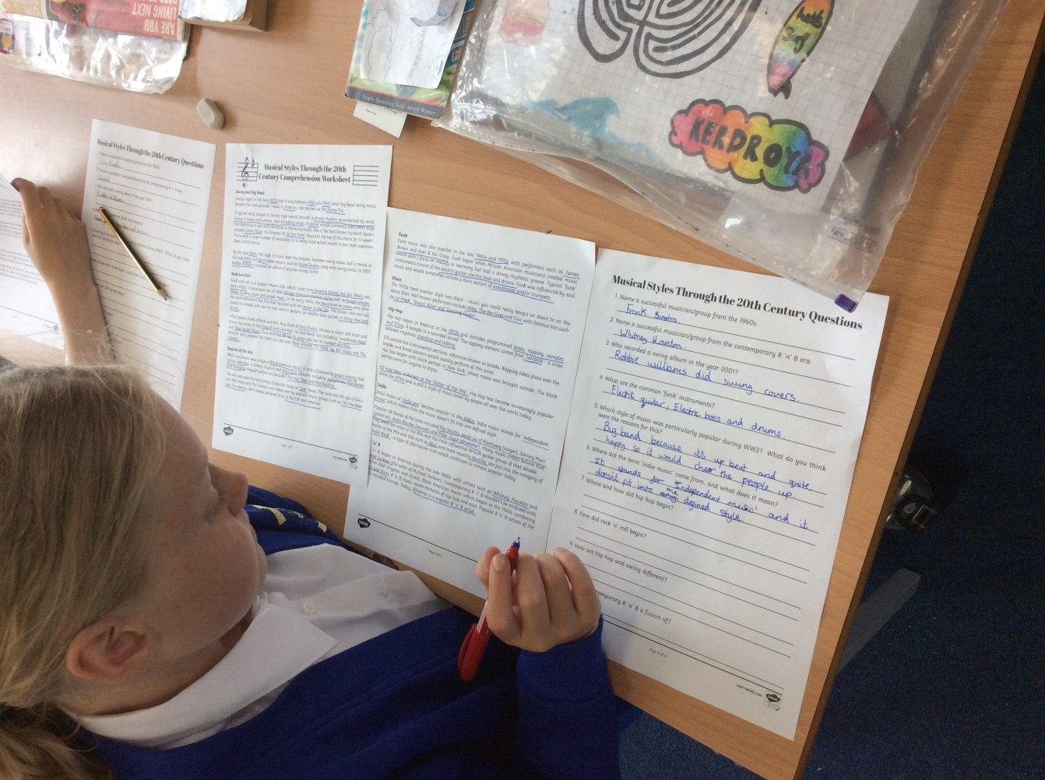
We read some key facts and answered questions about the different styles to jog our memories and then we wrote which of the styles we liked best and why.

Slide 8
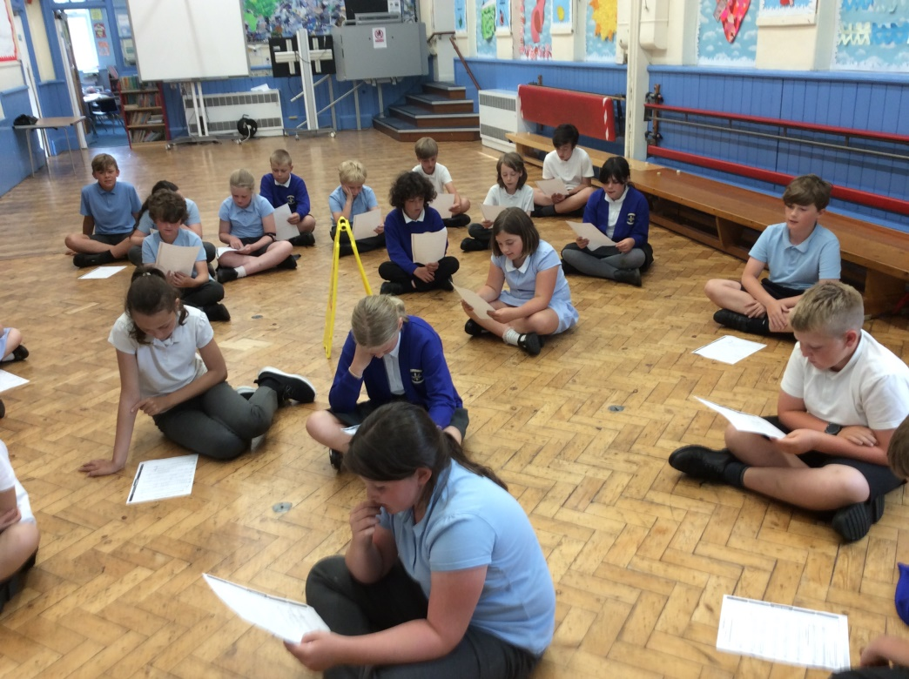
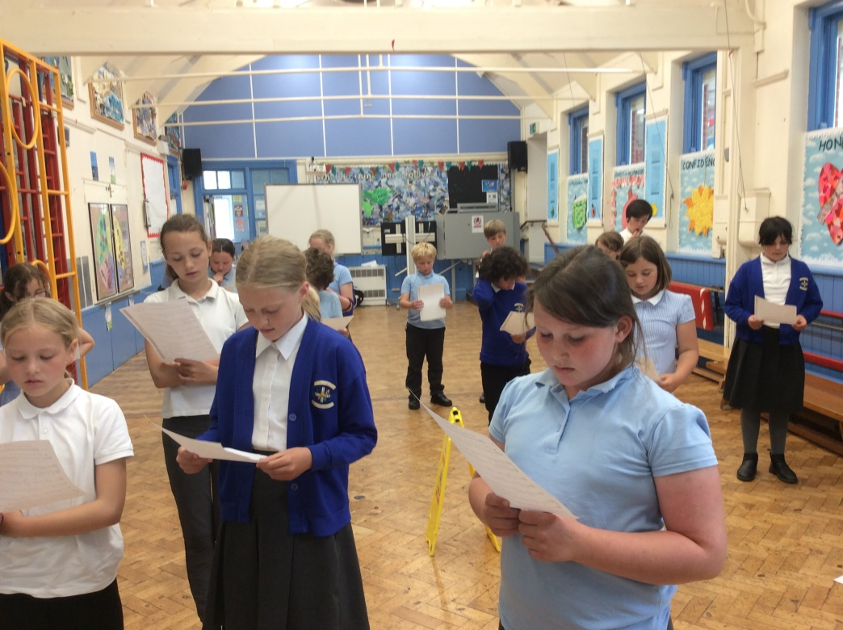
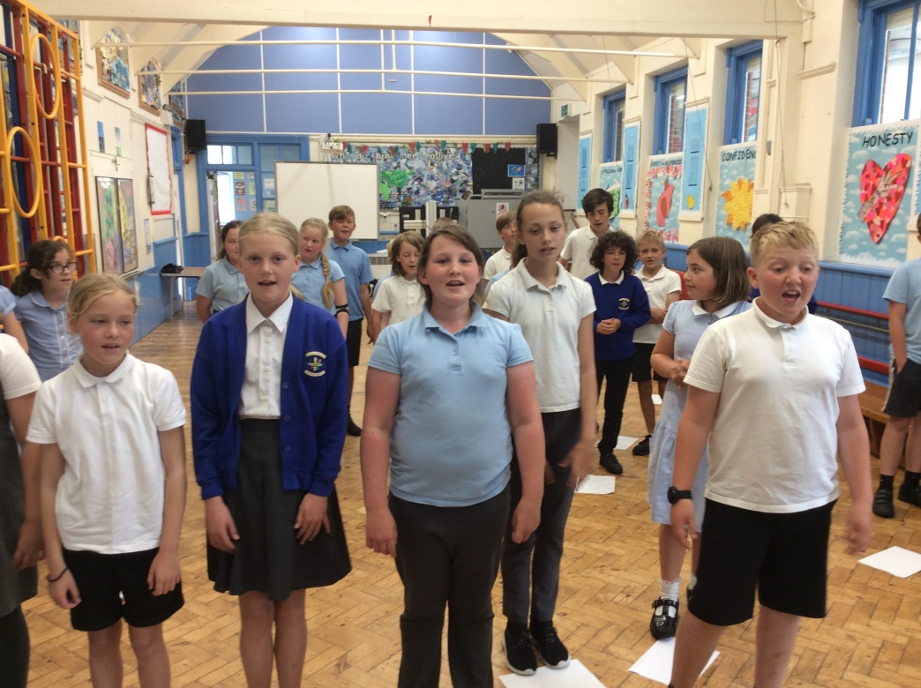
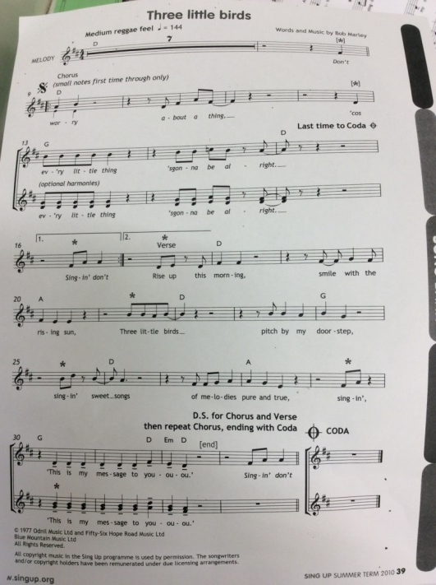
We learnt to sing a song in the style of Reggae. We used the sheet music to help us see where our pitch needed to change.

