Slide 1
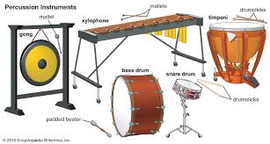
Class Cremyll
Music
Be in the band!

Slide 2
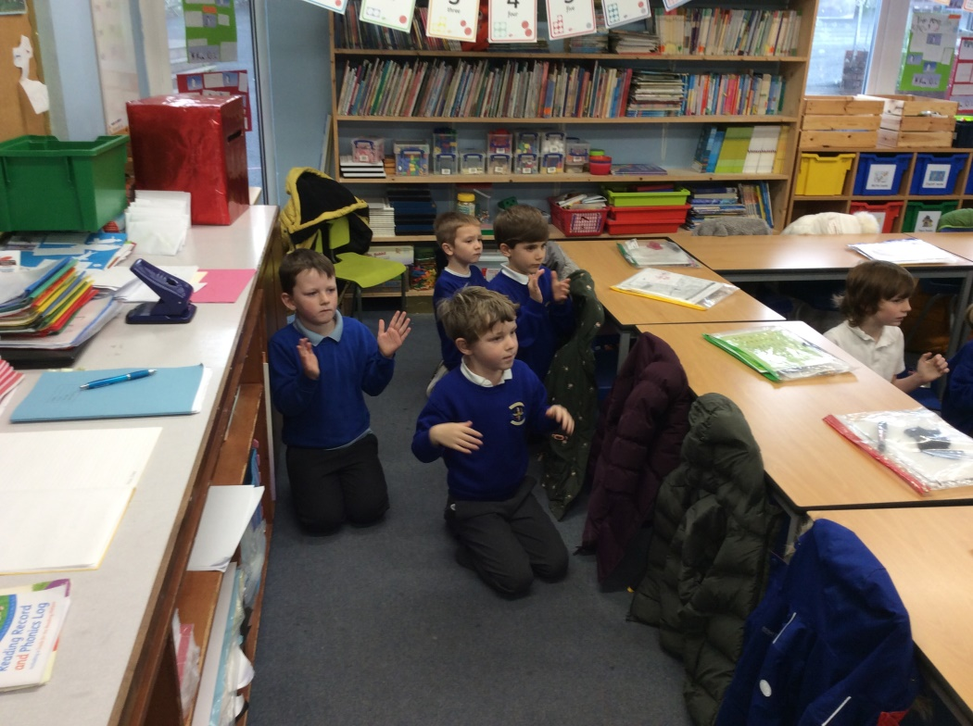
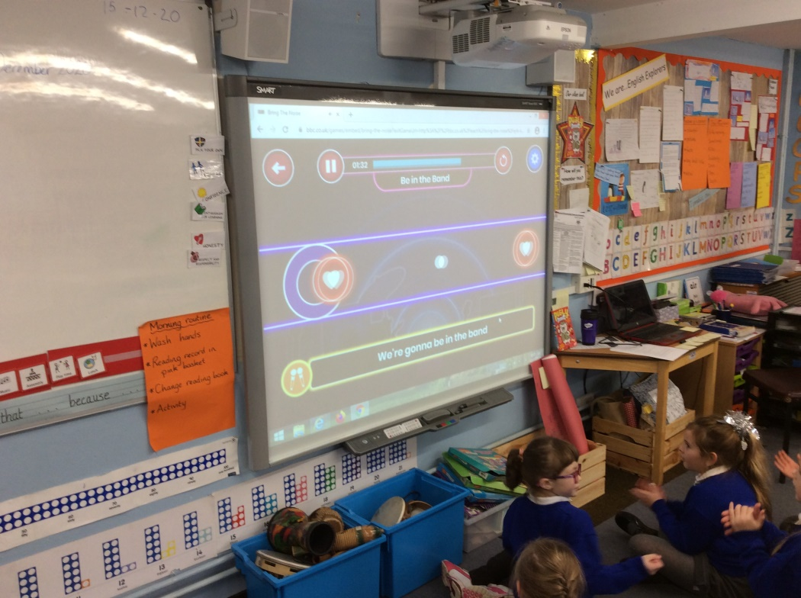
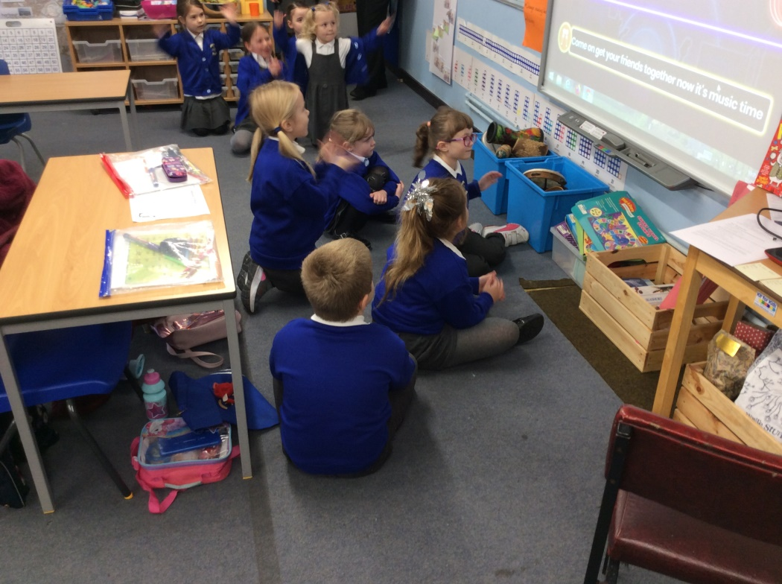
We practised clapping along to the rhythm of the ‘Be in the band’ song.
Then we used body percussion like tapping our thighs or clicking our fingers to create different sounds.
“I liked how we could use our fingers to click to the beat.”
“I really enjoyed the song.”

Slide 3
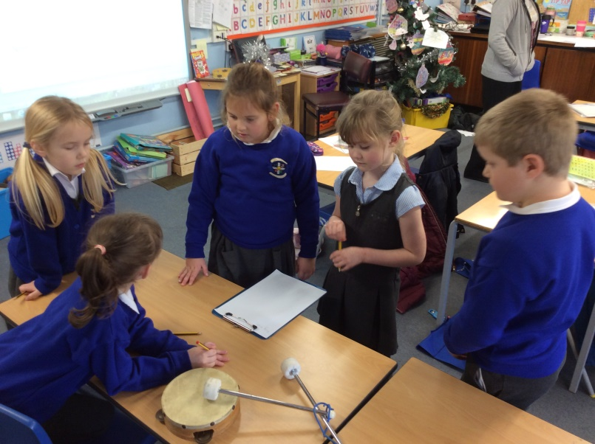
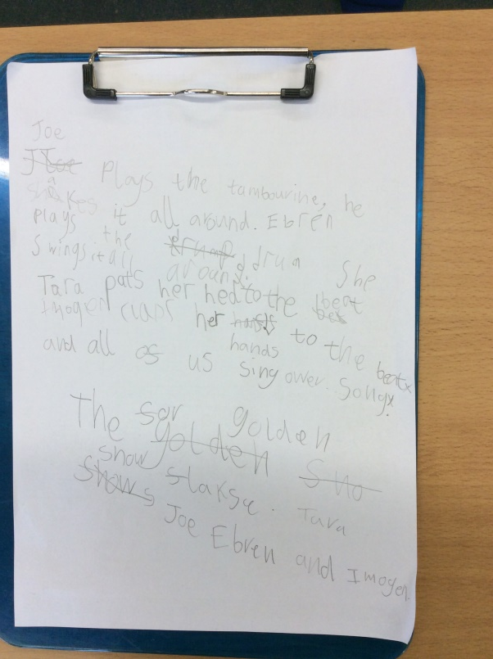
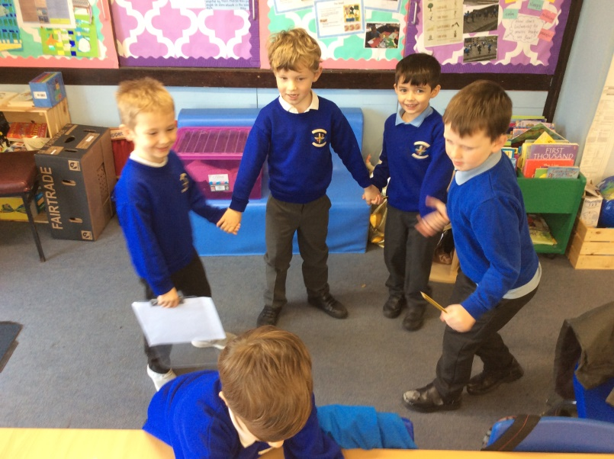
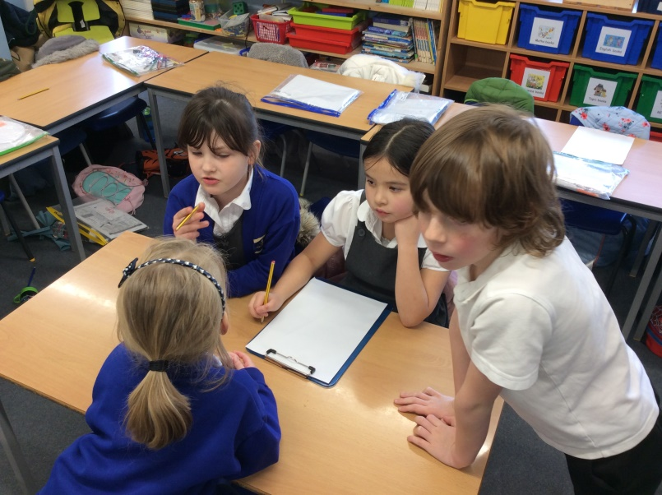
We came up with our own lyrics for a verse of the ‘Be in the band’ song and practised rapping our verse without our instruments.
“I liked making up our own rap using each other’s names and the instruments we had chosen.”

Slide 4
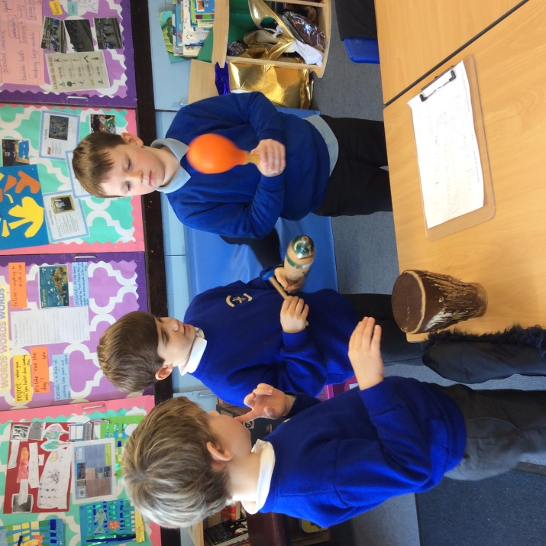
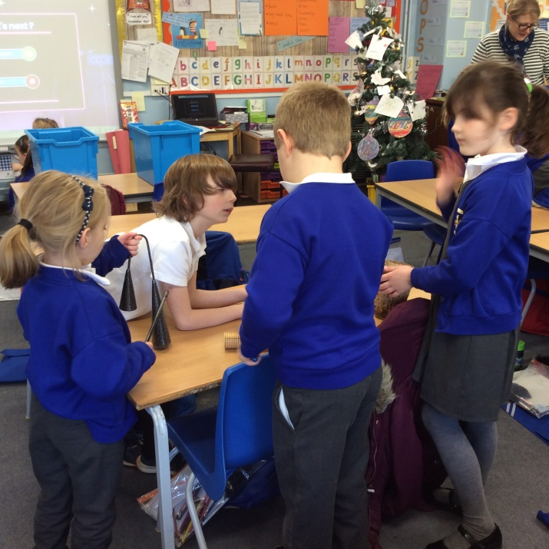
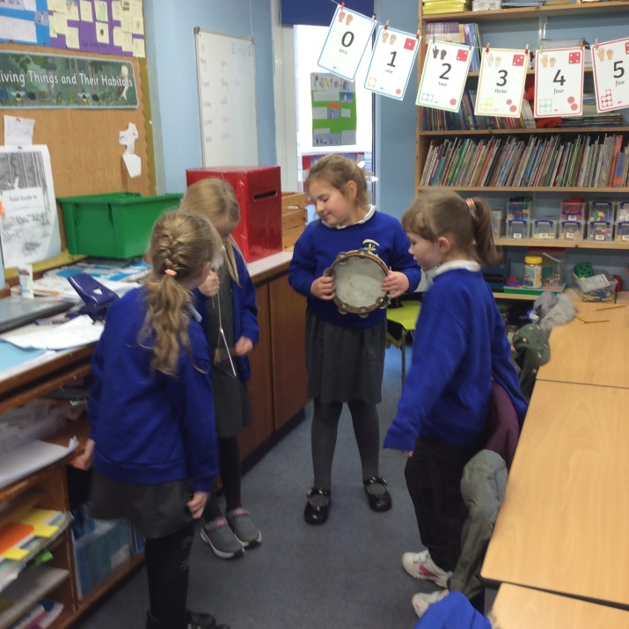
Next, we practised our verse of the rap with our chosen instruments.
“I really enjoyed trying out different instruments and then chose my favourite.“

Slide 5
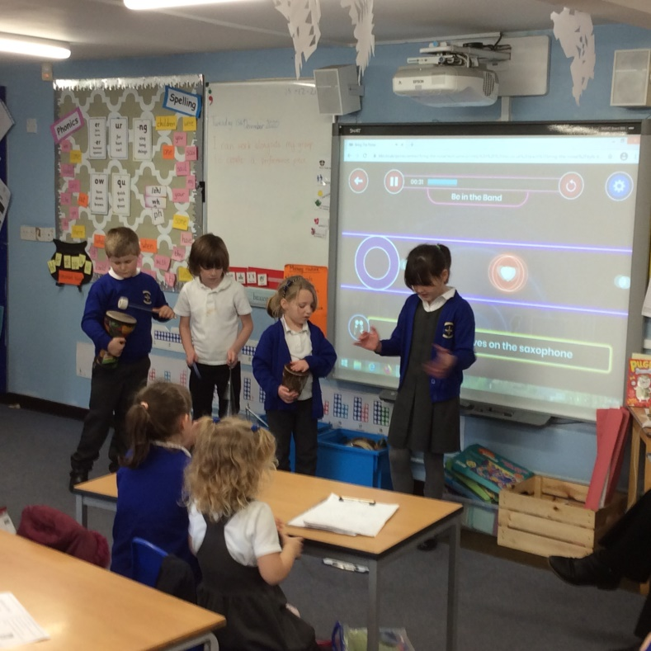
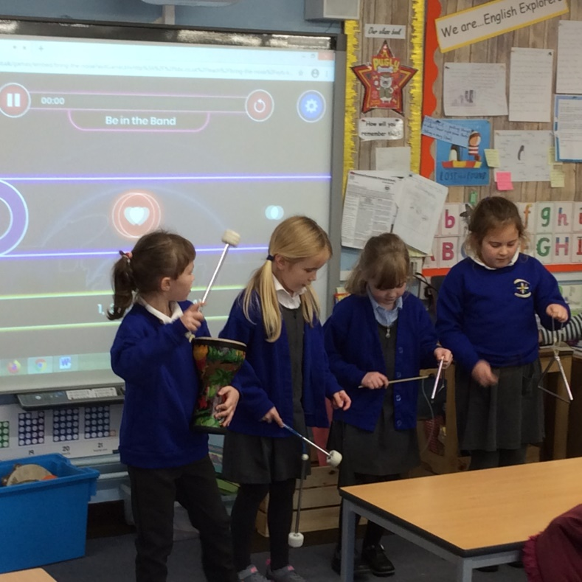
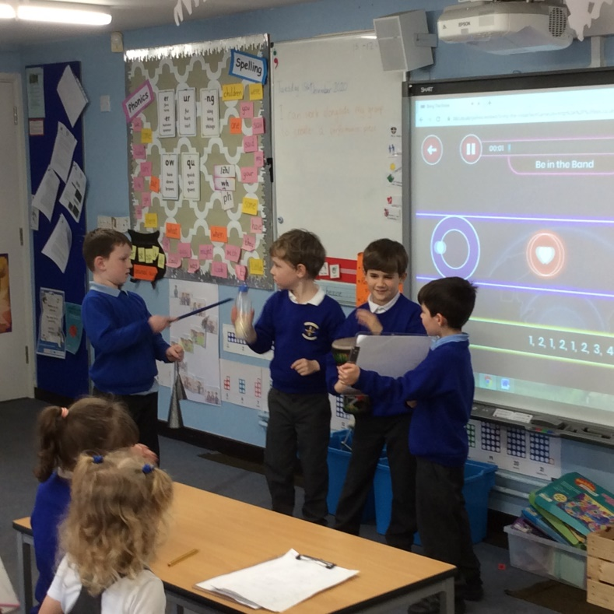
“I liked how all of the instruments went together and made a nice sound.”
“I liked how they all kept to the beat.”
Finally, we got to perform our verses in front of the class.
We created a Class Cremyll rap!

