Slide 1
Je me présente
French
Autumn 2020
Class Lynher

Slide 2
In our first lesson we tried to remember as much French as we could.

Slide 3
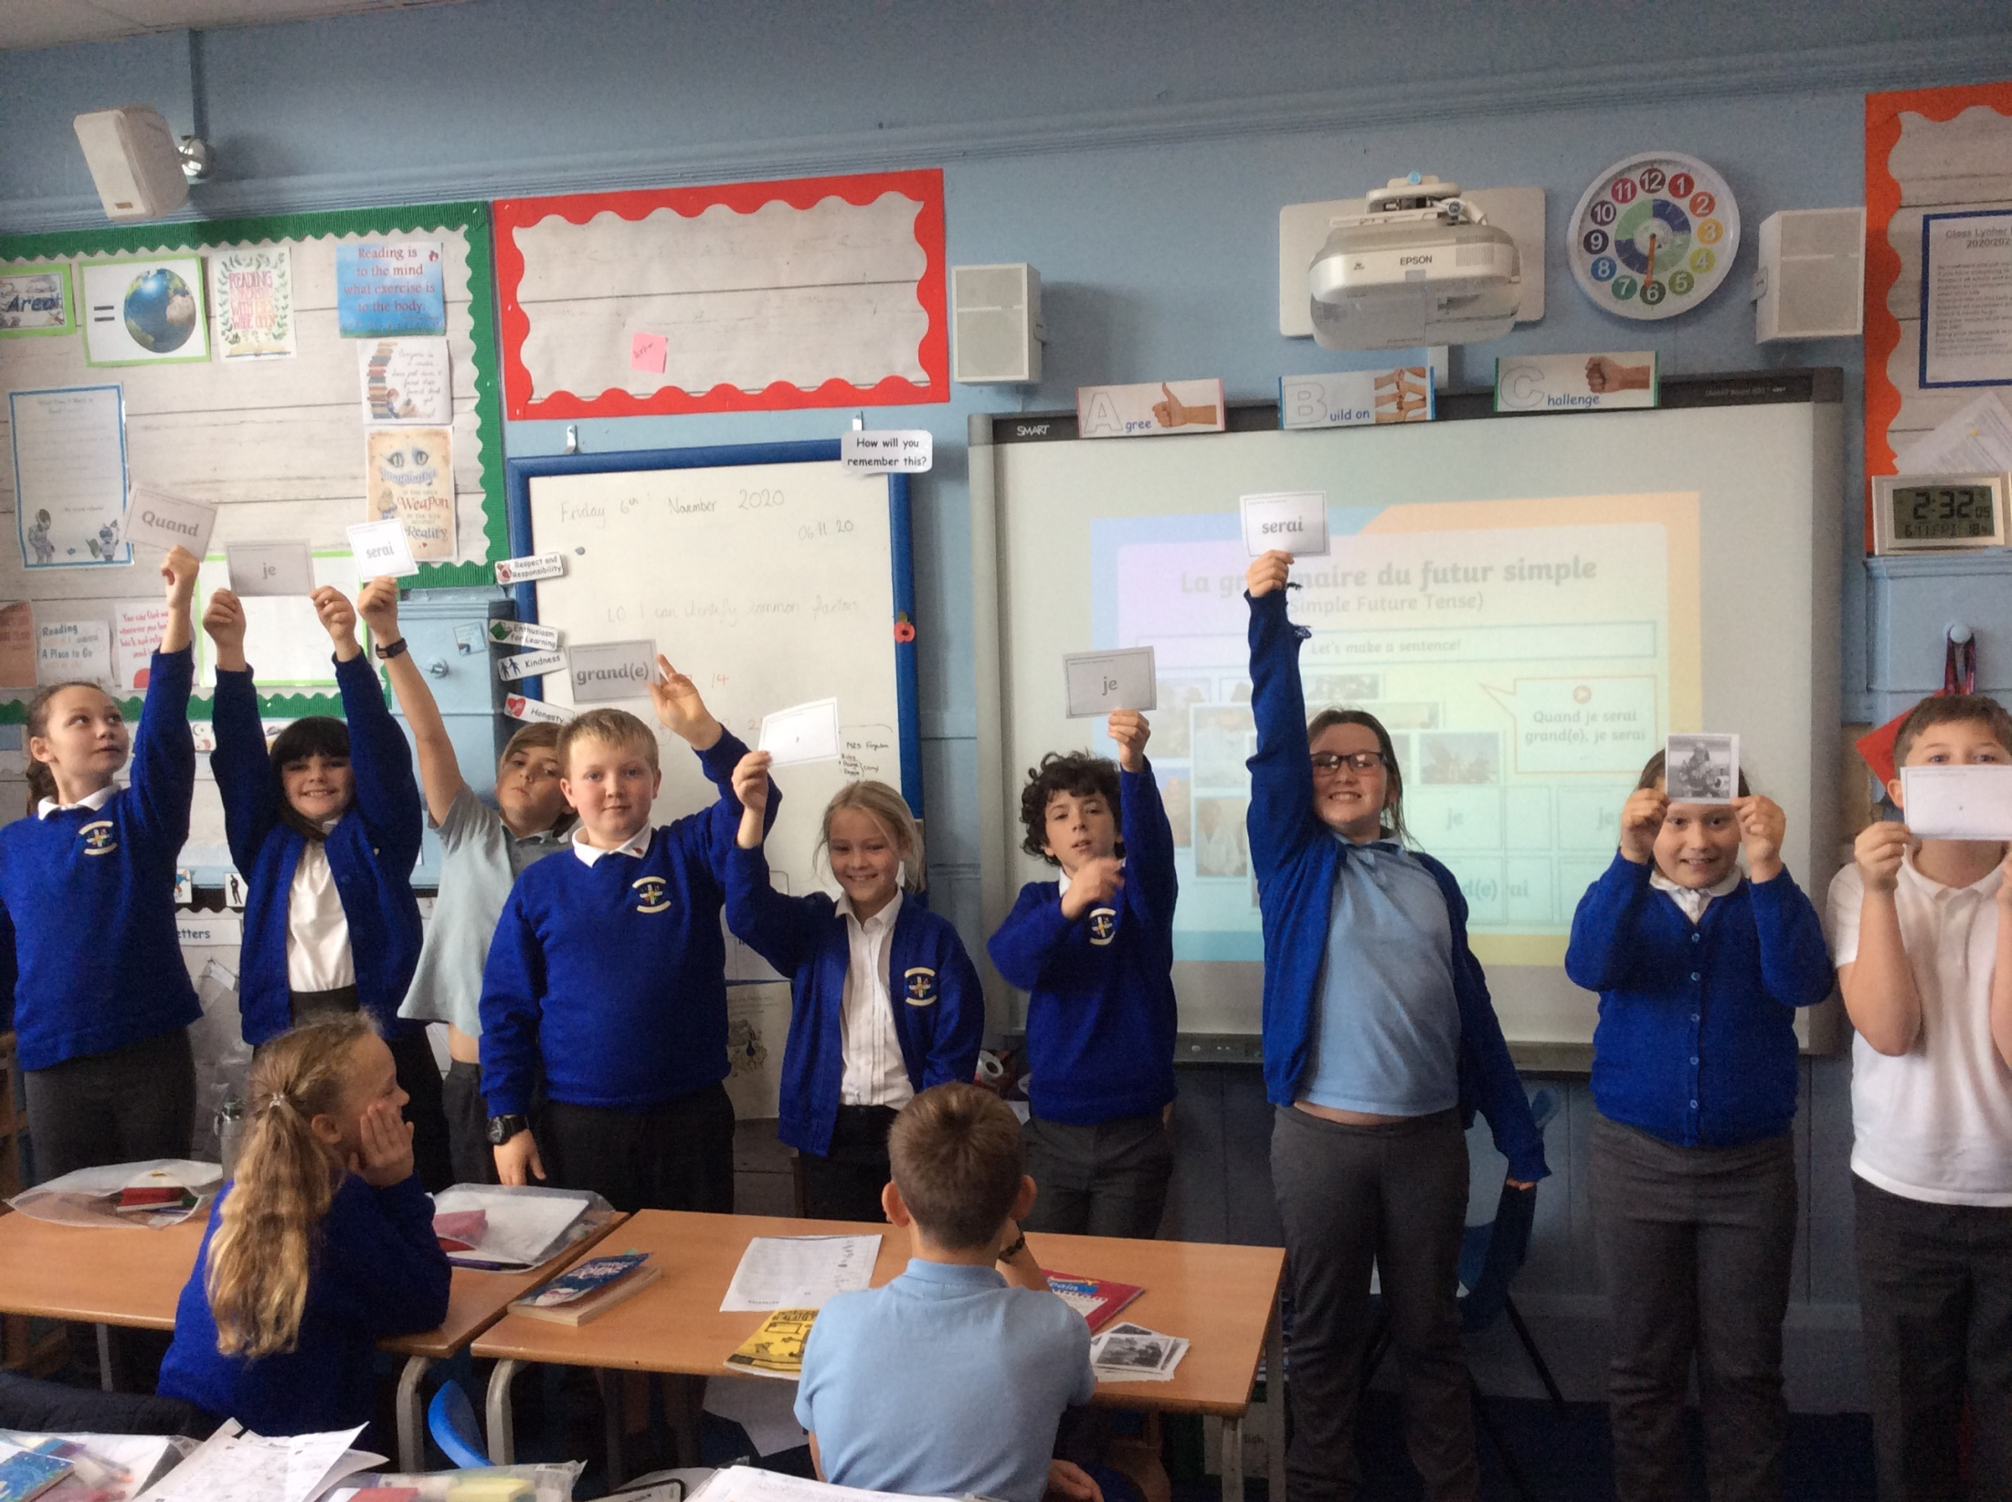
We learnt the names of different jobs and how to say what we want to be. For some jobs it changes if you are a man or woman.
When would you need to add the e?

Slide 4
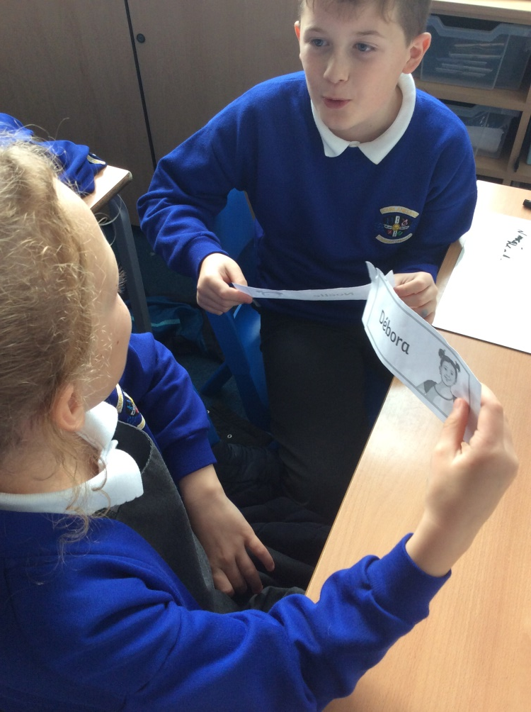
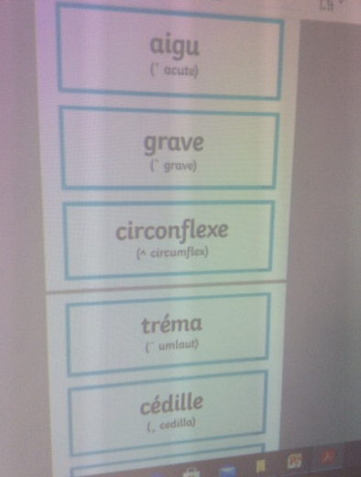
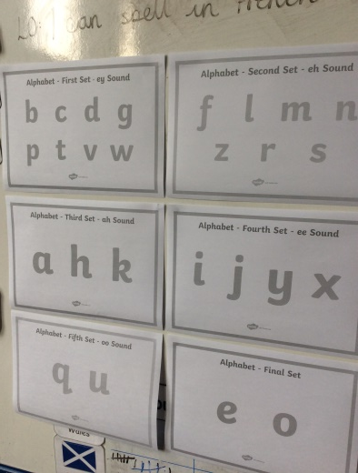
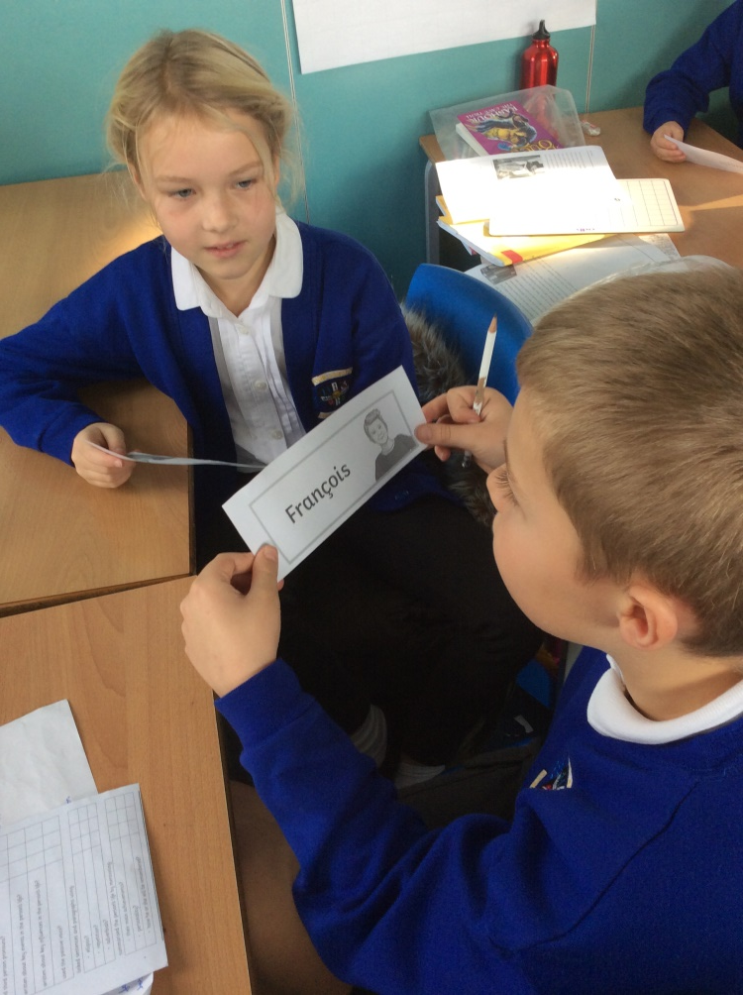
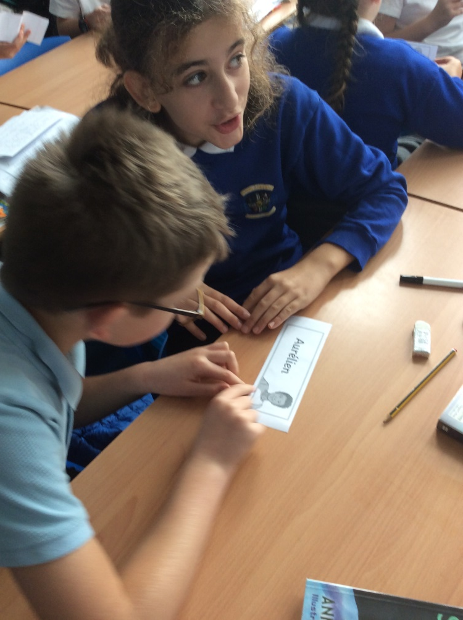
We recapped the alphabet in French and remembered a tune we knew to say it to.
We learnt how to say how words were spelt including letters with accents
How do you say if a letter is a capital?

Slide 5
Why is there a difference in spelling?
We learnt how to be more precise in saying how we felt.

Slide 6
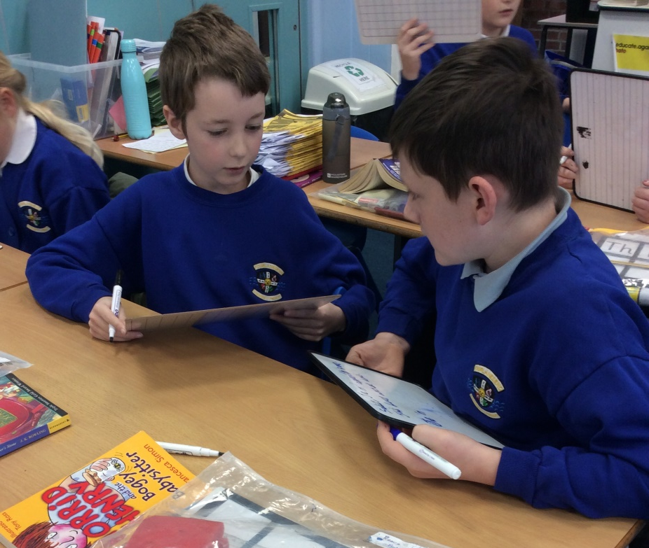
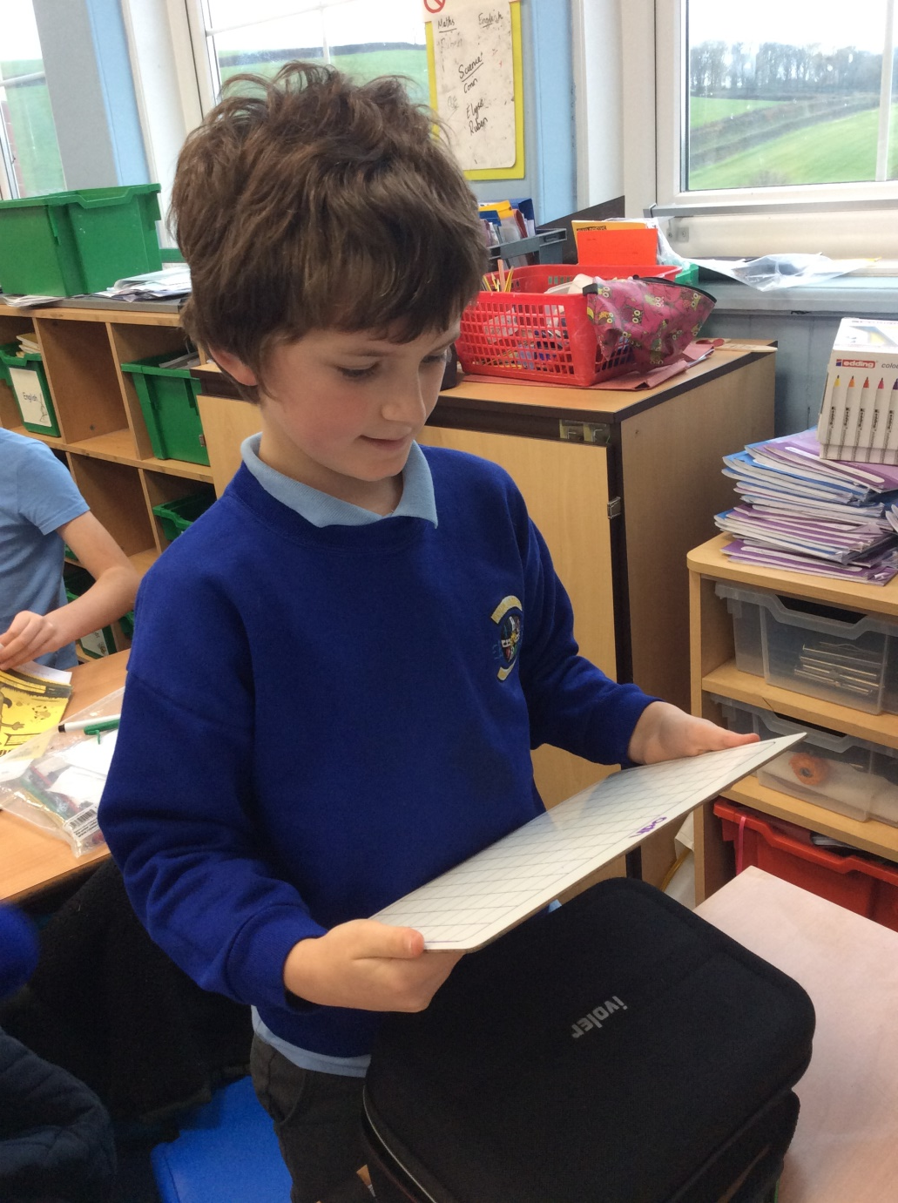
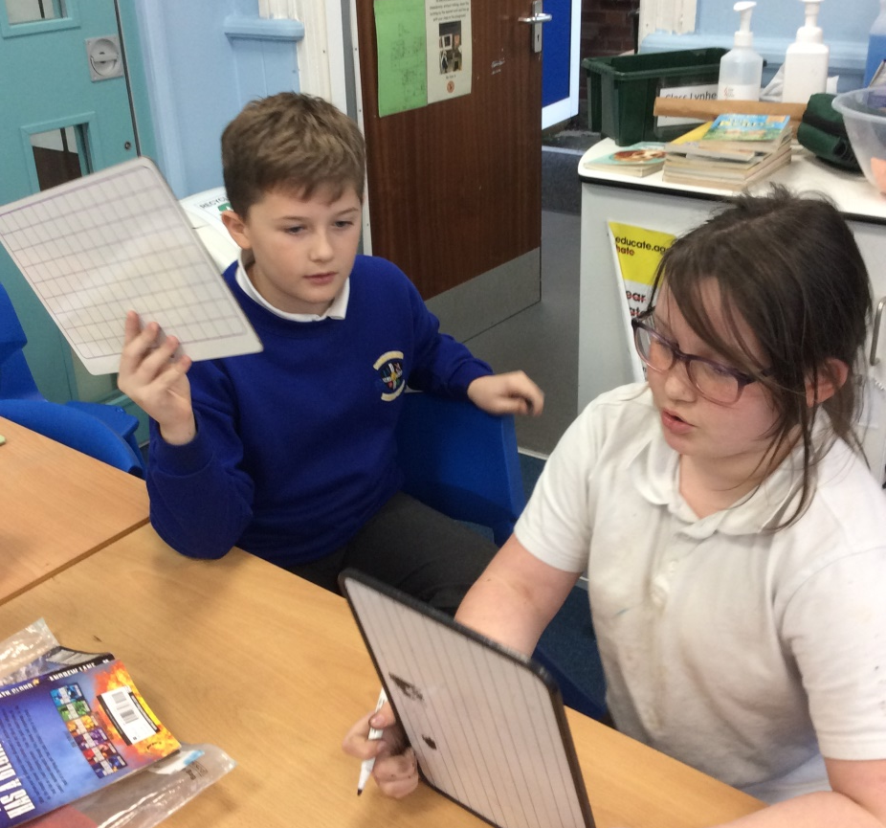
We wrote and then practised saying about ourselves to a partner.
We then used confidence to present ourselves to the whole class.

