Slide 1
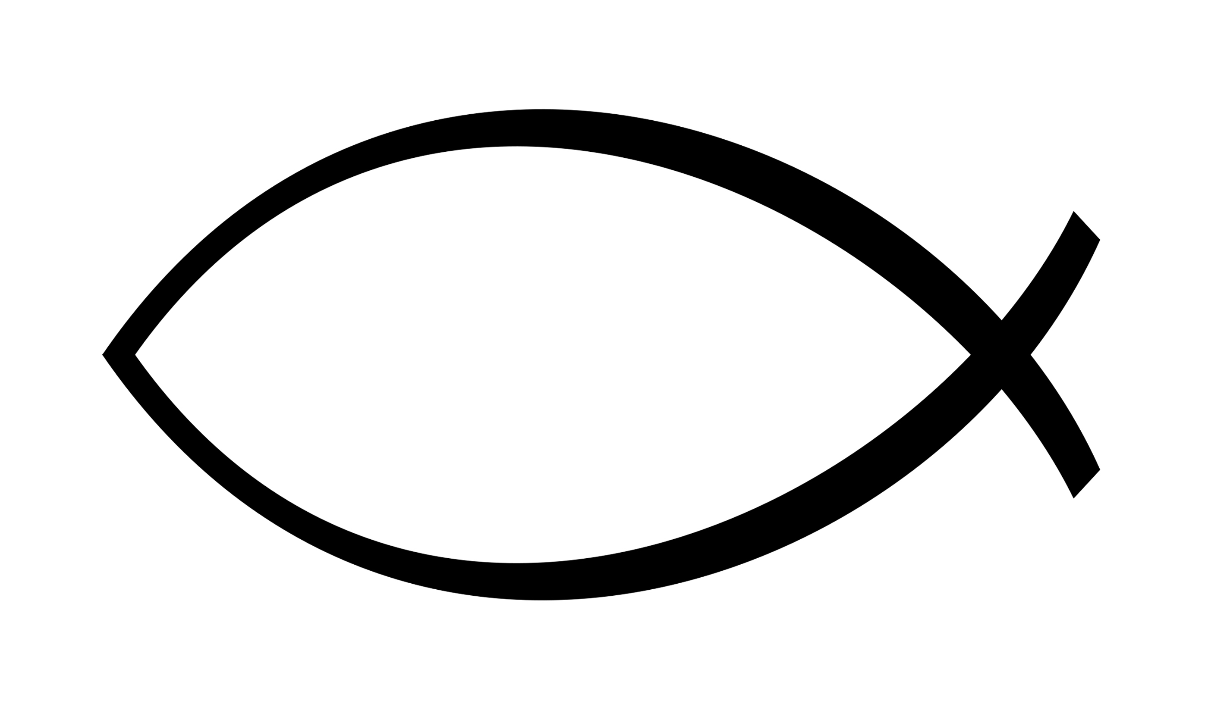
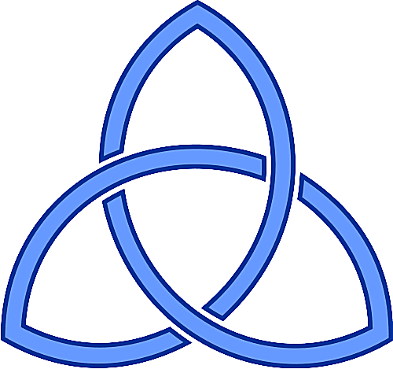
RE
Class Tamar
What is it like for someone to follow God?

Slide 2
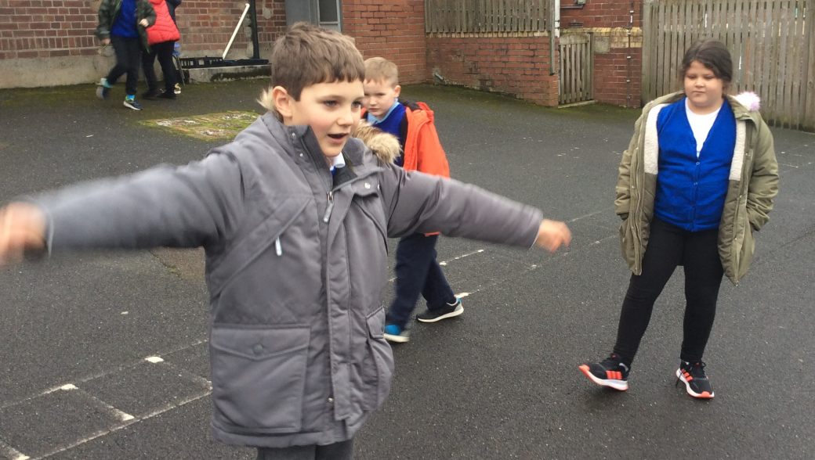
We read the story of Noah and re-enacted the story.
We discussed what we thought about the story and any questions it raised.

Slide 3
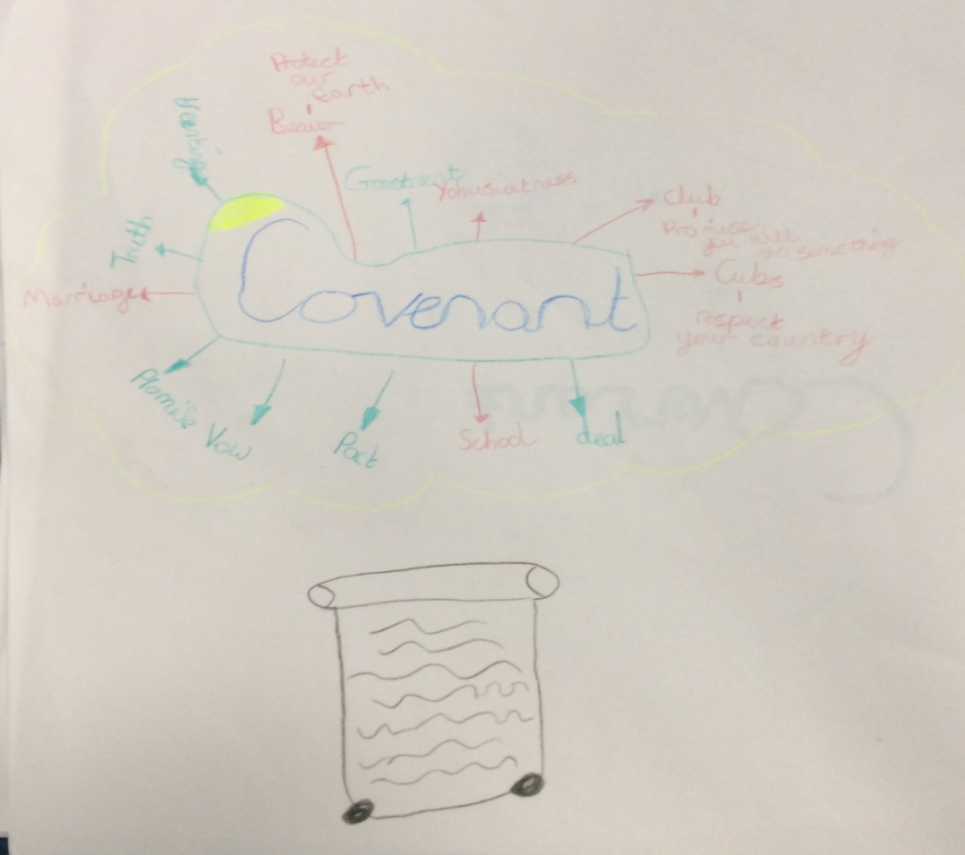
We discussed the meaning of a covenant and recorded different examples of covenants that we have experienced.
The rainbow is a symbol that shows God’s promise to Noah.
When Christians get married they wear rings to show that they have made promises to each other.
We discussed the different symbols that represent our promises.

Slide 4
We reflected on the question: What is it like for someone to follow God?
Christians feel like they will be forgiven by God and he will always be with them.
It feels good when someone makes a promise. You can trust them. Christians feel they can trust God.
Christians must always obey God and he will do the same.

