Slide 1
RE - Christianity
Autumn 1 2020
To understand why it is important for Christians to believe God is holy and loving

Slide 2
Cornwall Agreed Syllabus:
Make sense of belief:
• Identify some different types of biblical texts, using technical
terms accurately
• Explain connections between biblical texts and Christian ideas
of God, using theological terms
Understand the impact:
• Make clear connections between Bible texts studied and
what Christians believe about God; for example, through how
cathedrals are designed
• Show how Christians put their beliefs into practice in worship
Make connections:
• Weigh up how biblical ideas and teachings about God as
holy and loving might make a difference in the world today,
developing insights of their own.
The ability to debate issues of religious significance with reference to evidence and argument
The ability to consider the thoughts, feelings, experiences, attitudes, beliefs and values of other

Slide 3
What do Christians believe God is like?
Some of our ideas about God were similar to Christians
We put ourselves in a Christians shoes and thought about how they viewed God, then compared them to biblical texts

Slide 4
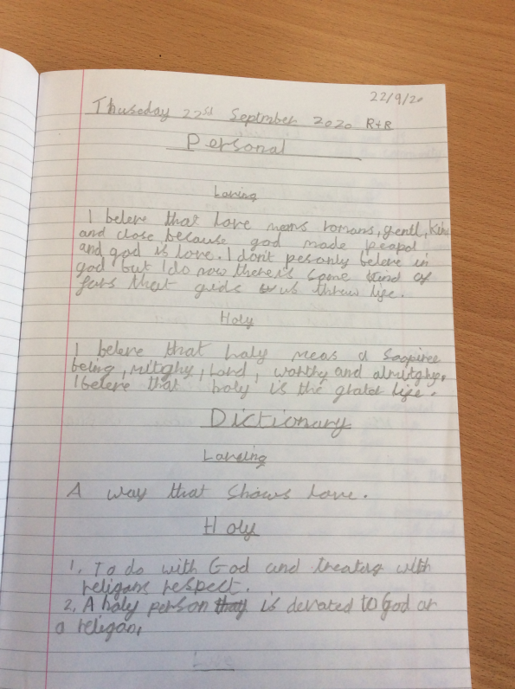
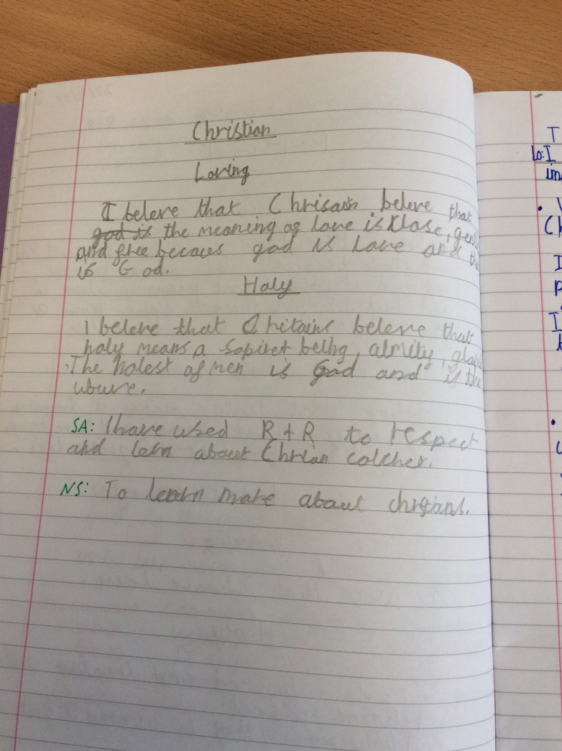
I can define God as holy and loving
We explored which parts of bible texts and Christian worship songs talk about God being holy and which are about God being loving. We examined the difference between these ideas, coming up with our own good definitions of both terms after finding out Christian and dictionary definitions.

Slide 5
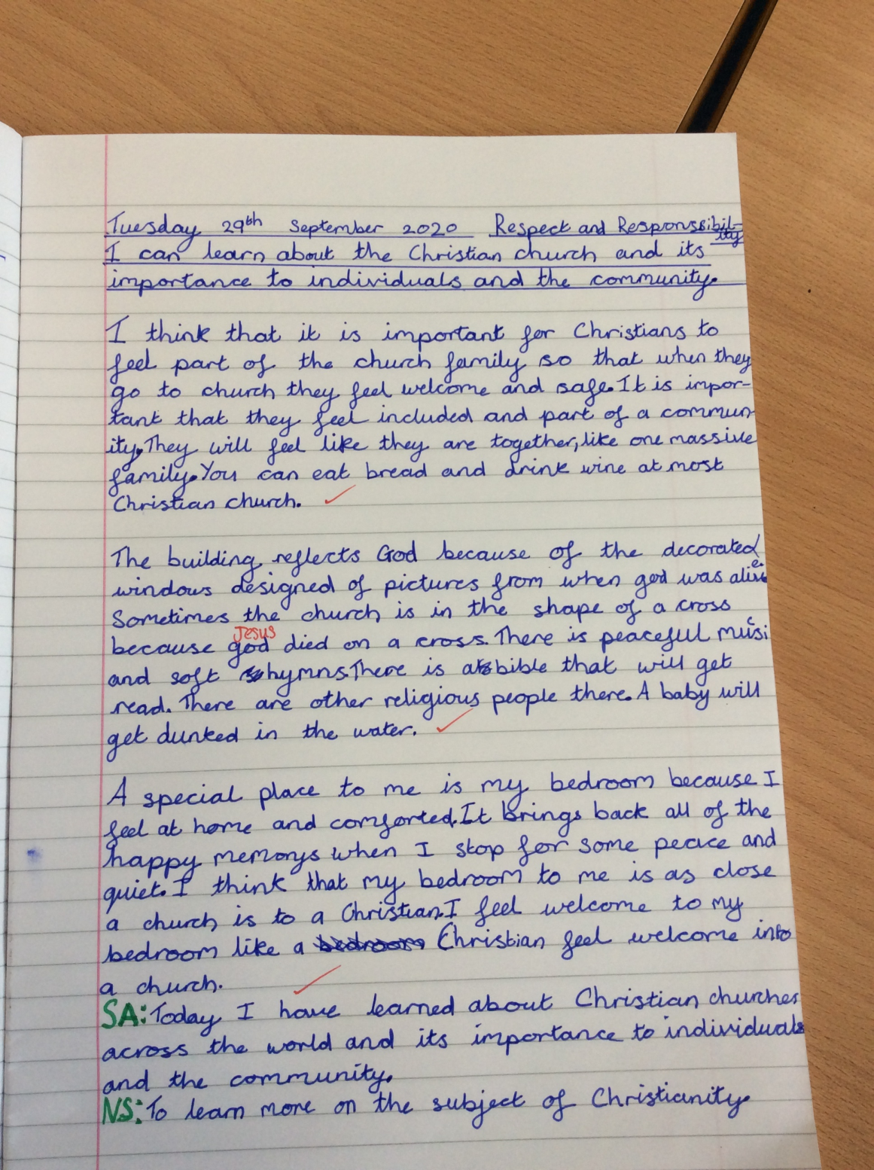
How do medieval and modern churches reflect God to Christians?
We learnt that Medieval Christians built cathedrals ‘to the glory of God’

Slide 6
I can creatively express God as holy and loving and explain why.
We used colours and symbols to show God as loving and holy

Slide 7
I can discuss different believes and values including my own
I shared my own beliefs and compared them to Humanists and Christians.
My beliefs and values affect my daily life because you show love to someone then they show it back.
I believe everyone is special which helps me be kind

