Slide 1
PHSE Autumn 2020 Class Lynher
Celebrating Differences

Slide 2
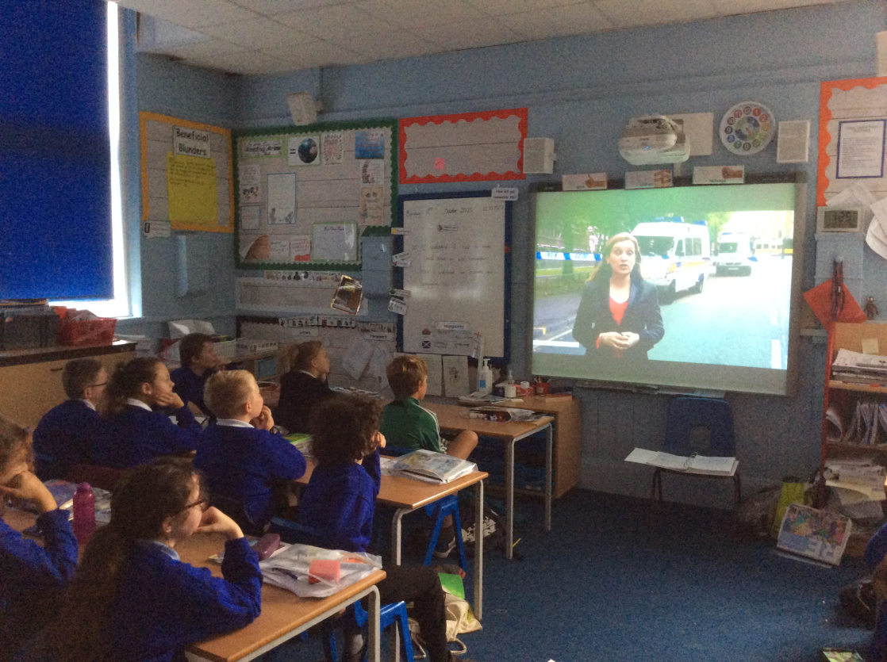
I understand that cultural differences sometimes cause conflict
We know we are all different
We watched the London Riots and talked about why they happened.

Slide 3
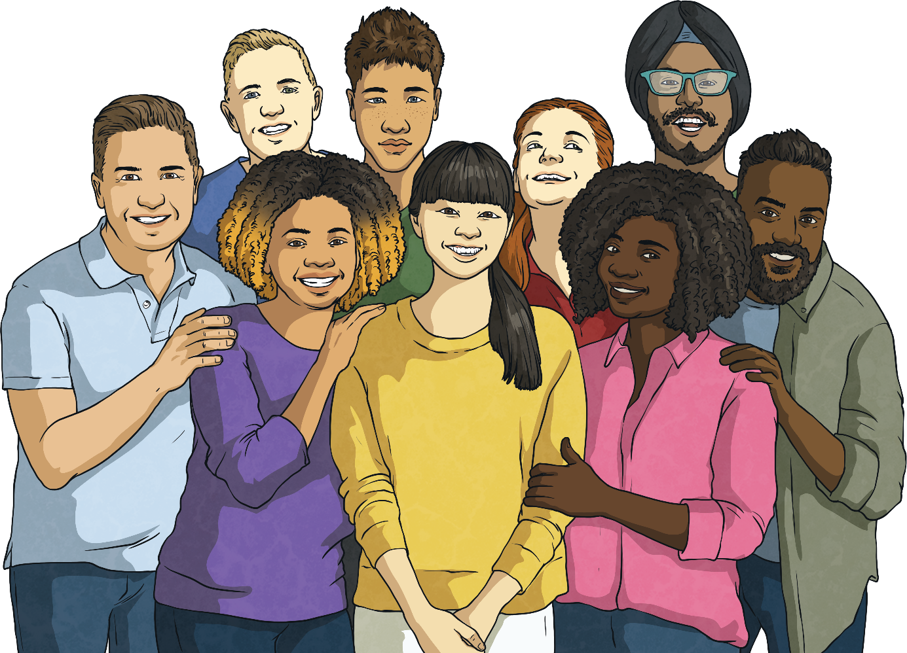
I UNDERSTAND WHAT RACISM IS
Racism is when someone is discriminating a person because of their skin colour or religion
We discussed what we could do to eliminate racism including Recognise that no matter what our skin colour, accent, language we speak or the place we are from, we are all equal and deserve the same rights and treatment.

Slide 4
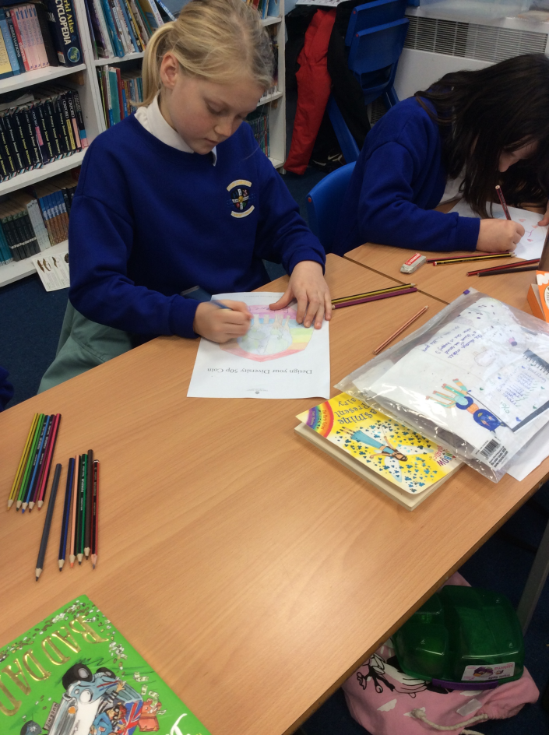
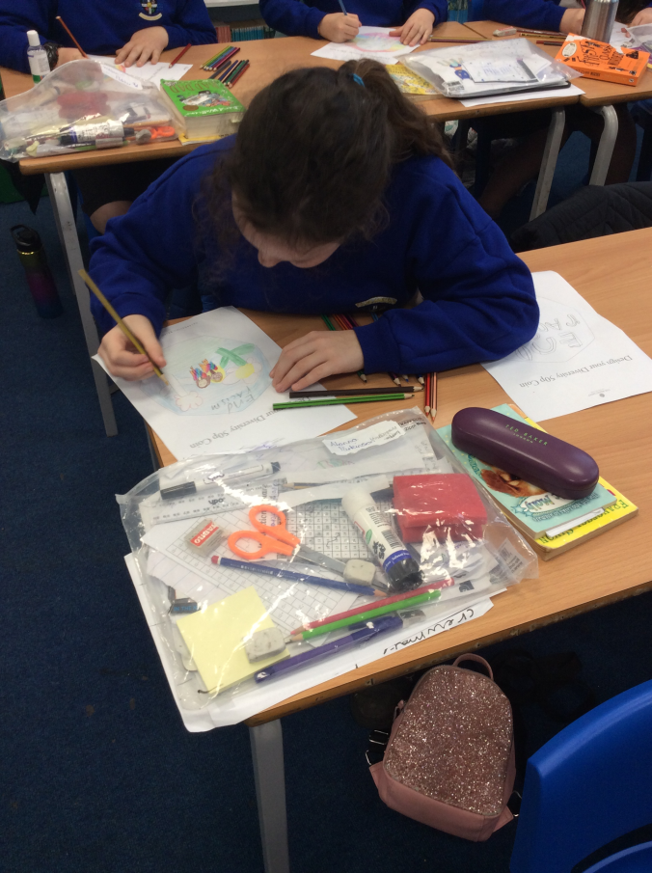
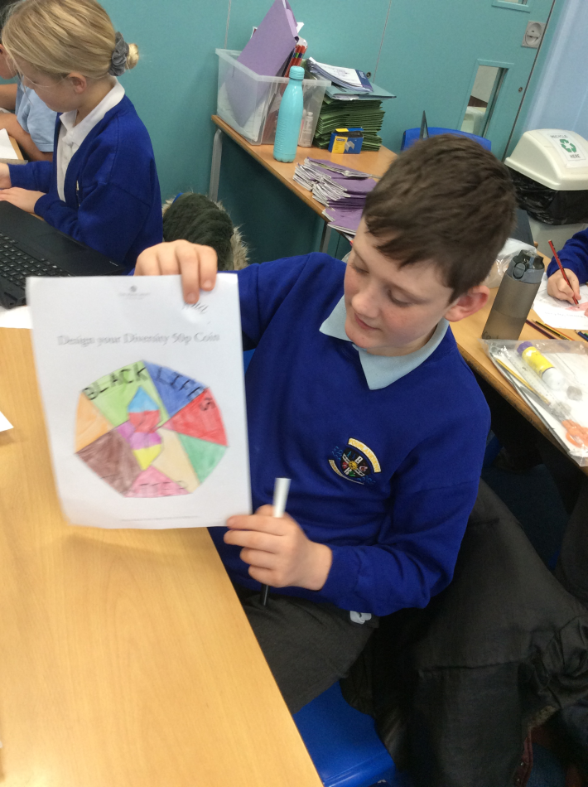
Celebrating diversity
We designed a new 50 pence coin, inspired by the 2020 diversity in Britain coin

Slide 5
I understand types of bullying behaviour
It can make people feel very sad
We discussed how people can help those who feel like they are being bullied
We spoke about direct and indirect bullying

Slide 6
Does Money matter?
I feel happy when I am with my family and they are healthy
Money does not necessarily make you happy

Slide 7
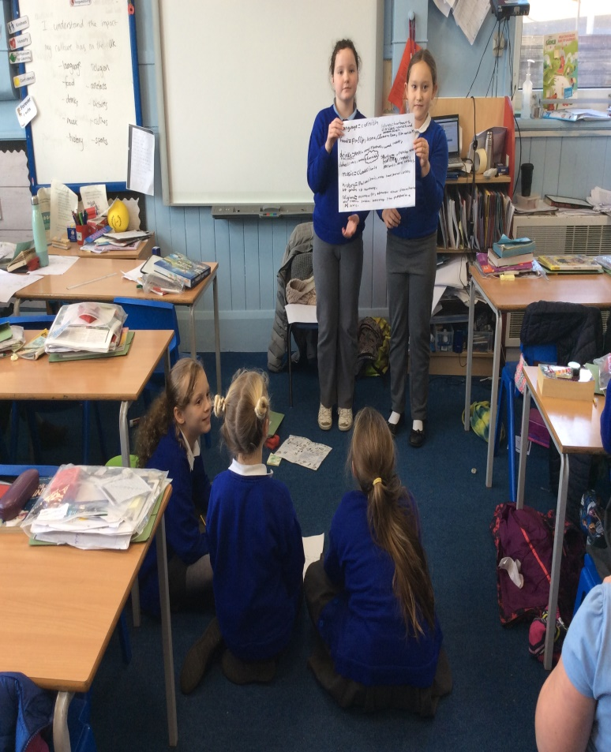
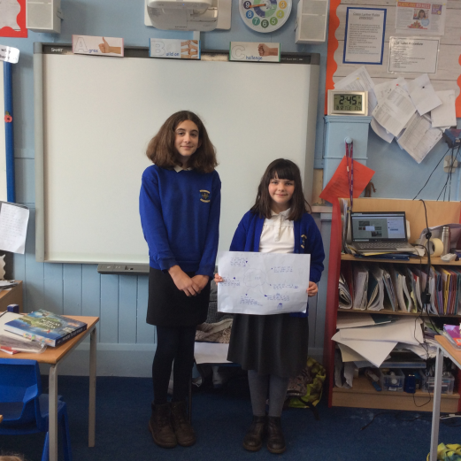
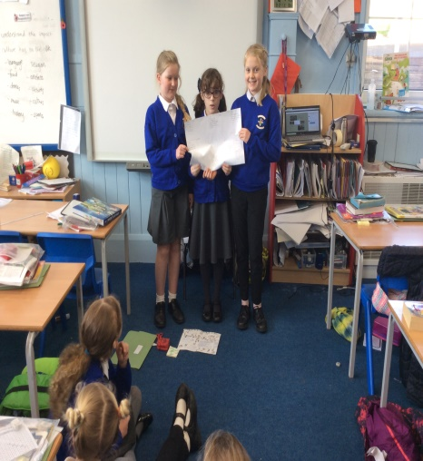
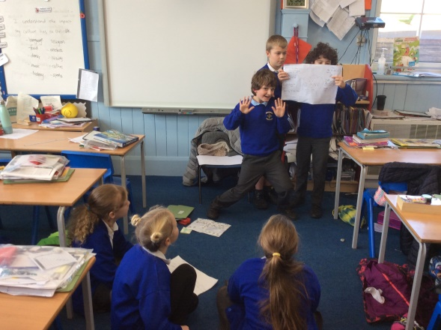
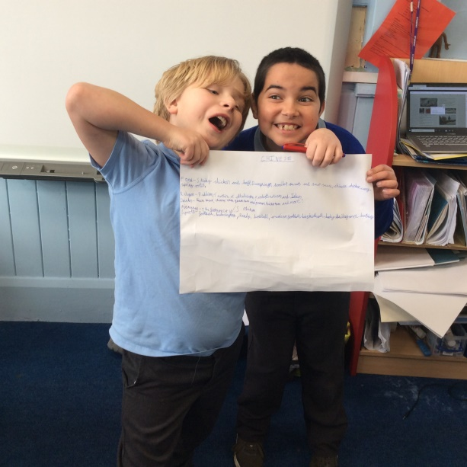
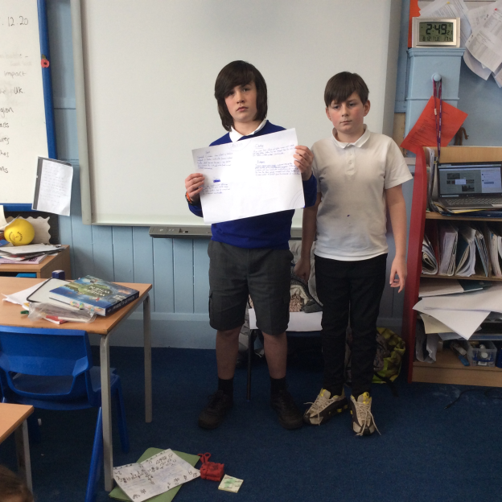
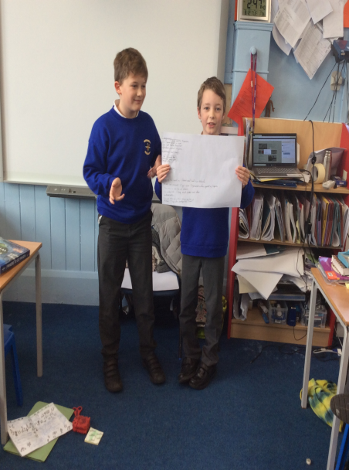
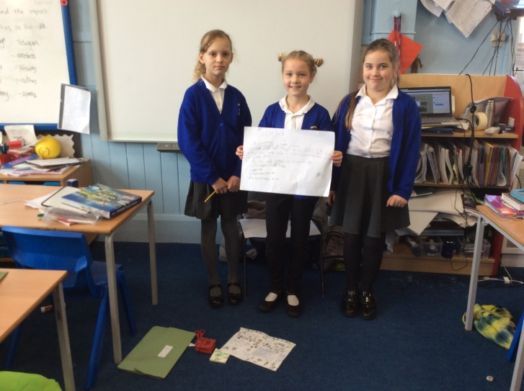
I can experience another culture
We looked at the impact different cultures in the UK have had on our country.

