Slide 1
PSHE
Go Big, Be Awesome
Transitions

Slide 2
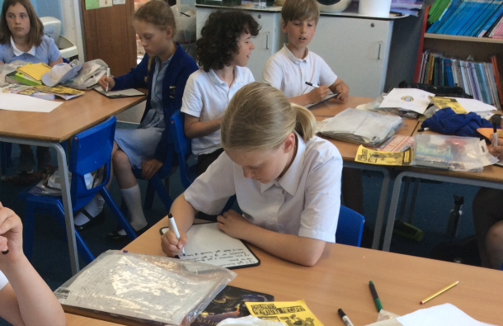
Being Awesome! I know how to persevere when I find something challenging
“I've missed more than 9,000 shots in my career. I've lost almost 300 games. 26 times, I've been trusted to take the game winning shot and missed.
I've failed over and over and over again in my life. And that is why I SUCCEED.”
Michael Jordan
Fourlanesend has prepared me for my next step
I learnt to be positive and keep persevering
I know I will make mistakes but I need to learn from them

Slide 3
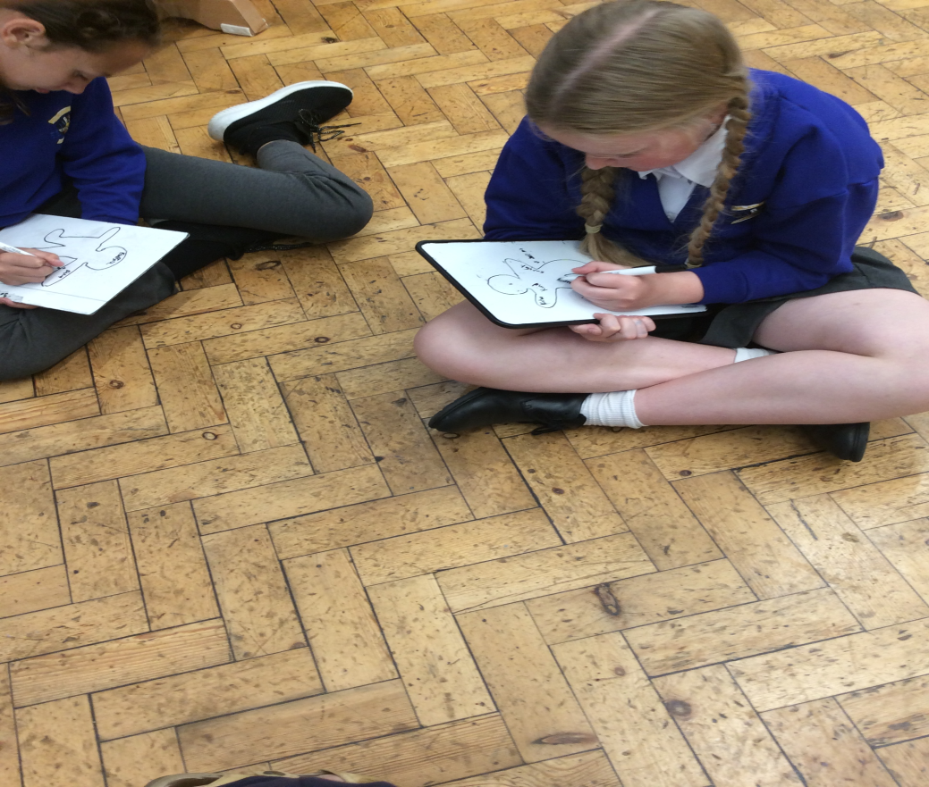
To know how to have a growth mind-set
I put inside my image what makes me who I am and outside what this makes me accomplish
Don’t fear failure. Failure is how we learn to be better!
I feel I'm not very good at maths but by using a growth mind-set I can say I am going to practise my tables to help my maths

Slide 4
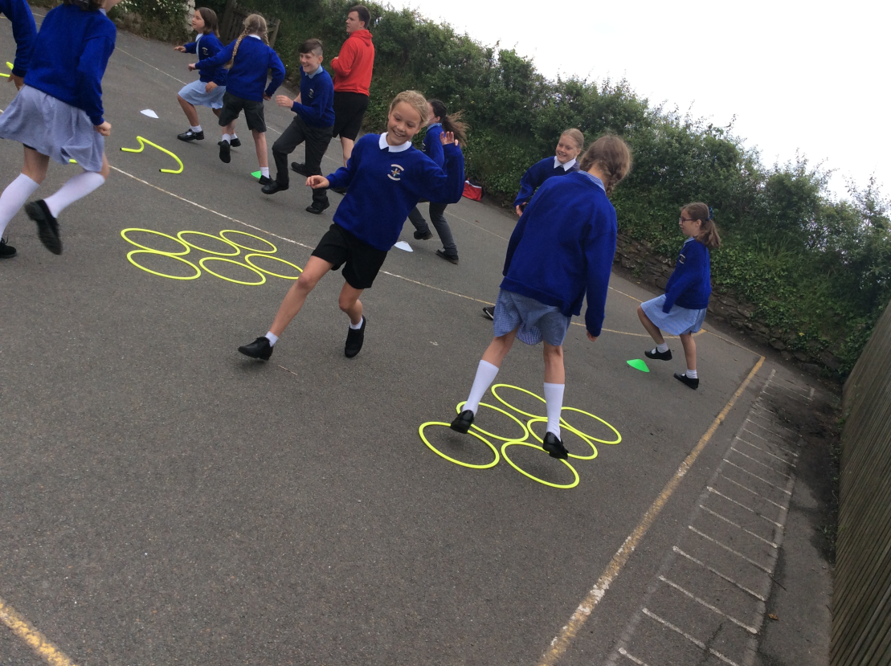
I can give everything my best!
We must remember to give everything our best shot!
We had a sports coach come in and he show us to push and challenge ourselves

Slide 5
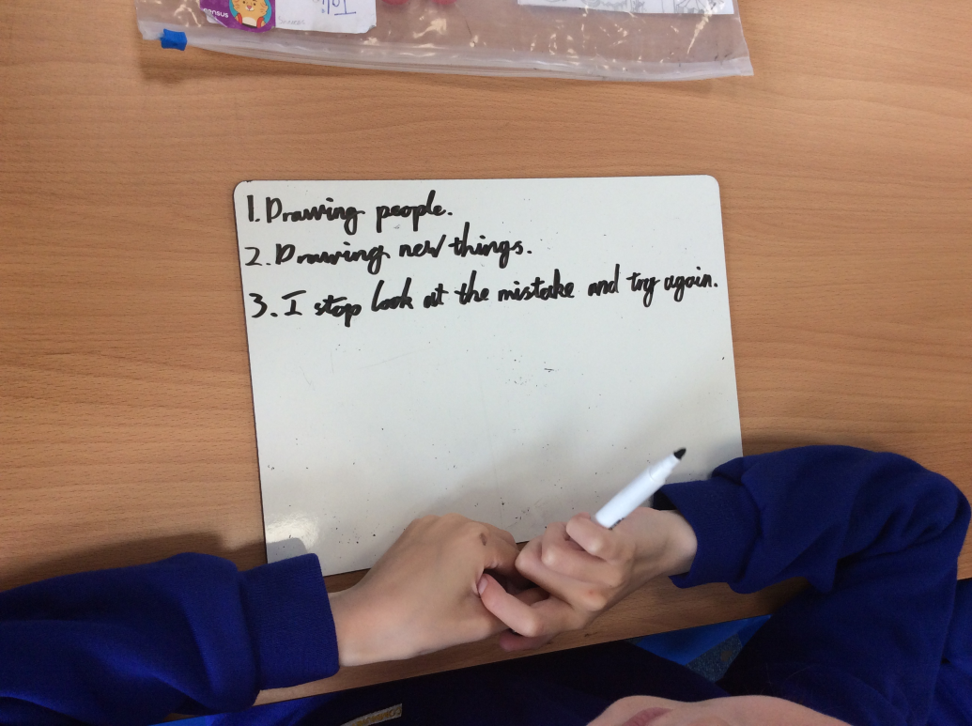
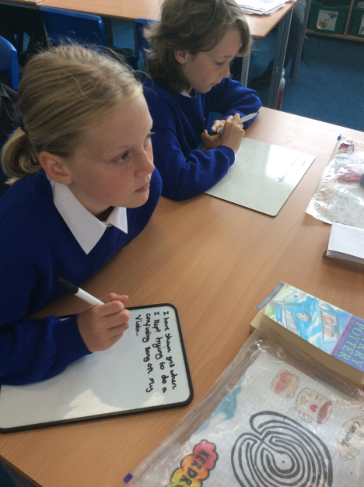
Bouncebackability! I know to try again when things may go wrong
I know that with grit and determination I can keep trying
"Be nice, work hard, bounce back, and all will be fine.
Go get ‘em!”
Matthew Burton

Slide 6
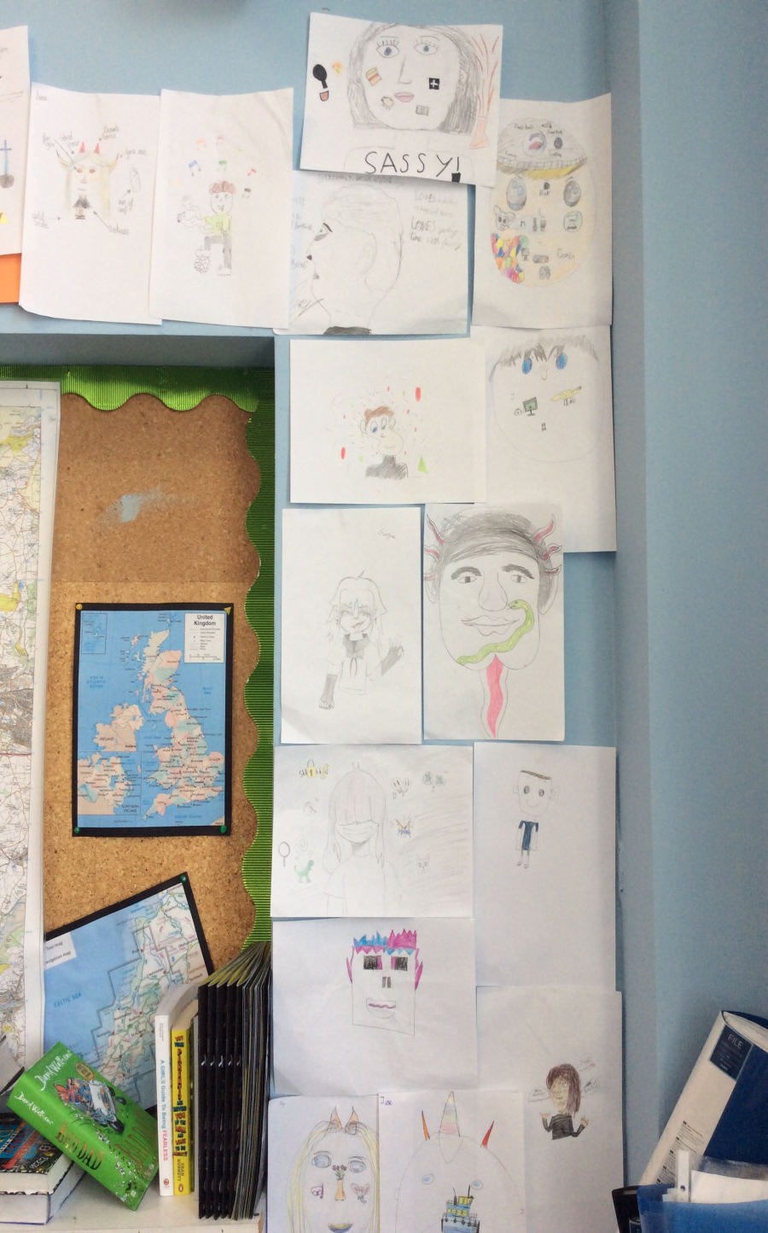
What is normal?
No one is normal, we are all unique so can’t have a normal to aim for.
I like drawing me as how I saw myself, bringing out the hidden parts of me
‘Find out who you are and do it on purpose’
Dolly Parton, American singer and songwriter

