Slide 1
History
The Indus Valley
Autumn 2020

Slide 2
Where and when was the Indus Valley?
The Indus Valley was in Northwest Afghanistan, Pakistan and Northwest India.
It had rivers, mountains, forest and even deserts!

Slide 3
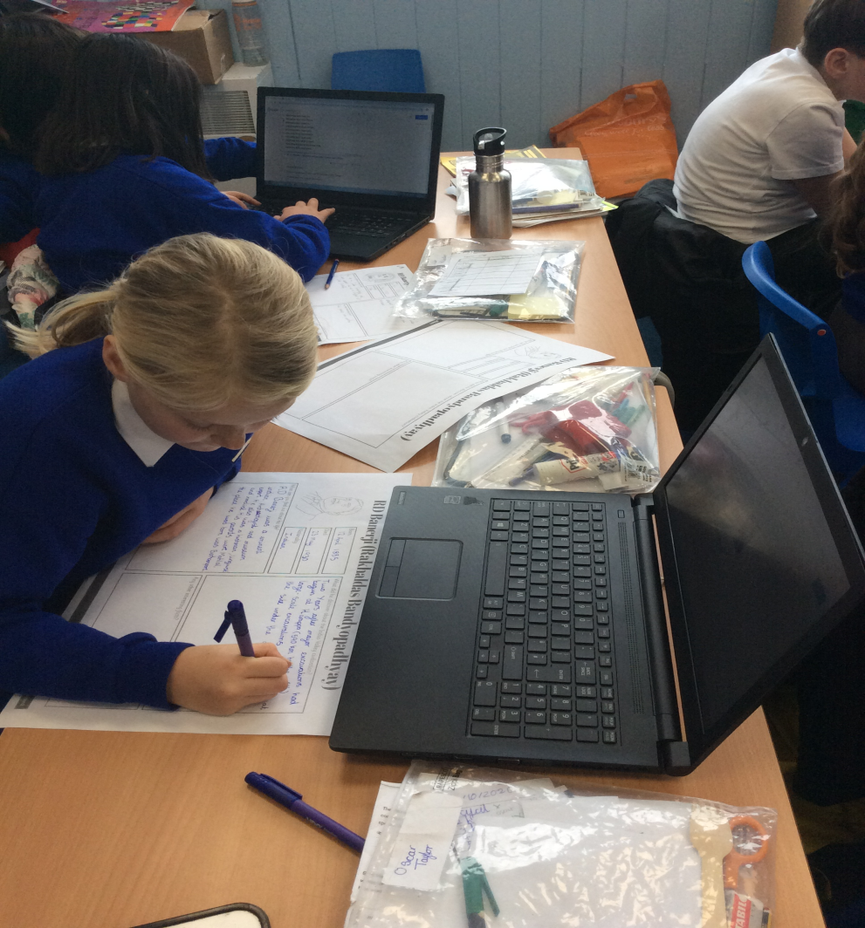
How did we discover the Indus Valley?
Charles Masson first discovered the Indus Valley when he found bricks he thought were castles.
It was only found around 100 years ago

Slide 4
I know how long this ancient civilisation lasted.
The Indus Valley was four times bigger than the UK
They started to write using scripts around 3200BC
Indus Valley
Ancient
Greeks
Ancient
Sumer
Romans
Anglo Saxons
Bronze Age
Vikings
Shang Dynasty
Ancient Egypt
3000BC
2000BC
1000BC
0
1000AD
2000AD
We ordered the Indus Valley chronologically. It started in 3300BC and ended around 2000BC because of climate change

Slide 5
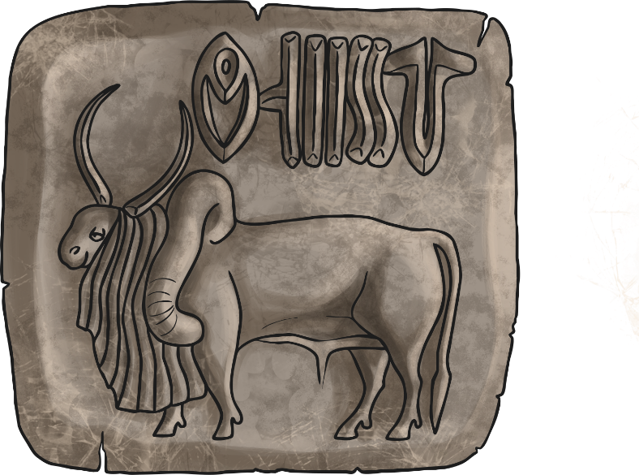
What artefacts did we discover and how does it tell us about the Indus Valley people?
We looked at a range of artefacts and worked out what they were and why they were used.

Slide 6
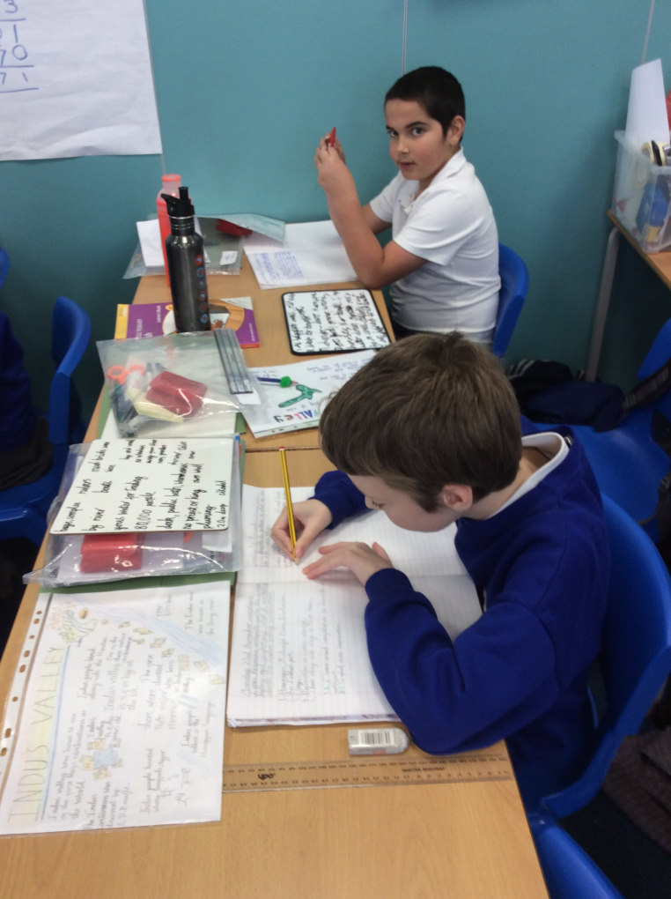
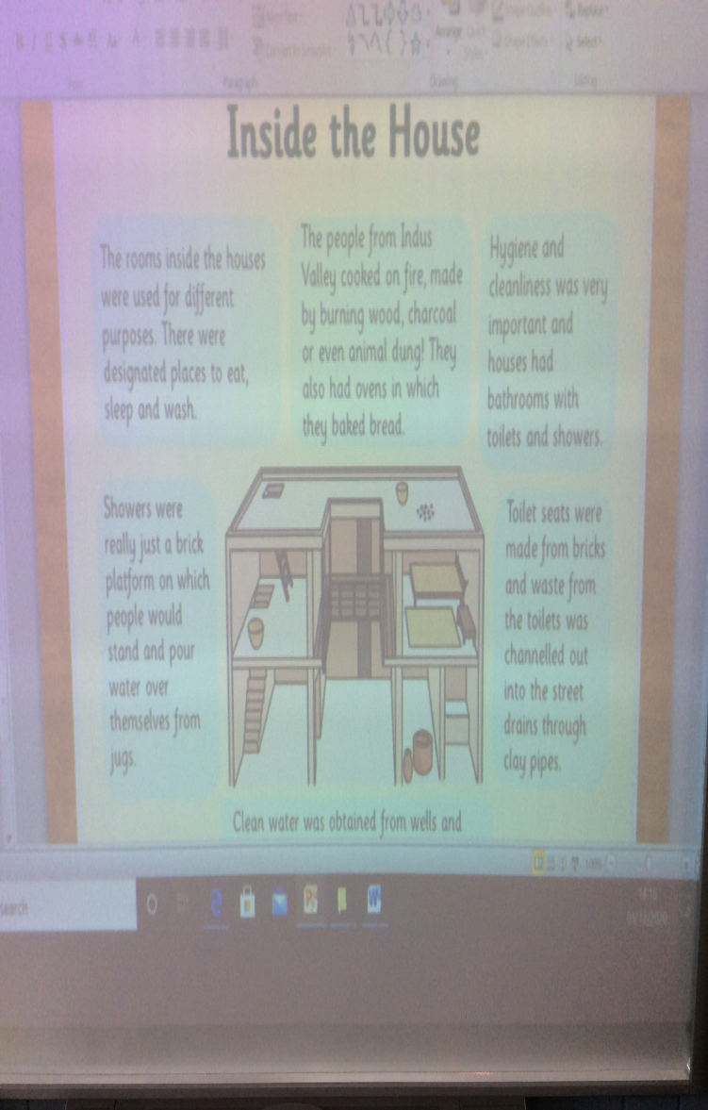
What were the cities and towns like at the time?
We learnt the Indus Valley people had a water system to separate dirty and clean water and even had indoor toilets with pipes!
There is no signs of temples, so no kings or priests.

Slide 7
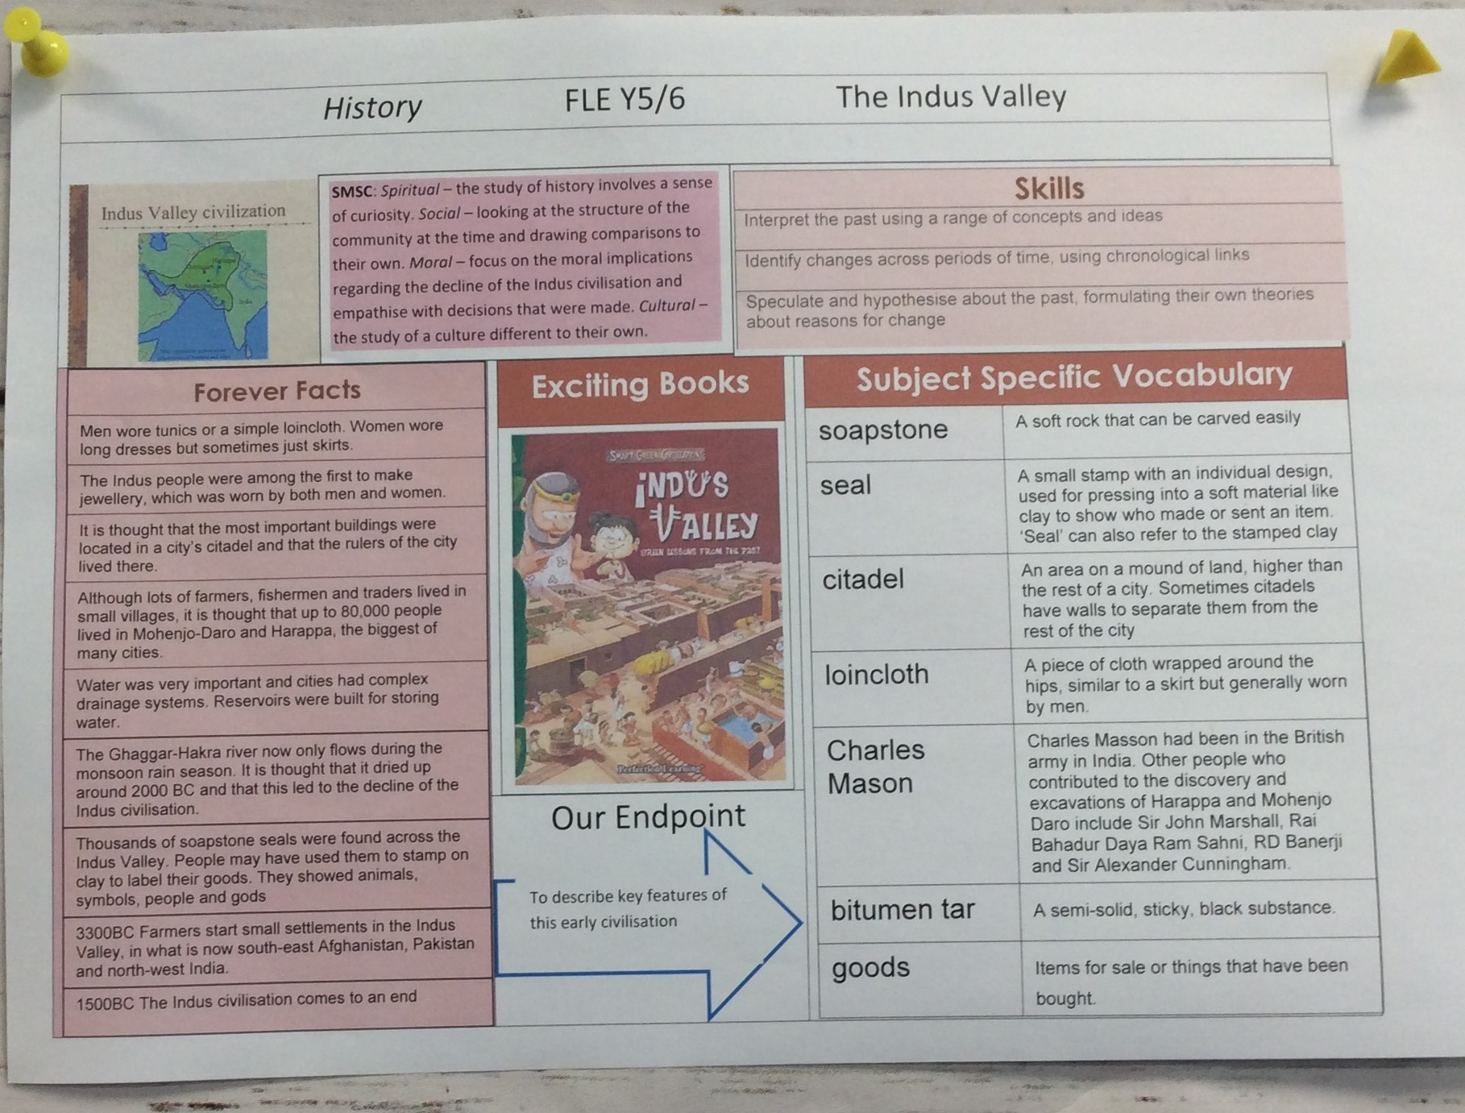
I

