Slide 1
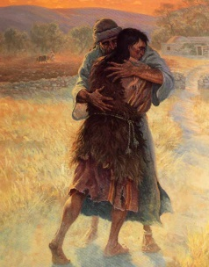
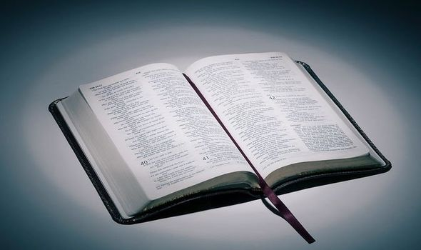
Class Cremyll
RE
What do Christians think God is like?

Slide 2
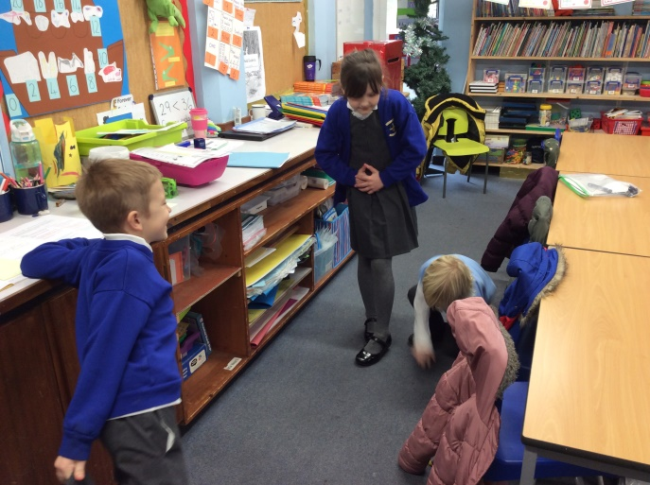
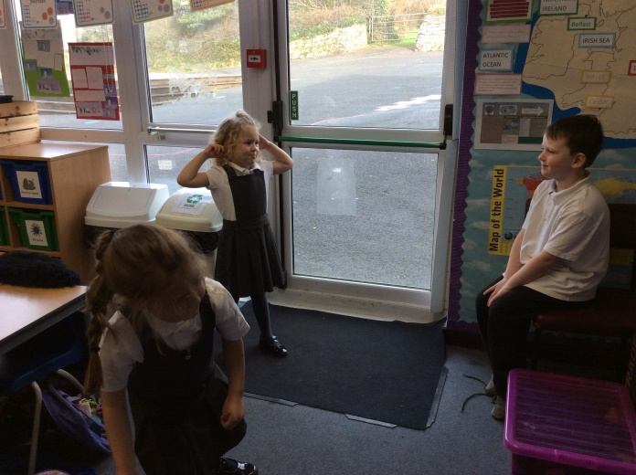
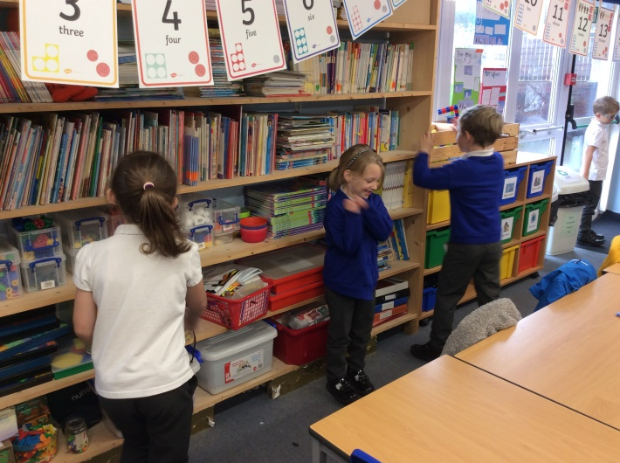
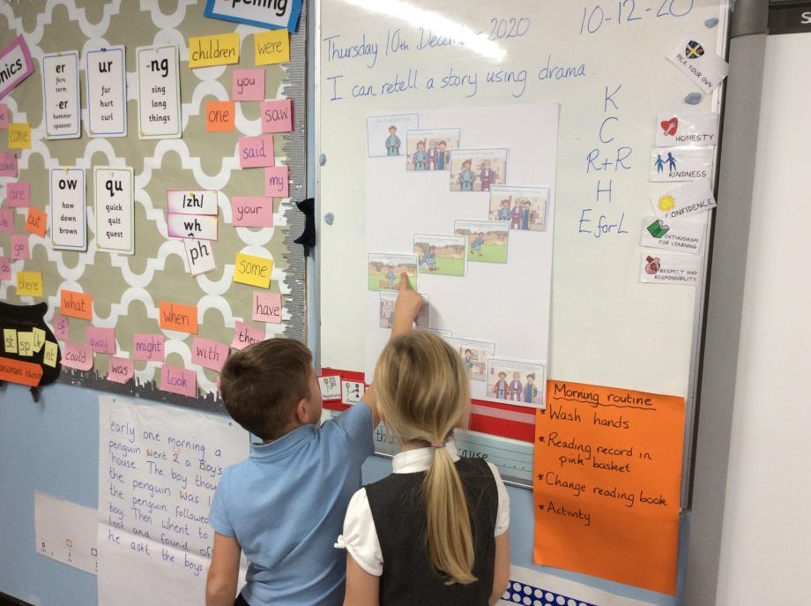
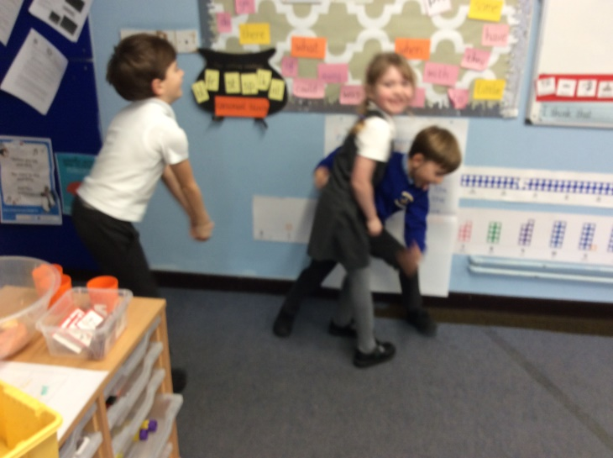
We listened to the parable of ‘The Prodigal Son’ and discussed that the story was about showing love and care for someone. Then we acted it out to get to know the story better.
“I enjoyed taking in turns to play the different characters.”
“I really like the dad because he was so kind.”

Slide 3
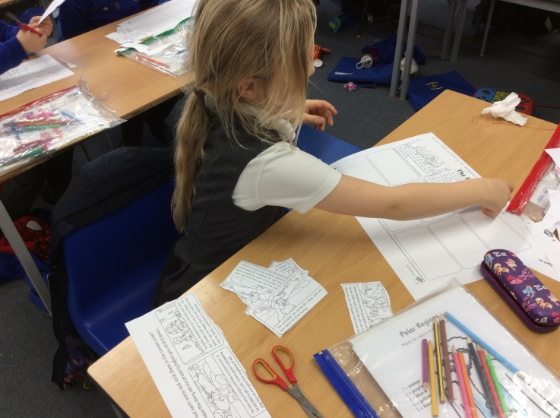
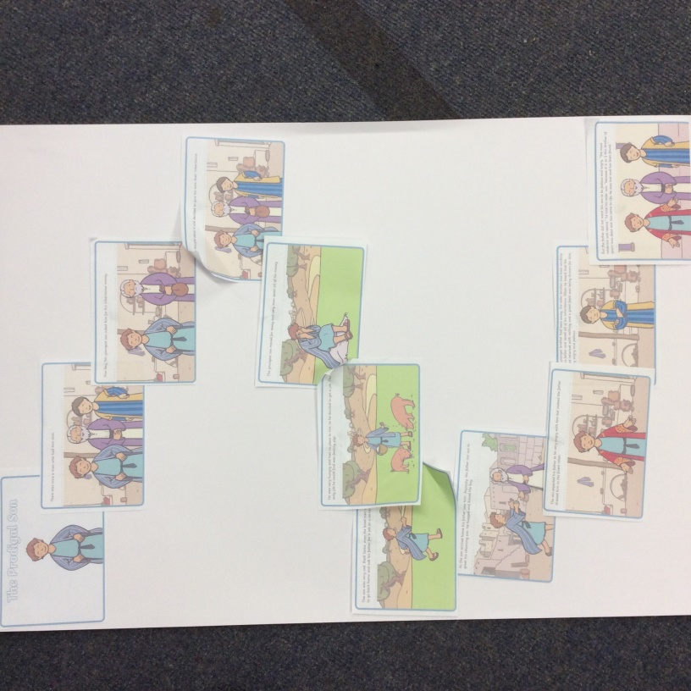
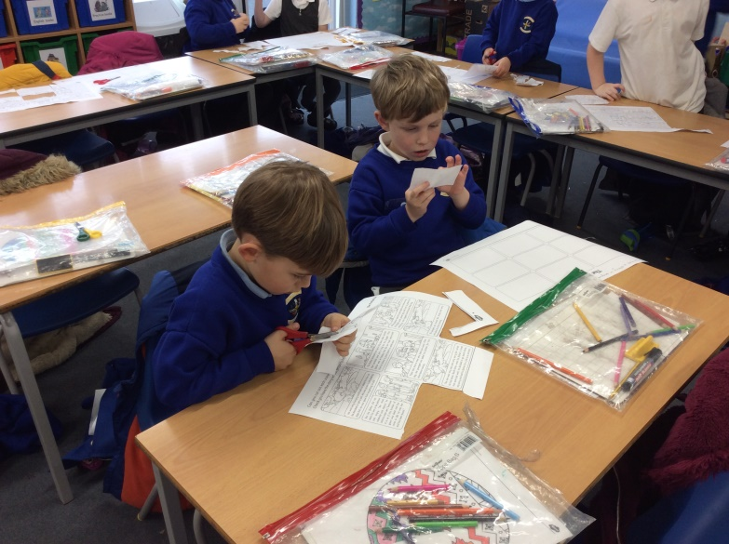
We created a story map of ‘The Prodigal Son’ and sequenced the story.
“The story map helps you put everything in the right order.”
“The younger brother was a bit spoilt.”

Slide 4
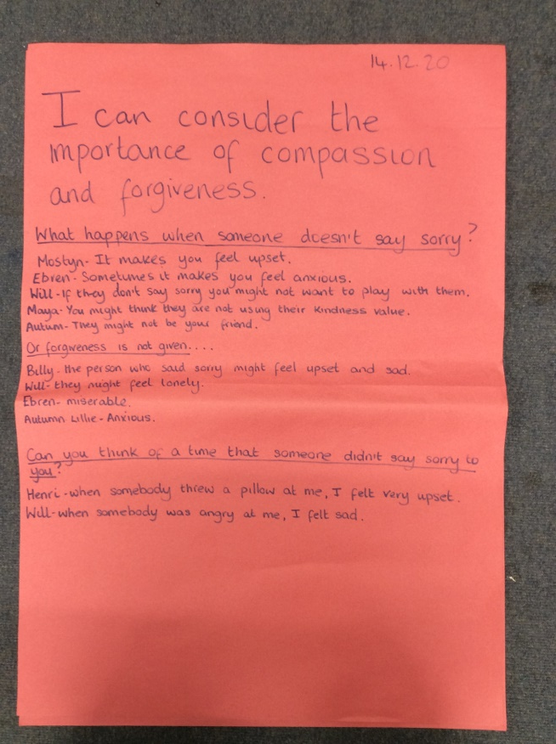
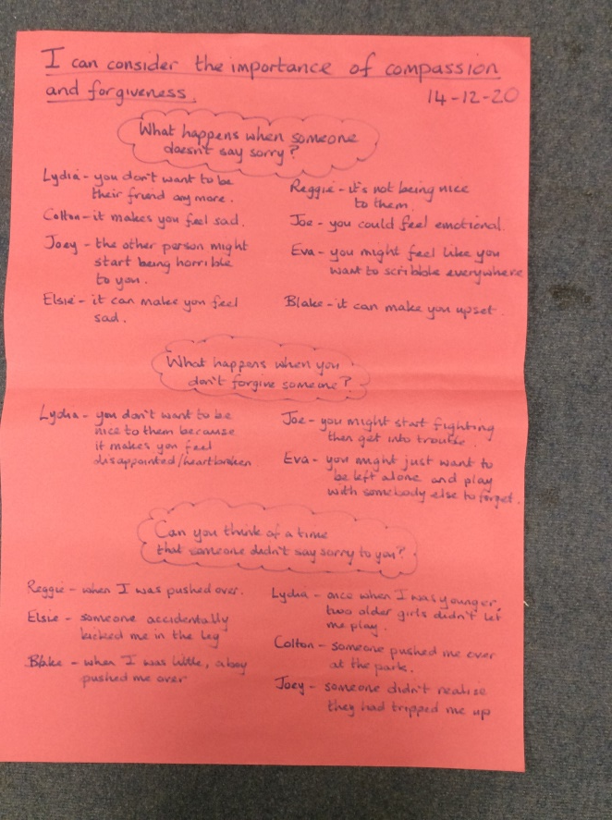
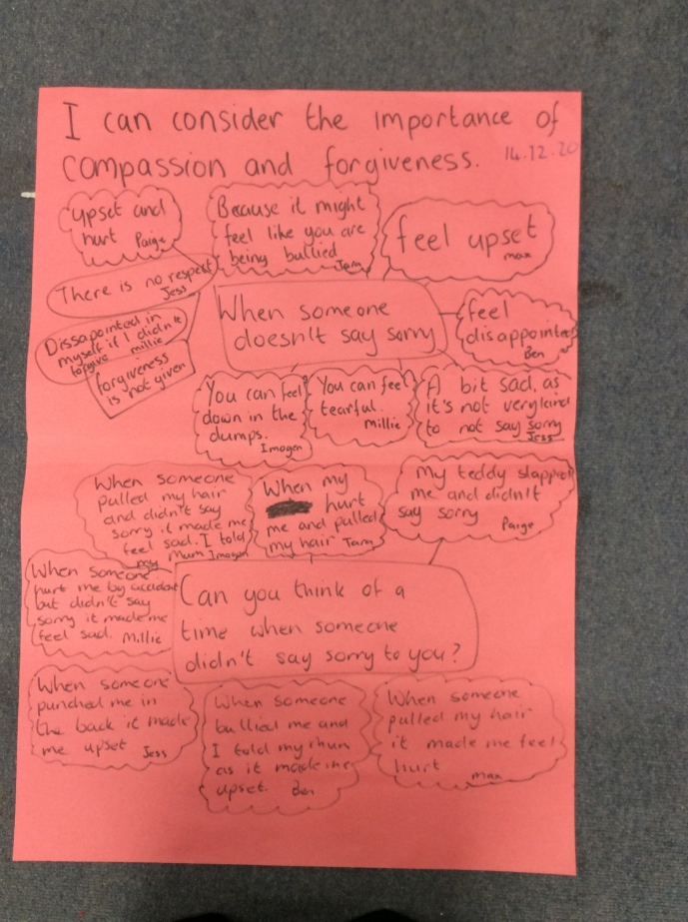
We talked about the meaning of compassion and decided that the dad showed this towards his younger son. We also talked about forgiveness and why it might be important to accept someone’s apology.
“I think it’s important to use your honesty value and say sorry even when it’s an accident.”
“I was sad when my friend didn’t say sorry to me.”

Slide 5
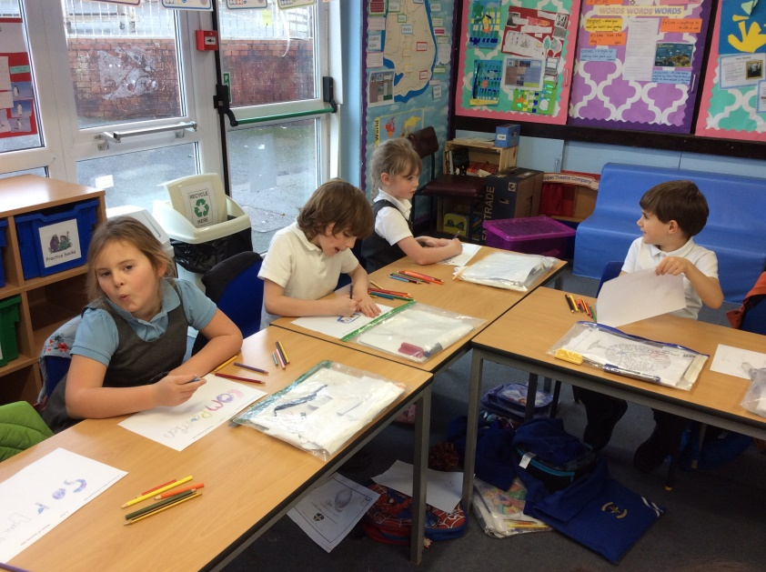
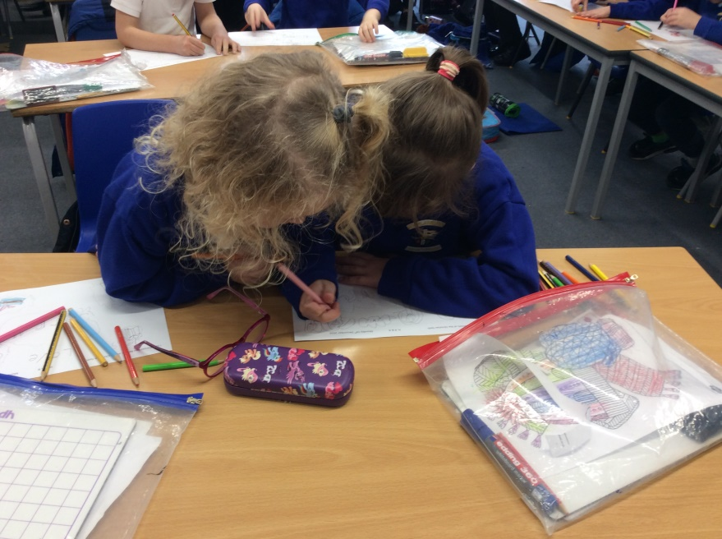
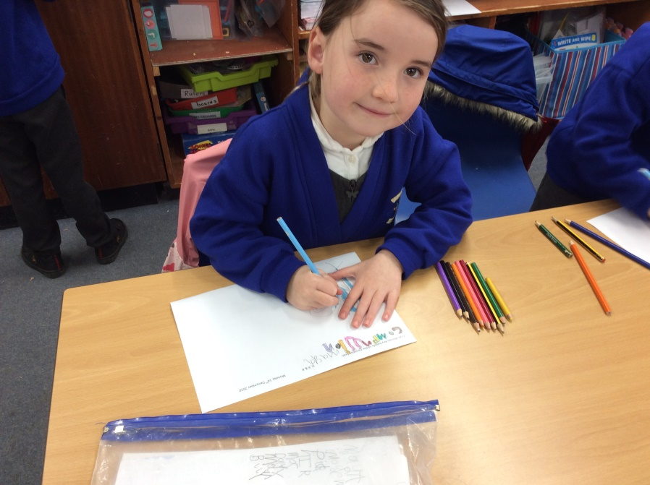
We thought about the values that the story is reminding Christians of. Then we discussed why this might be important to Christians.
We created our own artwork to show how we might remember to use our own values.
“I think the story helps us to remember to forgive others.”
“It’s kind to forgive people.”

